Slide 1
African Geography and Global Climates
Global History and Geography I
Mr. Cox

Slide 2
Bellringer
Differentiate between climate and weather.
Essential Question
How do the global wind patterns impact climate?
What factors make the climate and landscape of Africa so diverse?

Slide 3
Global Climates
Climate: long term weather for a region
Causes for different Climates
  Latitude
  Altitude (Elevation)
  Precipitation
  Wind Patterns
  Proximity to water
  Topography (shape of the land)
Six different Global Climate Zones

Slide 4
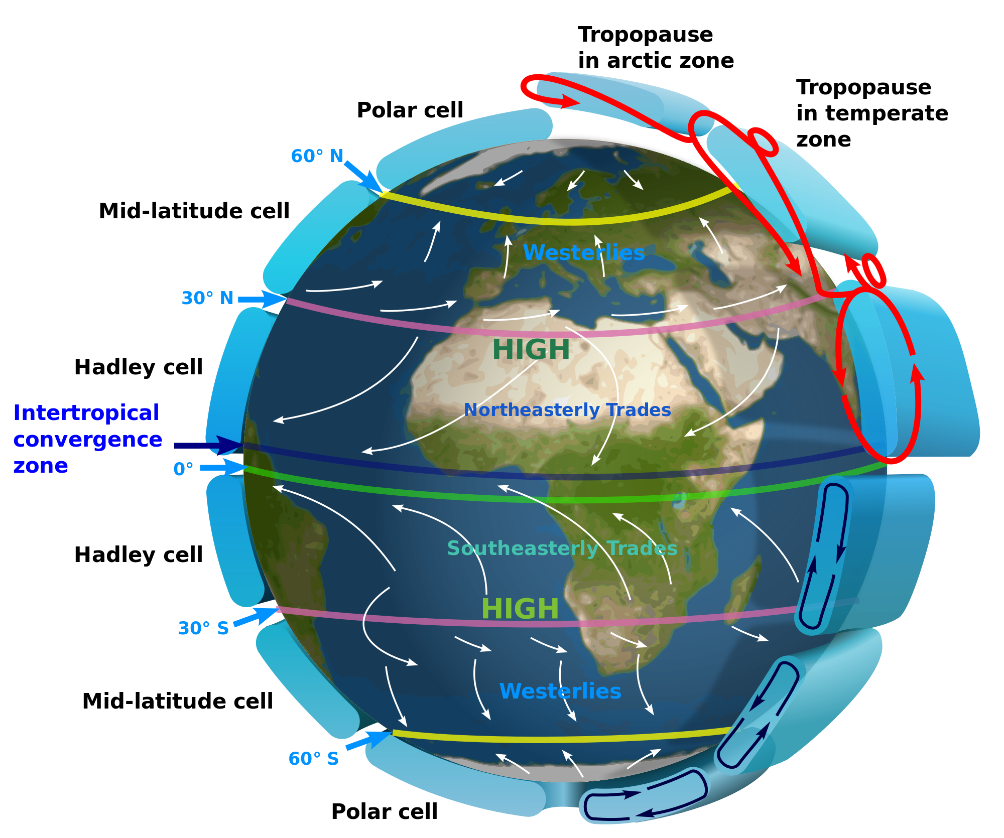

Slide 5
Koppen-Geiger Classification
Humid Equatorial Climate (Tropical Rainforest)
Dry Climate (Desert)
Humid Temperate Climate (Mediterranean)
Humid Cold Climate (Mid-Latitude)
Cold Polar Climate (Tundra, Arctic)
Highland Climate (Mountains)
Each of these climate zones has many subdivisions!

Slide 6
A. Humid Equatorial (Rain Forest)
10 degrees N and S of equator
High temps (consistently 80-100 degrees)
High humidity
Dense forest
Many species of trees (banana tree) and animals (monkeys)
Humidity means high mosquito population and malaria

Slide 7
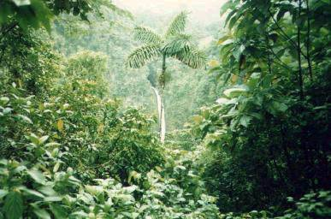
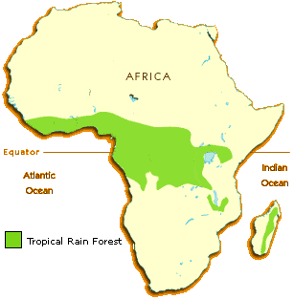
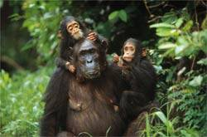
Annual rainfall of up to 17 ft.
Rapid decomposition (very humid).
Covers 37 countries.
15% of the land surface of Africa.

Slide 8
B. Dry (Desert)
Very little rain – less than 10 in per year
Temps as high as 130 degrees
Winter temps are lower-cool chilly nights
Sparse veg (shrubs grasses…)
Margins get some rain
Oases provide dates and palm trees
Camels used for transportation…

Slide 9
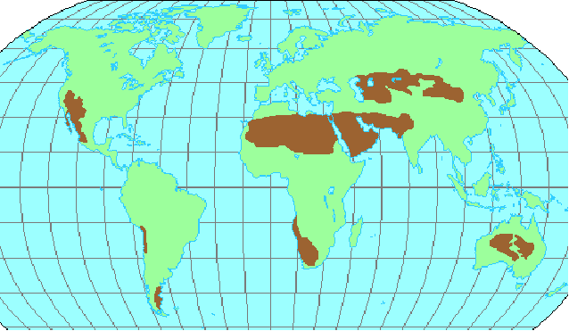
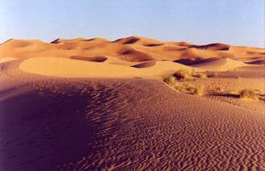
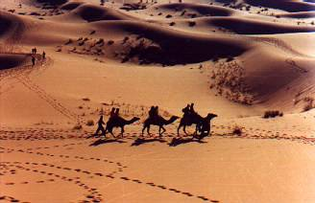
The Sahara Desert

Slide 10
C. Humid Temperate Climate
Mediterranean Savannah
Dry in the summer
Temperatures of 90+ degrees
Cool winters
Rainy winters
50’s and 60’s
Sea breezes keep temp. moderate
Vegetation:
Bushes, olive and fig trees and evergreen trees
Also citrus fruits (oranges, grapefruit…)
Rainy summers and dry winters
High temps (80-100)
Temp and rainfall varies w/ elevation and latitude
Vegetation:
  Trees, grasses (thick in many places) shrubs
  Great variety of large animals Elephant, Rhino, Giraffe…)

Slide 11
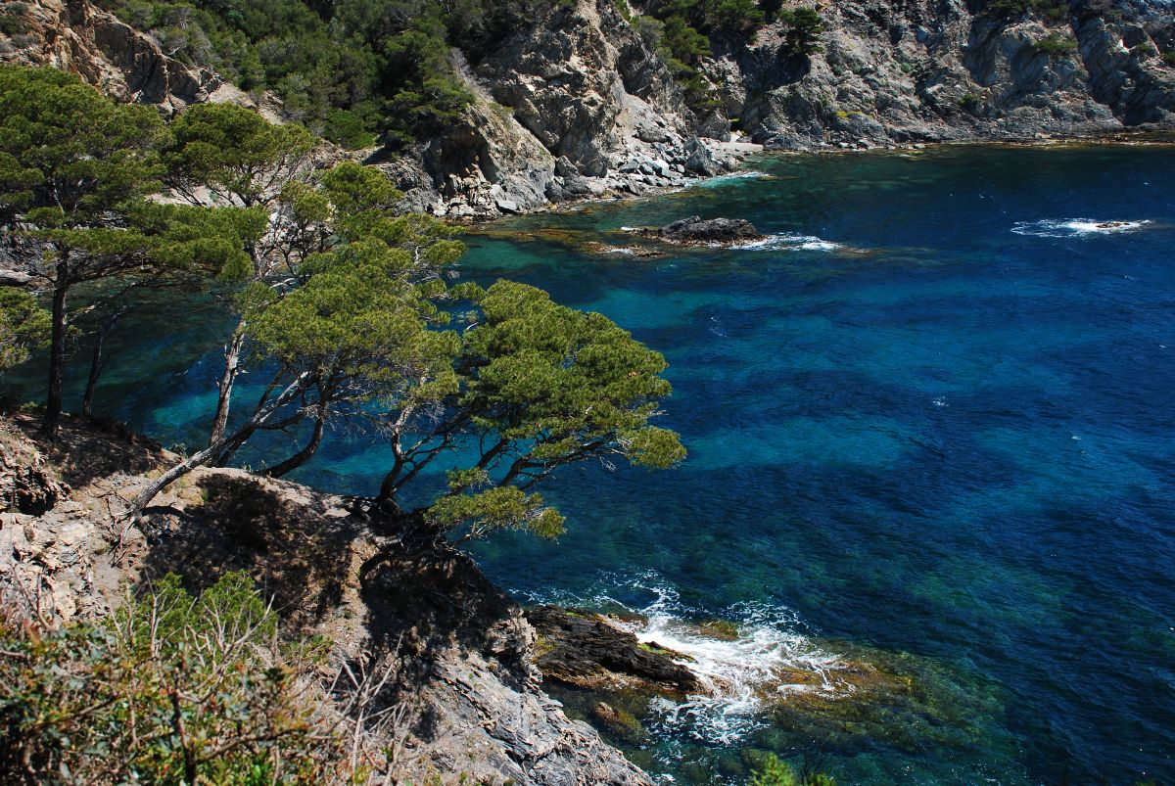
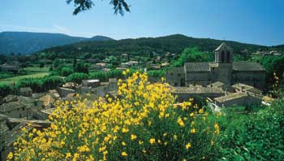
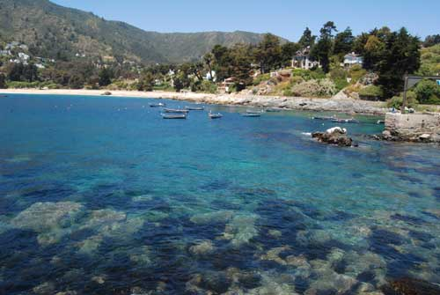
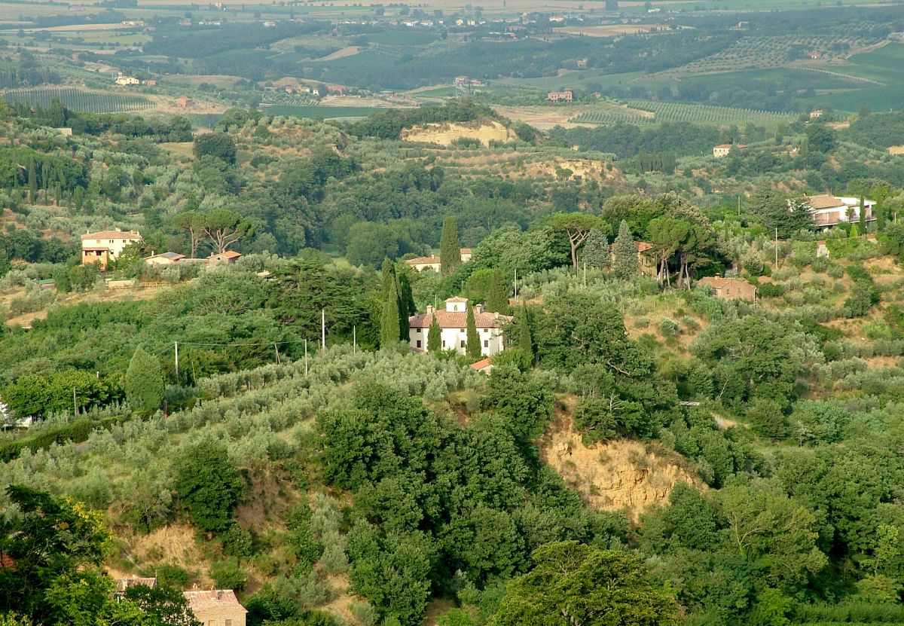
Mediterranean Climate

Slide 12
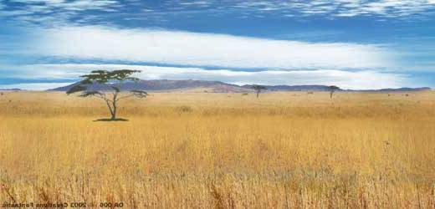
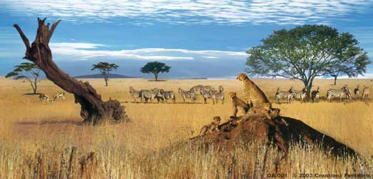
The African Savannah:
13 million sq. mi.

Slide 13
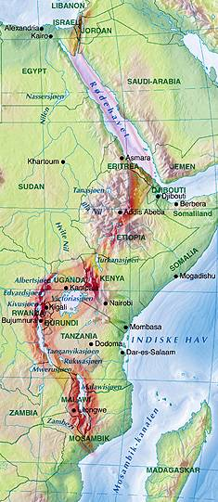
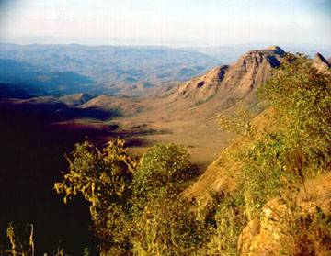
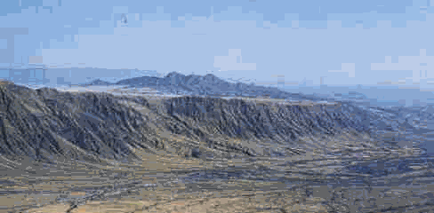
Great Rift Valley
3,000 miles long

Slide 14
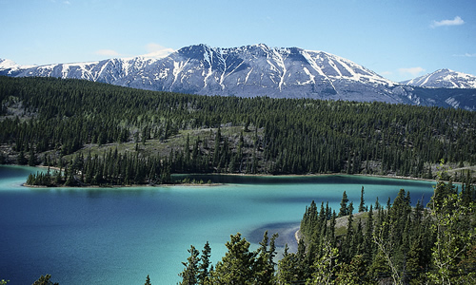
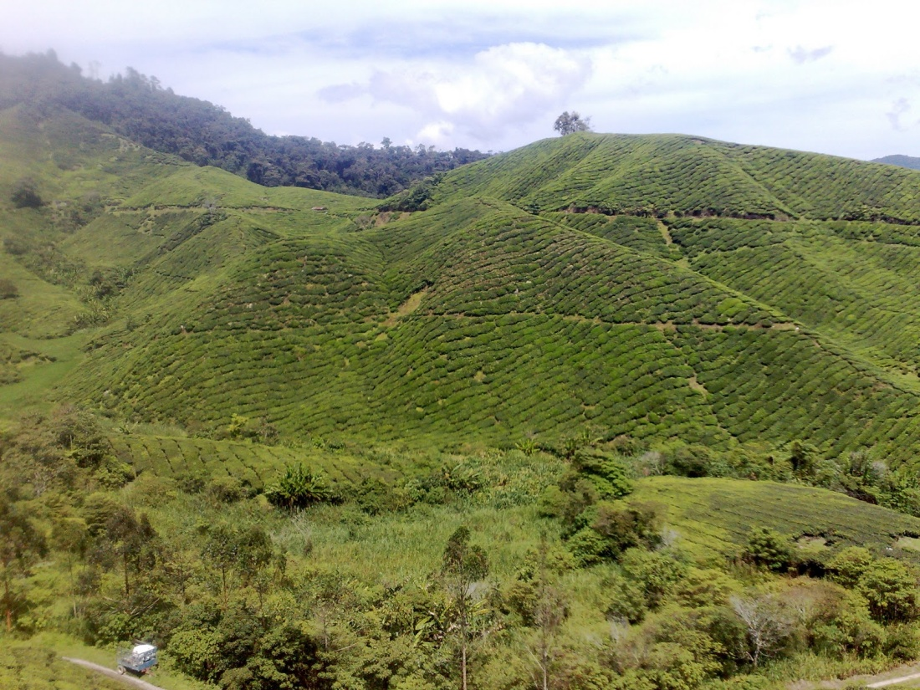
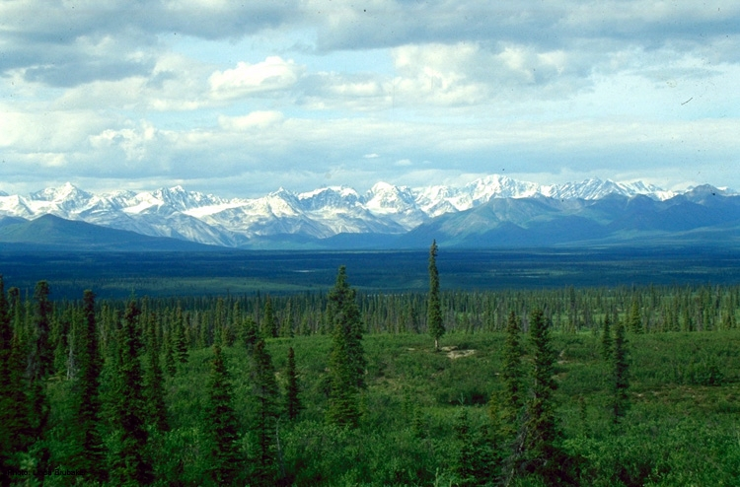
D. Humid Cold Climate
Continental Climate
Moderate temperatures
Large temp ranges
Moderate precipitation
Great soils

Slide 15
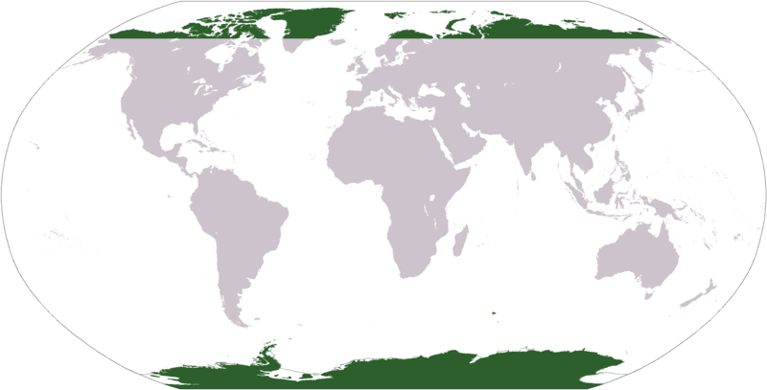
E. Polar Climate
8-10 months of snow
Generally underlain by permafrost
Days are long and temperatures may reach the teens in summer
Only in northern hemisphere, except in highlands and Antarctica

Slide 16
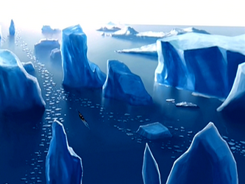
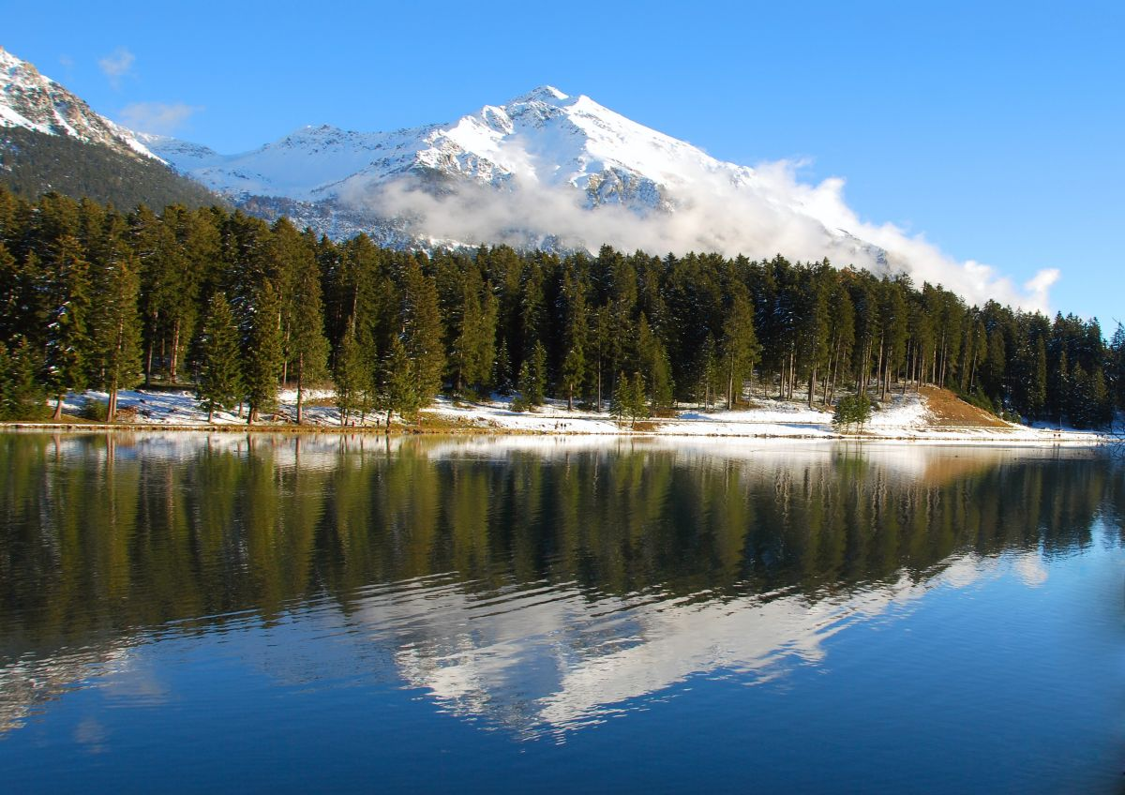
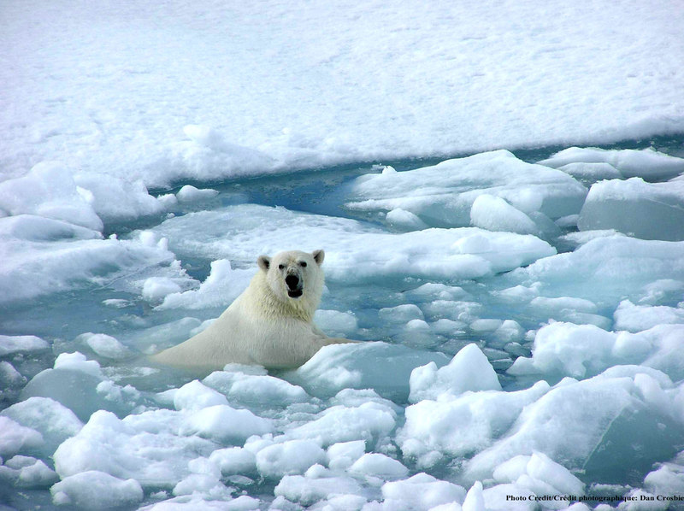
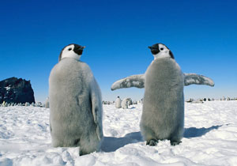

Slide 17
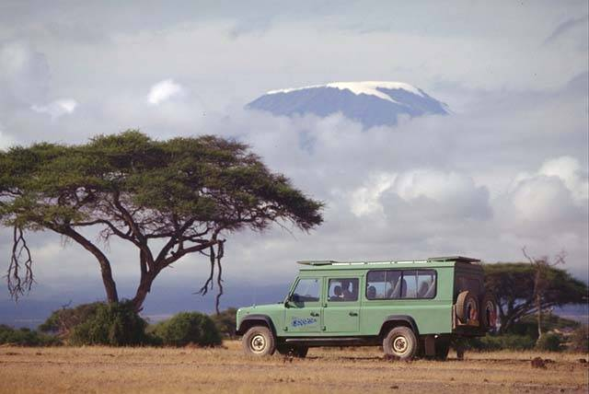
F. Highlands
Elevation + 5000 ft
Colder temps than at lower elevations
Snow at some elevations
Sometimes not labeled on maps

Slide 18
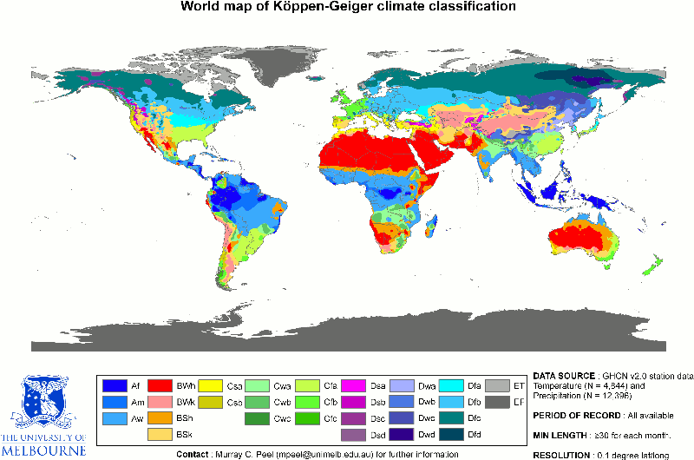
World Climate Map

Slide 19
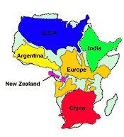
Africa’s Size
4 6 0 0 M I L E S
5
0
0
0
M
I
L
E
S
Second largest continent → 11,700,000 sq. mi.
10% of the world’s population.
2 ½ times the size of the U. S.

Slide 20
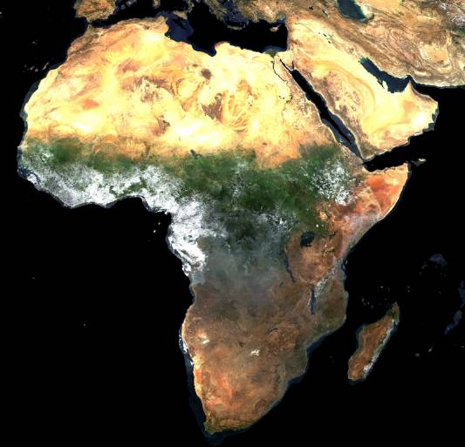
A Satellite View

Slide 21
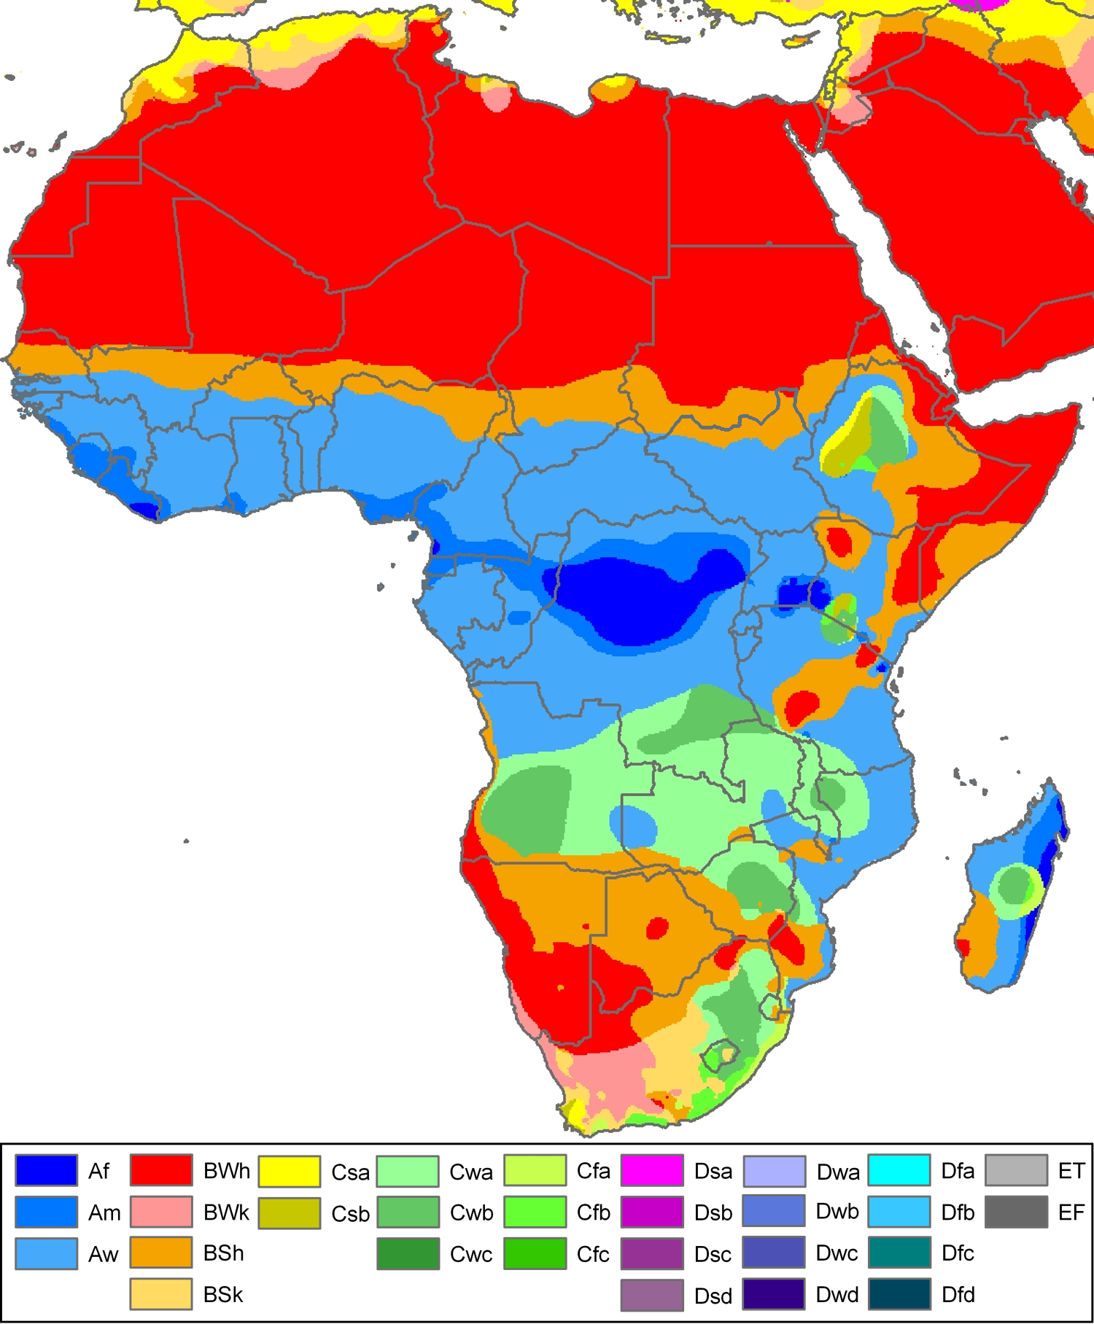
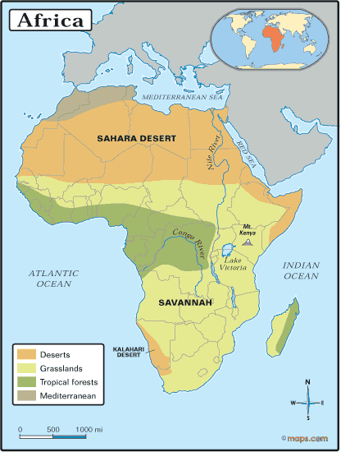
Africa is home to some of the most diverse climate regions in the world

Slide 22
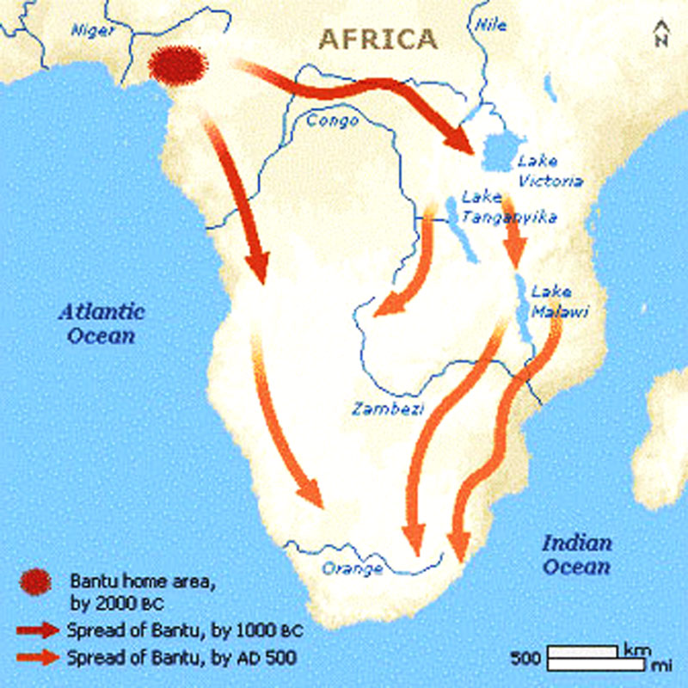
African Migrations
People migrated away from Great Rift Valley Africa because of desertification, or the slow drying of land and spread of deserts
Of these migrations, the movement of the Bantu people brought settlement to much of south Africa
  People spread their culture and language
  Adapted to the different climate zones
  Used swidden (slash and burn) agriculture

Slide 23
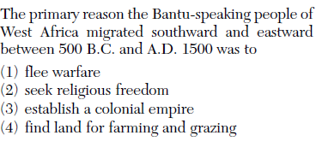

Slide 24
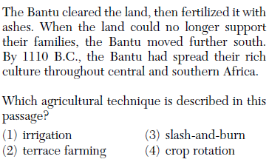

Slide 25
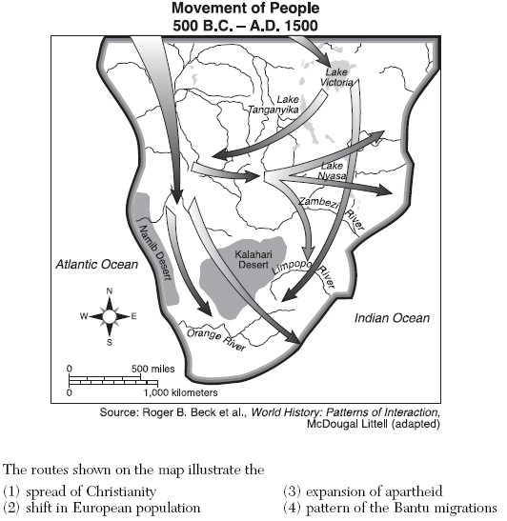

Slide 26
Essential Question
What factors make the climate and landscape of Africa so diverse?
World Climate activity
Homework

Slide 27
World Climates
http://webmap.ornl.gov/wcsdown/wcsdown.jsp?dg_id=10012_1

Slide 28
What climates do Africa’s largest cities have?
Lagos | Nigeria
Cairo | Egypt
Kinshasa | Congo Dem Republic
Alexandria | Egypt
Casablanca | Morocco
Abidjan | Cote d’ Ivoire (Ivory Coast)
Kano | Nigeria
Ibadan | Nigeria
Cape Town | South Africa
Addis Ababa | Ethiopia
Use the link from the previous slide, found on the Honors page on my CCS page to cross reference the cities location from the atlas in your textbook to the map!
Integrate quantitative or technical analysis (e.g., charts, research data) with qualitative analysis in print or digital text.
CCSS.ELA-LITERACY.RH.9-10.7
Use technology, including the Internet, to produce, publish, and update individual or shared writing products, taking advantage of technology's capacity to link to other information and to display information flexibly and dynamically
CCSS.ELA-LITERACY.WHST.9-10.6

