Slide 1
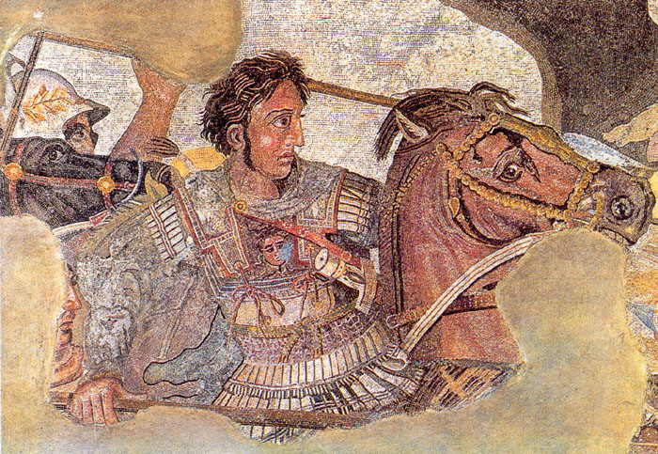
Alexander the Great and The Hellenistic Age
Global History and Geography I
Mr. Cox

Slide 2
Bellringer
What is an assassination? Have any historical figures been assassinated? Who?
Essential Question
Who was Alexander the Great and what was the Hellenistic Age?

Slide 3
I. Alexander Comes to Power
Phillip, his father, King of Macedon
Conquered the Balkan Peninsula, wanted Persia
Assassinated: murder of a public figure for political reasons
Mother secured the throne for Alexander
Shared his father’ ambitions

Slide 4
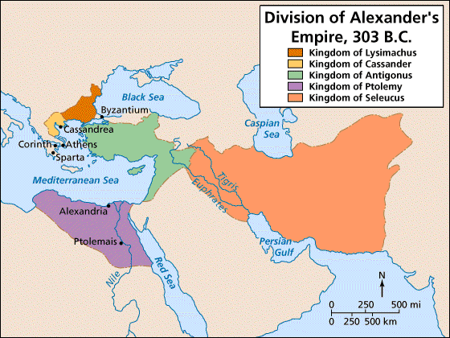
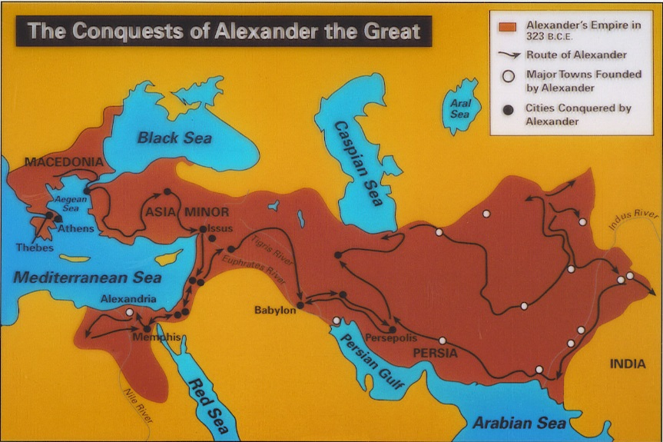
II. Alexander’s Empire
He pressed eastward, conquering Persia, Egypt, and India.
Soldiers refused to press forward, forced Alexander to turn back.
Died of a sudden fever in Babylon, 323 BCE
Empire was divided amongst his generals, never again united.

Slide 5
Quickwrite
What were the border’s of Alexander’s empire in the West and East?

Slide 6
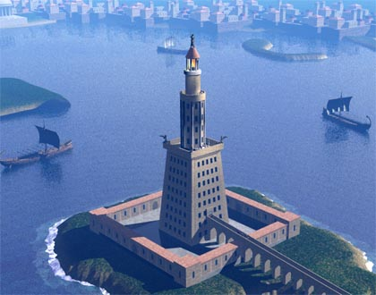
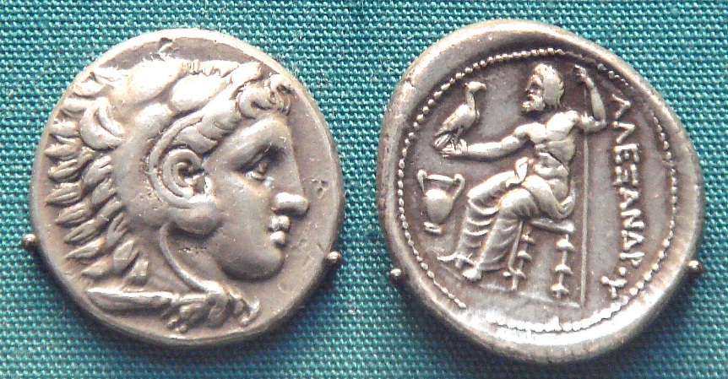
III. Legacy of Alexander
Spread Greek Culture across the Middle East
Assimilation: absorption of Greek culture into the areas he conquered
Cultural diffusion occurred, cultures became blended
City of Alexandria in Egypt became a cultural center

Slide 7
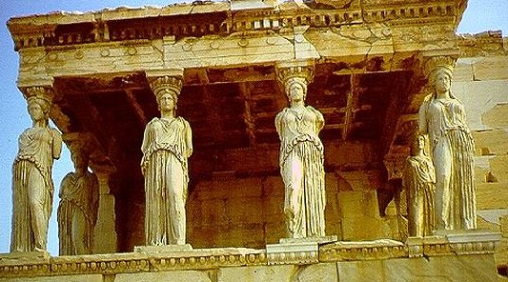
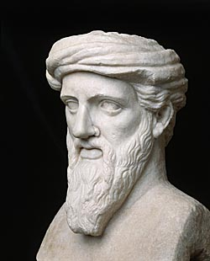
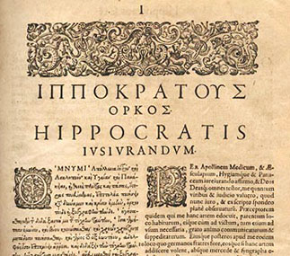
IV. The Hellenistic Age
New schools of thought
Stoicism: avoid desires and accept life as it comes
Advancements in Learning
Pythagorean Theorem
Euclid: The Elements, Geometry
Geocentric Model: earth centered solar system
Archimedes: physicist
Hippocrates: Hippocratic Oath for doctors
“help the sick according to my ability and judgment but never with a view to injury and wrong”
http://www.youtube.com/watch?v=0LsrkWDCvxg

Slide 8
Essential Question
Who was Alexander the Great and what was the Hellenistic Age?

