Slide 1
Enlightenment Sparks the American Revolution
Global History and Geography I
Mr. Cox

Slide 2
Bellringer
How did the ideas of the Enlightenment spark the American Revolution?
Essential Question

Slide 3
I. Causes of the American Revolution
The 13 English Colonies | Growing Discontent | Early Clashes

Slide 4
I. Causes of the American Revolution
The 13 English Colonies | Growing Discontent | Early Clashes
Part of British global trade Mercantilist policies Navigation Acts: regulated colonial trade Colonists felt entitled to the rights of English citizens

Slide 5
I. Causes of the American Revolution
The 13 English Colonies | Growing Discontent | Early Clashes
Part of British global trade Mercantilist policies Navigation Acts: regulated colonial trade Colonists felt entitled to the rights of English citizens | French and Indian War drained British treasury. Britain passed and enforced new tax law on the colonists “No taxation without representation.” Thomas Paine’s Common Sense

Slide 6
I. Causes of the American Revolution
The 13 English Colonies | Growing Discontent | Early Clashes
Part of British global trade Mercantilist policies Navigation Acts: regulated colonial trade Colonists felt entitled to the rights of English citizens | French and Indian War drained British treasury. Britain passed and enforced new tax law on the colonists “No taxation without representation.” Thomas Paine’s Common Sense | Boston Massacre Boston Tea Party Punitive laws passed by British to punish colonists Continental Congress with representatives from all 13 colonies

Slide 7
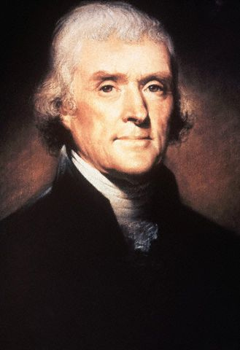
Declaration of Independence
Drafted by Thomas Jefferson
People had the right to “alter or abolish unjust governments.”
Popular sovereignty
All government power comes from the people
King had trampled the peoples’ natural rights.
Colonists now had the right to rebel

Slide 8
The Constitution
Used ideas of Locke, Montesquieu, Rousseau and Voltaire
Created a Federal Republic
Government in which power is divided between the national, or federal government, and the states
Separation of powers
Bill of Rights added later.
Federalist Papers – Writing campaign to convince American citizens to ratify the new Constitution
First President: George Washington.

Slide 9
Separation
Of Powers
Gov’t’s power
comes
from the people
People have natural
rights to life,
liberty and property
Checks
& Balances
Enlightenment Ideas
Checks &
Balances
US Constitution
Guaranteed
Individual Rights
Gov’t’s
authority
comes from people
Separation of
three
branches
of gov’t

Slide 10
Essential Question
How did the ideas of the Enlightenment spark the American Revolution?
w was the limited monarchy of England different than the absolute monarchies of Spain, Russia, and France?
Homework

