Slide 1
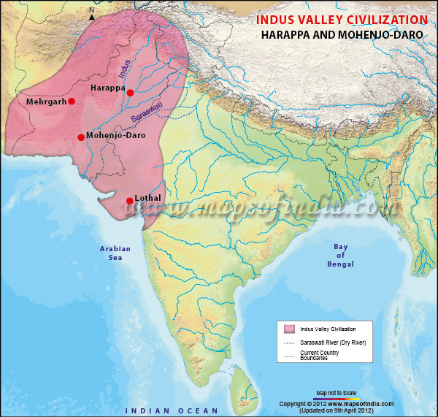
Cities of the Indus Valley
Global History and Geography I
Mr. Cox

Slide 2
Bellringer
Review: What are the 8 characteristics of a civilization?
Essential Question
How did Cities in the Indus River Valley rise and fall?

Slide 3
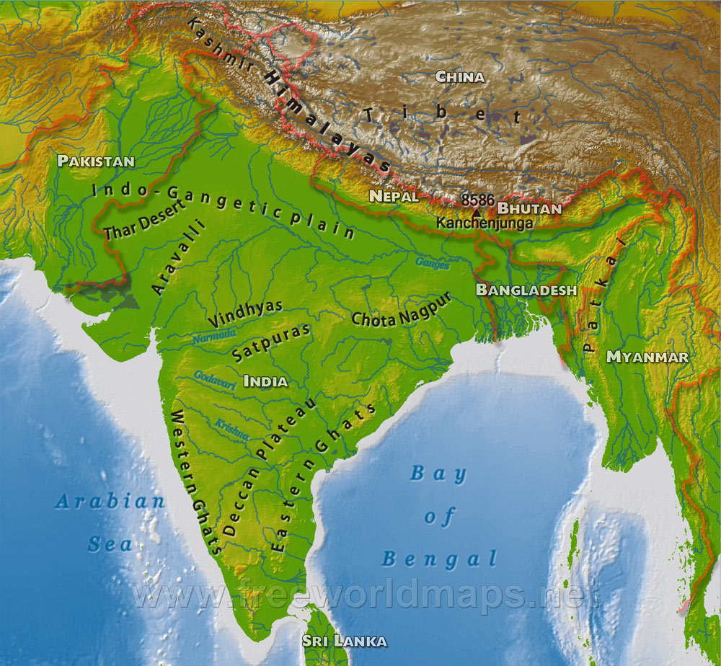
I. The Indus River and Indian Subcontinent
Southern Asia
Bordered in the North by the Himalayan Mts. and the West by the Hindu Kush Mts.
The Deccan Plateau is in the center of the Peninsula
Agriculture dependent on Monsoons.
http://www.youtube.com/watch?v=9peDRkO-TLc

Slide 4
II. Early Civilizations and Cities
An early civilization existed in the Indus River Valley, but little is known about it.
Two cities emerged: Harappa and Mohenjo-Daro.
These cities were well-planned, with grid patterns and brick structures

Slide 5
III. Culture
Many people were farmers and traders, relying on the monsoons and flooding of the Indus River.
Polytheistic
These people had a special veneration, or respect for, cattle.
This connects to many modern Hindu beliefs.

Slide 6
Quickwrite
What similarities did these early cities have with other ancient civilizations?

Slide 7
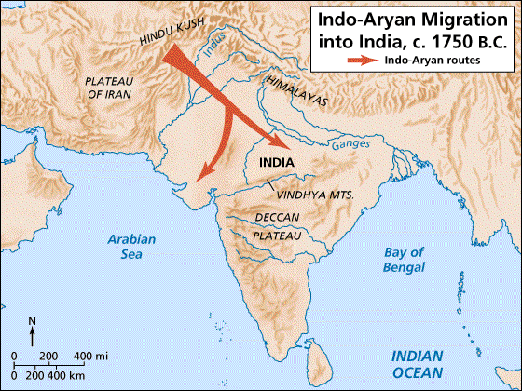
IV. New Peoples Come to India
Aryans and other ethnic tribes
Most of what is known comes from the Vedas
Collection of prayers
Vedic Age 1500-500 B.C.
Came to India seeking water and pastures from a crowded Europe.

Slide 8
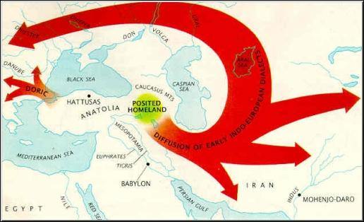

Slide 9
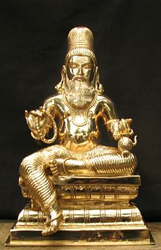
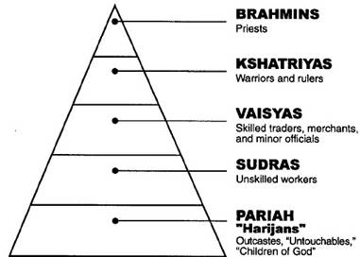
III. Religion and Culture
Religion was very important
Caste System: religious social structure, based off Hindu teachings
New written language emerged in India – Sanskirt
Set a foundation for Indian Culture
Language, social classes, religion

Slide 10
Essential Question
How did Cities in the Indus River Valley rise and fall?
Homework

