Slide 1
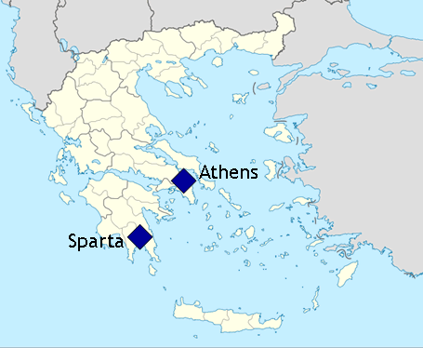
Sparta and Athens
Global History and Geography I
Mr. Cox

Slide 2
Bellringer
How is New York influenced by Geography?
Essential Question
How were the city states of Athens and Sparta different?

Slide 3
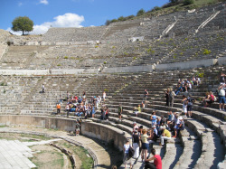
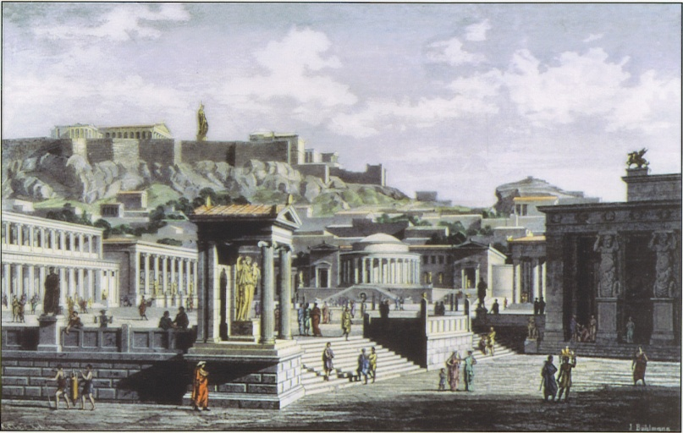
I. Athens: A Democratic State
Democracy: government by the people
Solon: reformed Athens
Outlawed some slavery
Expanded assembly and citizenship
Economic reforms
Featured a legislature: lawmaking body
Limited to males

Slide 4
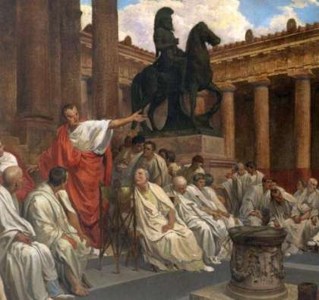
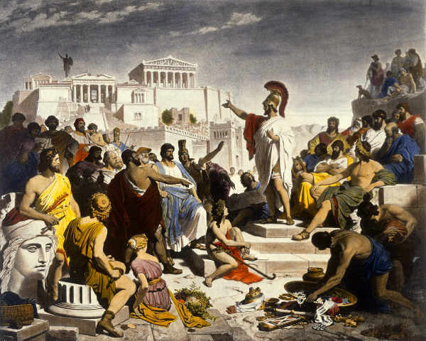
Women had few freedoms, seen as below men
‘Seen, not heard from’
Respectable woman was to tend the house and husband
Education:
Intense for wealthy men
Common people indirectly
Military training, advanced Navy

Slide 5
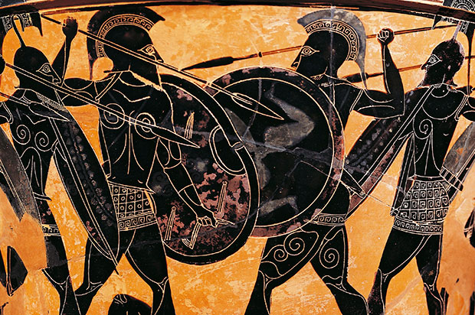
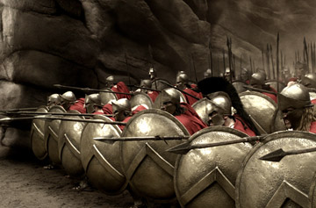
II. Sparta: A Military State
Controlled by a King
Forced military service
Men educated in ways of battle and military history
Phalanx: battle formation of foot soldiers
Helots: government owned slaves forced to work the land

Slide 6
Citizenship
Sick/deformed newborns were left to die
At 7, boys were forced to train for military service
http://www.youtube.com/watch?v=i5lvqx5c98c
Forced to live in the barracks, until 30, could marry at 20
Became a member of the assembly at 30
Women: could inherit property and were respected more than in Athens

Slide 7
How were the city states of Athens and Sparta different?
 | Military | Education | Government | Women | Citizenship
Athens
Sparta

Slide 8
How were the city states of Athens and Sparta different?
 | Military | Education | Government | Women | Citizenship
Athens | Men received some training Highly decorated naval fleet | Wealthy men became highly educated Common people could still learn | Democracy Law making legislature | Very few rights Seen as second-class citizens | Men had more rights than women
Sparta | Mandatory Military service for all men King was top general | Men educated in ways of war and battle | Monarchy Military controlled the state | Could inherit property Had more respect than Athenian women | Helots: forced to work the land After serving in military, men became members of assembly

