Slide 1
Babylon and the Code of Hammurabi
Global History and Geography I
Mr. Cox

Slide 2
Bellringer
Provide an example of a document that contain laws.
Essential Question
What is the major theme of the Code of Hammurabi?
What is the significance of the Code of Hammurabi?

Slide 3
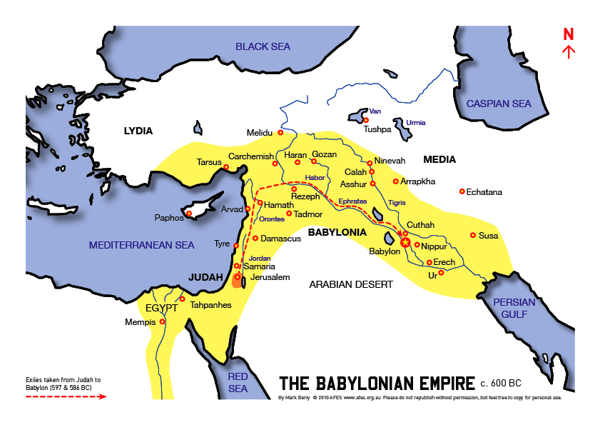
I. The Babylonian Empire
City-State of Babylon conquered much of Mesopotamia
King Hammurabi expanded the empire, took over Sumer.
Golden Age of Mesopotamian Culture ensued
Art/Architecture
Cuneiform writing developed

Slide 4
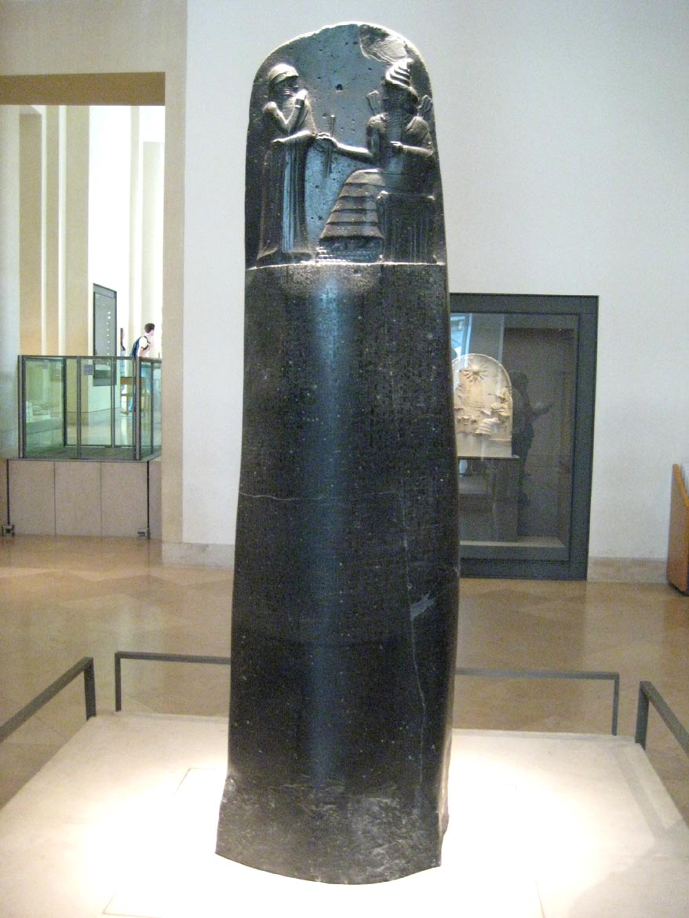
II. Hammurabi’s Code
Code of Hammurabi: a collection of laws posted an a public pillar.
Criminal Law
Civil Law (proper conduct)
First code of laws every published
publically

Slide 5
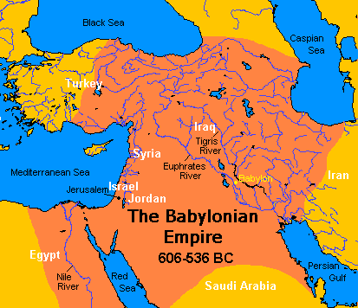
Problems
Severe punishments
(An eye for an eye)
Non-literate population

Slide 6
Close-Reading Activity
Excerpt from the Code of Hammurabi
Directions
As a class, we will read through the following excerpt from the “Code of Hammurabi”. As we read through the excerpt, you will do the following:
Highlight important information (main ideas, facts, etc)
Underline and star (*) people or places
Circle examples of an example of a punishment that represents an “eye for an eye”

Slide 7
Essential Questions
What is the major theme of the Code of Hammurabi?
What is the significance of the Code of Hammurabi?

Slide 8
Homework
9th Grade: Finish Code of Hammurabi worksheet

