Slide 1
The Beginning of the Middle Ages
Global History and Geography I
Mr. Cox

Slide 2
Bellringer
Review: What were the causes for the collapse of the Roman Empire?
Essential Question
Why did Western Europe become so culturally divided after the fall of Rome?

Slide 3
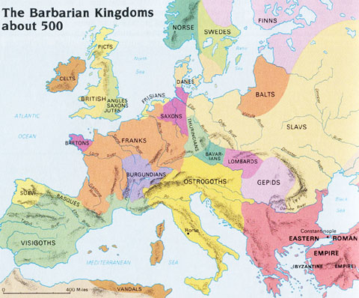
I. Western Europe – Post Rome
Medieval – Latin for “Middle Age”
“Dark Ages”
Ruled by ‘Germanic’ Kingdoms
Not of Latin descent (not Roman or Greek)
Developed Germanic Languages
No cities, small communities and villages
Frequently fought Muslims from Africa and the Middle East

Slide 4
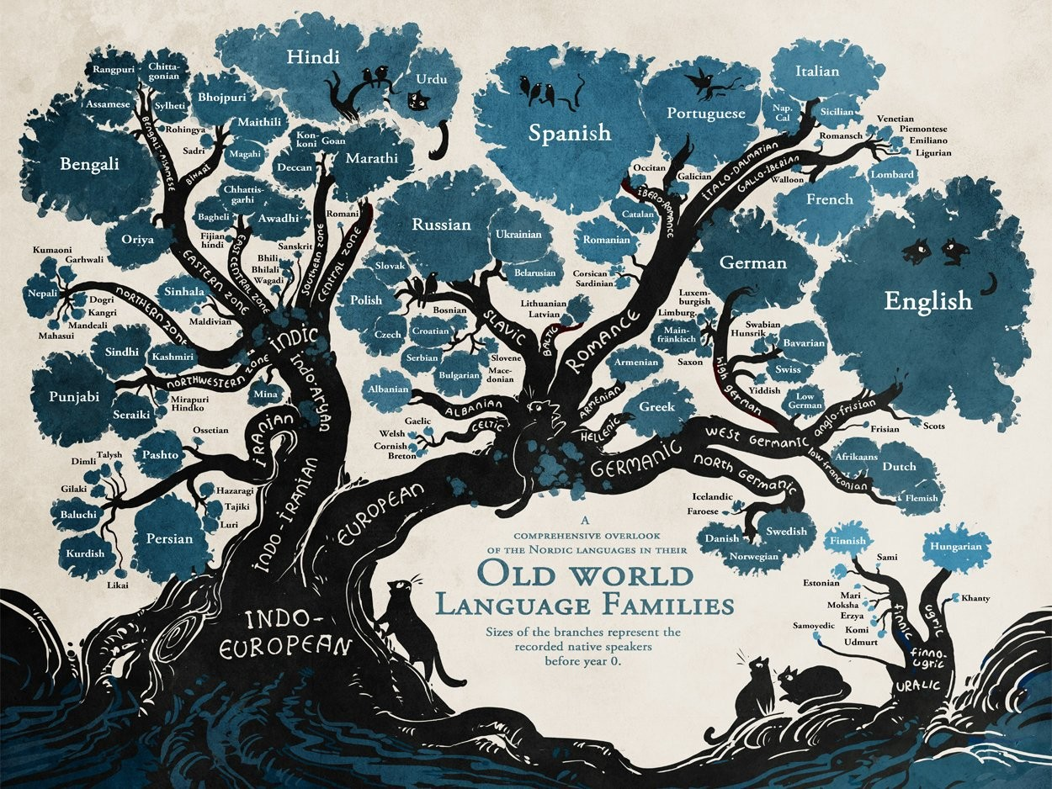

Slide 6
Quickwrite
Why did Western Europe become so culturally divided after the fall of Rome?

Slide 7
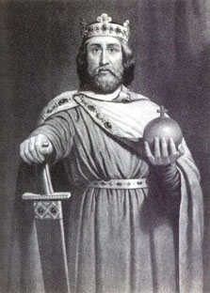
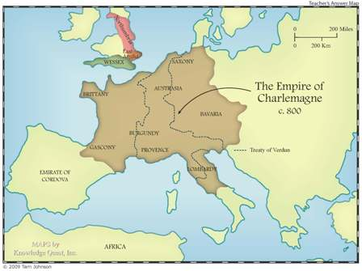
II. Charlemagne Attempts Unity
United areas of France, Germany, and Italy
Eventually called the Holy Roman Empire
Crowed ‘King of the Romans’ by Pope Leo III
Missi Dominici – officials who would maintain/govern empire
Revived learning: Curriculum – formal course of study
Empire largely fell apart after his death

Slide 8
III. The Vikings
A group of seafaring traders who arose in Scandinavia
Along with other tribes, they harassed and eventually broke Charlemagne's Empire
Sacked ocean coastal villages
Also developed a massive trade network, including the first European settlement in the Americas

Slide 9
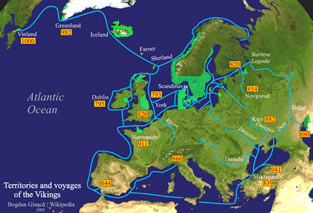
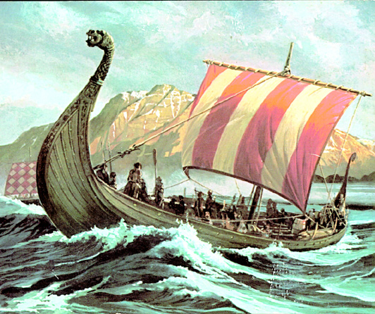
https://www.youtube.com/watch?v=Wc5zUK2MKNY

Slide 10
Essential Question
Why did Western Europe become so culturally divided after the fall of Rome?
Pg. 185 – 1, 3, 5
Homework

