Slide 1
The Renaissance Movement
Global History and Geography I
Mr. Cox

Slide 2
Bellringer
Review: Describe the geography of Italy.
Essential Questions
What was the Renaissance Movement?
Why was it able to begin and spread in Italy?

Slide 3
I. The Renaissance Movement
A time of creativity and change
Politics, culture, society, economy
The ways people viewed themselves and the world also changed
Began due to a renewed interest in Greco-Roman learning and writings
Spurned an appreciation for experiences during life, not after (Medieval Scholars)

Slide 4
I. The Renaissance Movement
Core to the Renaissance movement was the belief called humanism
The focus on worldly issues instead of religious issues
Study of humanities, or the subjects of study in Greece and Rome, including poetry, grammar, rhetoric, and history

Slide 6
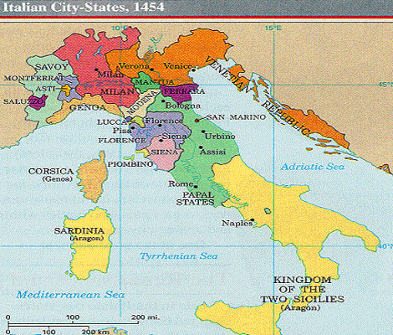
II. Why Begin in Italy?
Former center of Roman Empire
Italian City-States survived and prospered through the Middle Ages
Rome, Naples, Milan (TRADE)
Venice developed a powerful merchant class
Florence truly became the center of the Renaissance
Large number of talented/gifted individuals
Medici family organized a banking business and became patrons, or financial supporters, of the arts

Slide 7
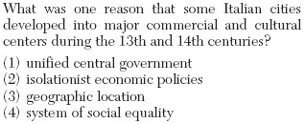

Slide 8
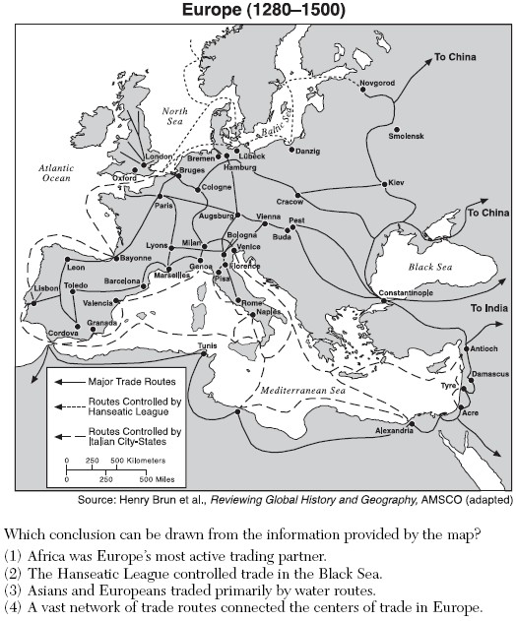

Slide 9
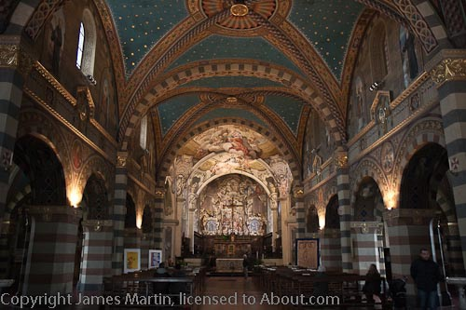
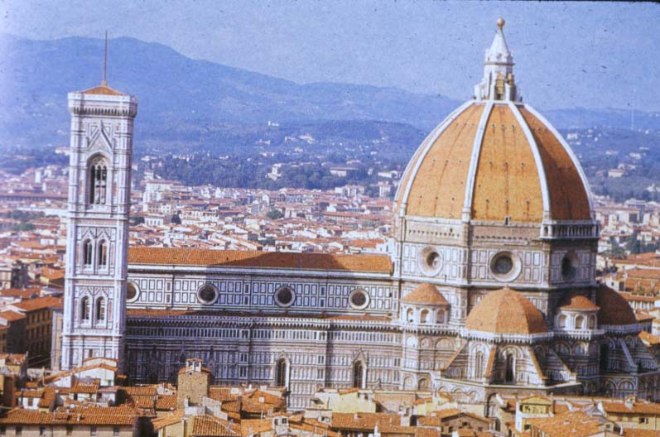
III. Features of Renaissance Advancements
Humanist Concerns were addressed
Religion and Greco-Roman influences
New Techniques emerged
Use of perspective and shading in art
Some woman became famous for their work
Rejected Gothic architecture and favored classic Greco-Roman columns, arches, and domes

Slide 10
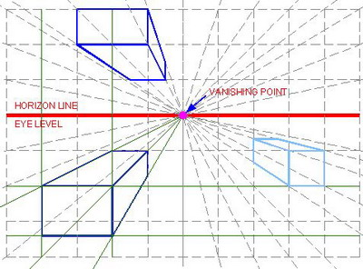
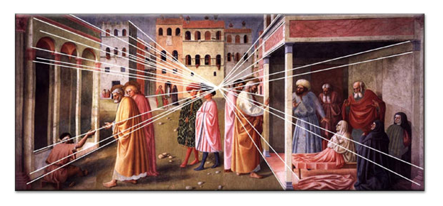

Slide 11
Essential Questions
What was the Renaissance Movement?
Why was it able to begin and spread in Italy?
Homework

