Slide 1
Europeans Look Outward: The Beginnings of the First ‘Global Age’ of Humanity
Global History and Geography I
Mr. Cox

Slide 2
Bellringer
Review: define the term cultural diffusion.
What caused European countries to begin to expand outwards?
Who were the notable early explorers and what countries did they come from?
Essential Questions

Slide 3
What is a “Global Age”?
The term Global Age refers to the connectivity of world cultures
(In essence, people of different cultures and geographic locations becoming connected)
Also called the Age of Exploration, this era coincided with the Renaissance
Although some contact had occurred thus far through trade, many of the world’s cultures of this time remained largely isolated from one another.
World map circa 1490 CE

Slide 4
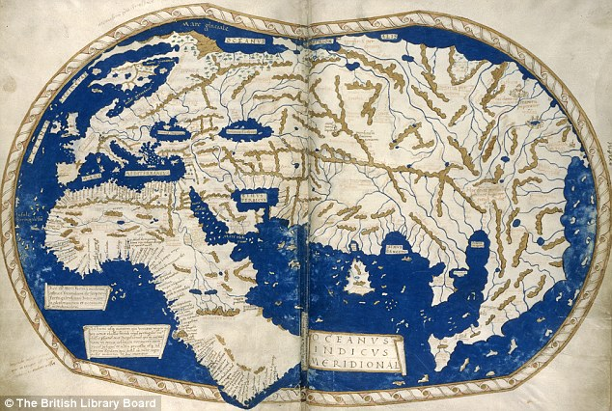

Slide 5
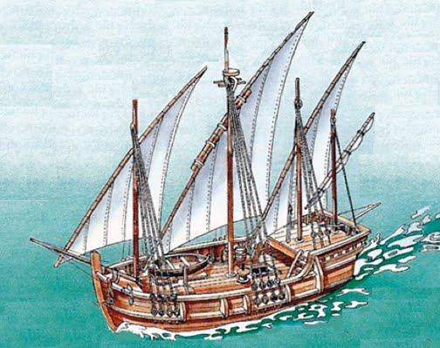
I. Causes for Exploration
New trade routes to Asia
Did not want to rely on Muslim trade routes
Would increase the wealth of the Monarch
Rivalries amongst European nation-states
Increased demand for goods after the Plague
Improved Technology
Cartographers made accurate maps for the time, needed a compass
Astrolabes were a tool for determining latitude at sea
Caravels were Portuguese ships that improved sailing

Slide 6
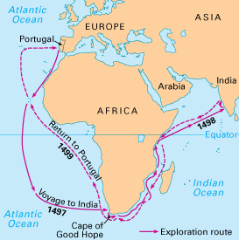
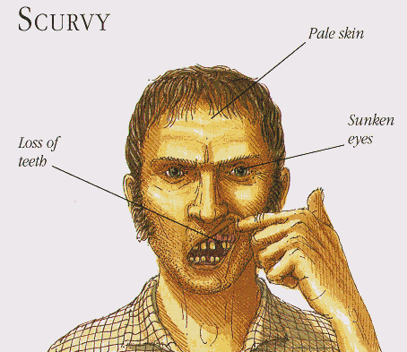
II. Early Exploration: Portugal
By defeating the Muslims and expanding into N. Africa, Portugal was the earliest European country to explore
Henry the Navigator maps out West Africa
Bartholomeau Dias rounds the tip of South Africa
Vasco de Gama led expedition to India, but many died from scurvy, or a lack of vitamin C
Led to the establishment of a vast Portuguese trade empire around the Indian Ocean

Slide 7
III. Christopher Columbus
Excited by Portugal’s success, Italian navigator and merchant Christopher Columbus wished to search for a more direct route to the Indies
Needed funding
Portugal said no, so he..
Asked Ferdinand and Isabella of Spain, who agreed to finance his voyage

Slide 8
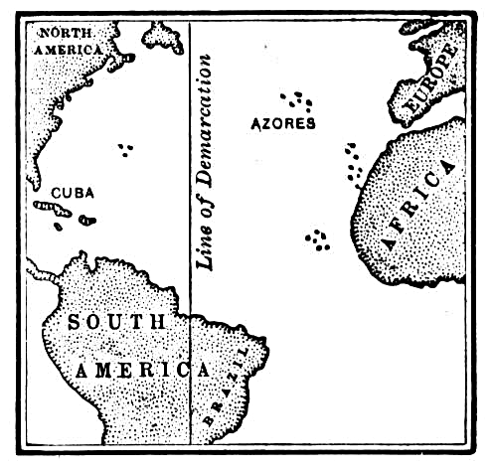
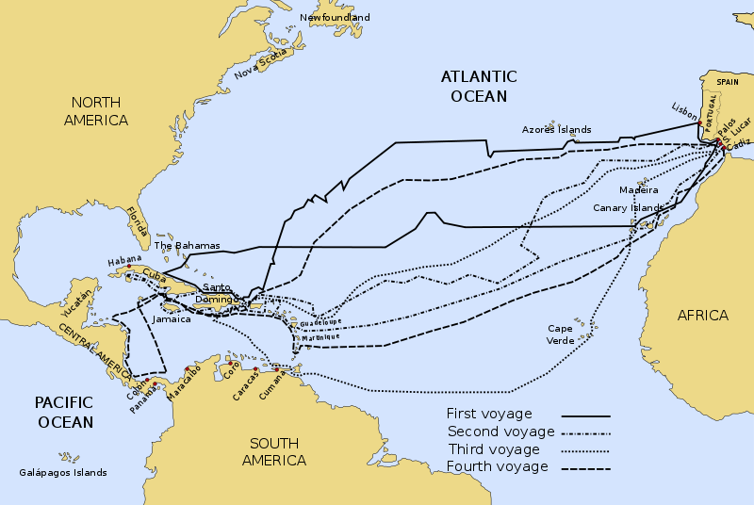
IV. Early Exploration: Spain
Columbus sailed west four times total, thinking he had reached India, thus naming the people ‘Indians’
During the travels, Spain laid claim to these lands
Spain and Portugal feuded over the lands, so the Pope declared the Line of Demarcation
East was Portugal’s, and West and Spain’s

Slide 9
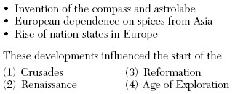

Slide 10
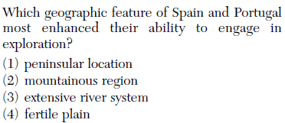
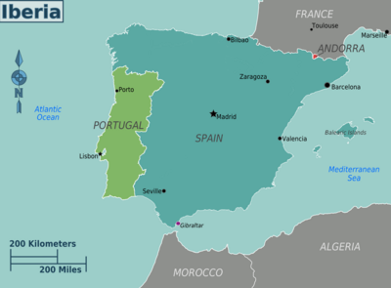

Slide 11
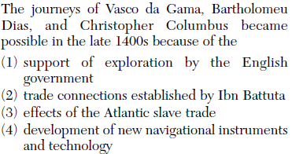

Slide 12
V. Other Early Explorations
Amerigo Vespucci wrote tales of the ‘New World’ that were read by many
Europeans began calling the ‘New World’ America
Ferdinand Magellan’s voyage became the first to circumnavigate the world (3 years)
Died in the Philippines
English, Dutch, and French begin to explore North America

Slide 13
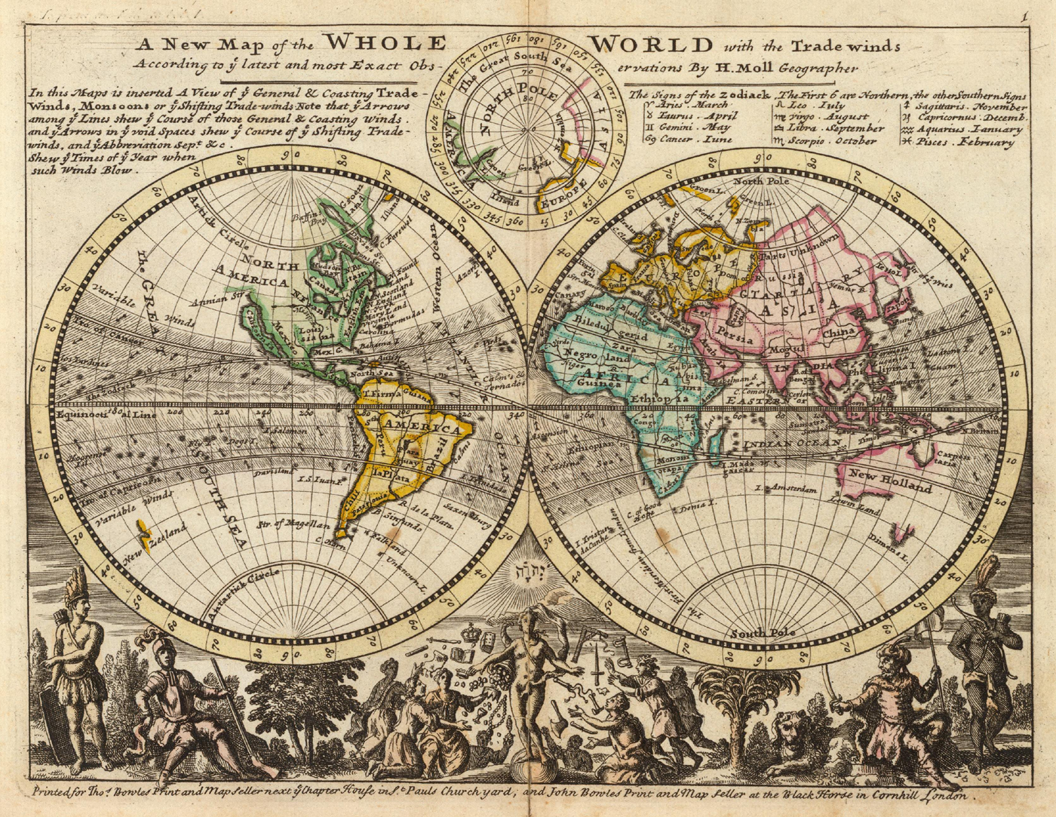

Slide 14
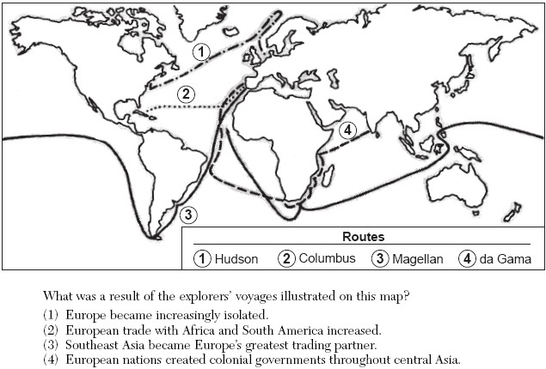

Slide 15
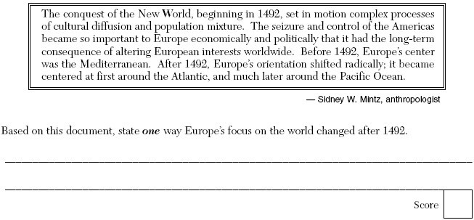

Slide 16
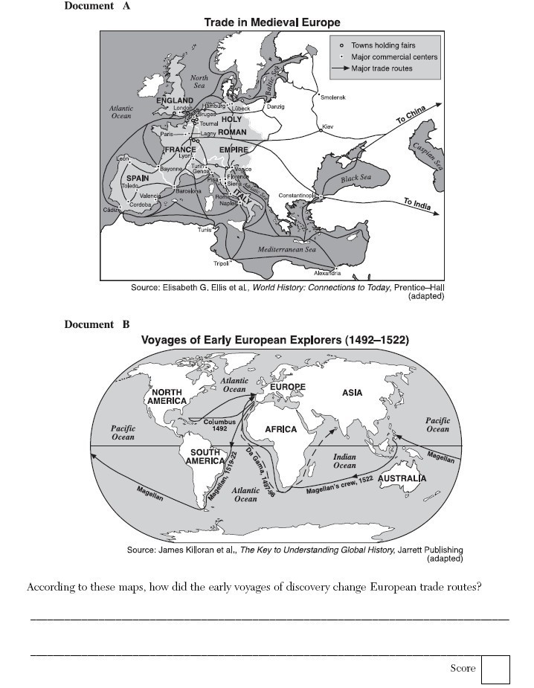

Slide 17
Essential Question
What caused European countries to begin to expand outwards?
Who were the notable early explorers and what countries did they come from?
Homework

