Slide 1
Beginning of Civilization
Global History and Geography I
Mr. Cox

Slide 2
Bellringer
What does the term specialize mean? Provide an example.
Essential Question
What are the eight characteristics of a Civilization?

Slide 3
I. Rise of Civilizations
Civilization: a complex, organized social order.
Civilizations were able to rise as a surplus, or extra, amount of food was grown.
Many of the first civilizations were located next to Rivers.

Slide 4
Quick Write
Why did early civilizations develop alongside Rivers? Share with your neighbor when you are finished.

Slide 5
The 8 Characteristics of a Civilization
Cities
Organized Government
Complex religions
Job specialization
Social Classes
Arts and Architecture
Public Works
Writing system
1 | 2 | 3 | 4 | 5 | 6 | 7 | 8
… | … | … | … | … | … | … | …

Slide 6
Cities
More than just a collection of people, an advanced city is the cultural and economic center for an area or group of people.

Slide 7
Organized Central Governments
An institution is a long last pattern of organization in a community. Rising populations made governments necessary to keep order.

Slide 8
Complex Religions
Organized belief system.
Polytheism.

Slide 9
Specialization
As people began to live together, there became less need for everyone to farm. New jobs emerged, including:
Artisans
Scribes
Merchants
Soldiers

Slide 10
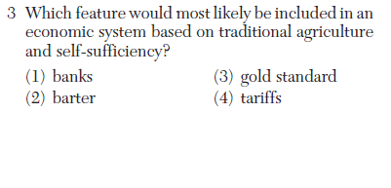

Slide 11
Social Classes
“Ranking” people in a society according to a set of principles (money, land, etc)

Slide 12
Arts and Architecture
Were developed and expressed the beliefs and values of the society

Slide 13
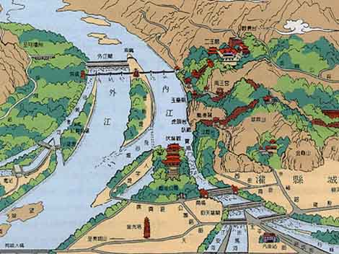
Public Works
Irrigation, infrastructure, city walls, etc

Slide 14
Writing System
Used as a form of communication
Record Keeping (scribes)
Used for religious activities
Pictograms – simple drawings that look like the objects they represented

Slide 15
Homework
Essential question
What are the eight characteristics of a civilization?

