Slide 1
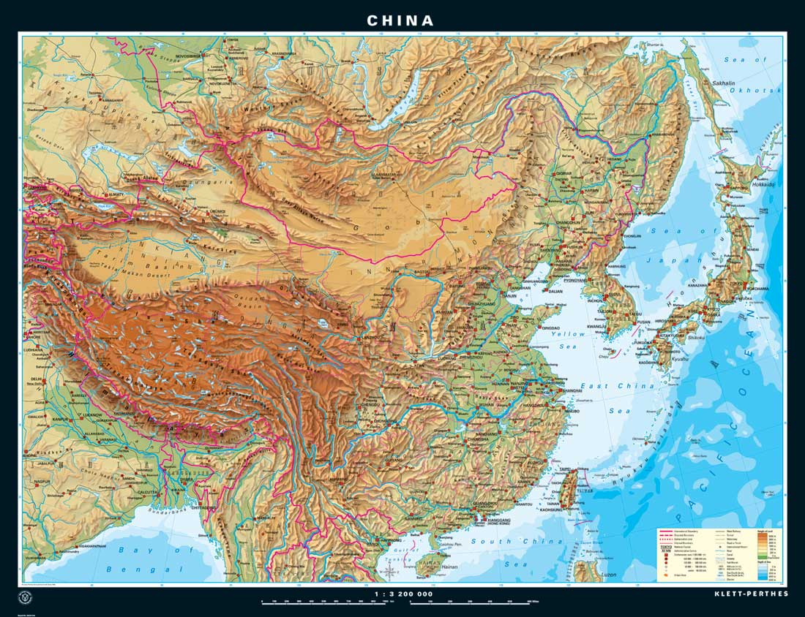
Chinese Geography and the Early Dynasties
Global History and Geography I
Mr. Cox

Slide 2
Bellringer
What is a cycle? Provide some examples.
Essential Question
What geographic features of China allowed for the Dynastic Cycle to occur?

Slide 3
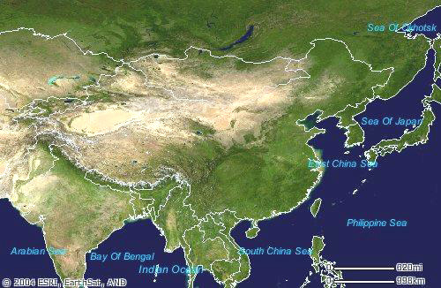
I. Chinese Geography
Isolated due to natural boundaries
Tien Shan and Himalayan Mts. In the west
Gobi Desert and thick jungles in the north and south
Pacific Ocean to the east
Trade was slow in developing, partnerships developed

Slide 4
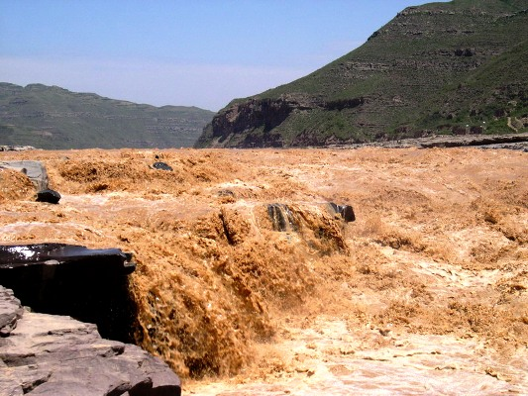
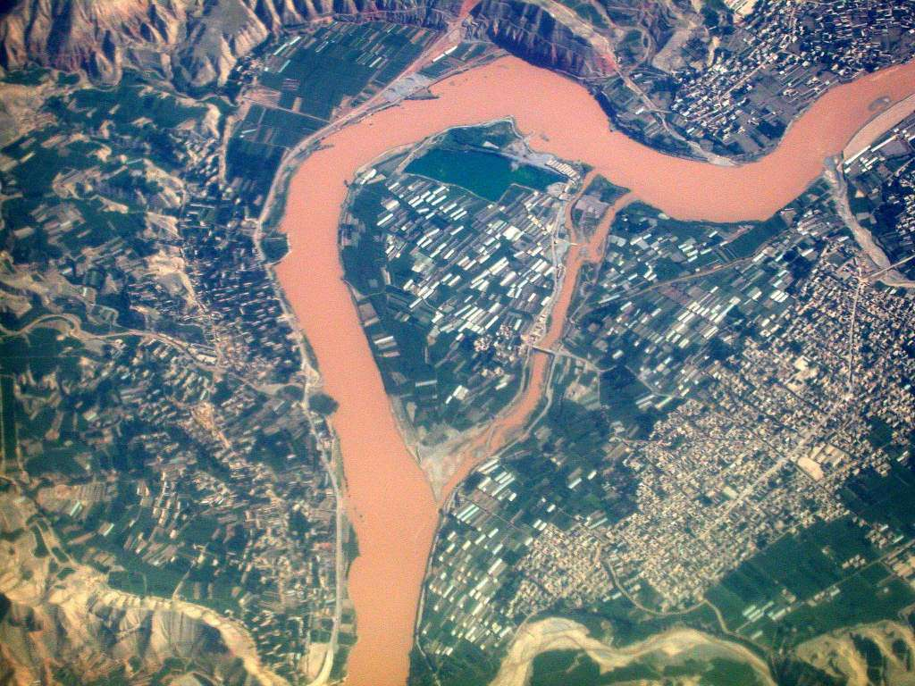
II. China’s Rivers
Earliest people along the Huang He river, also known as the Yellow River
Earned the name because of loess, fine yellow soil, that was deposited during floods.
People also settled near the Yangtze

Slide 5
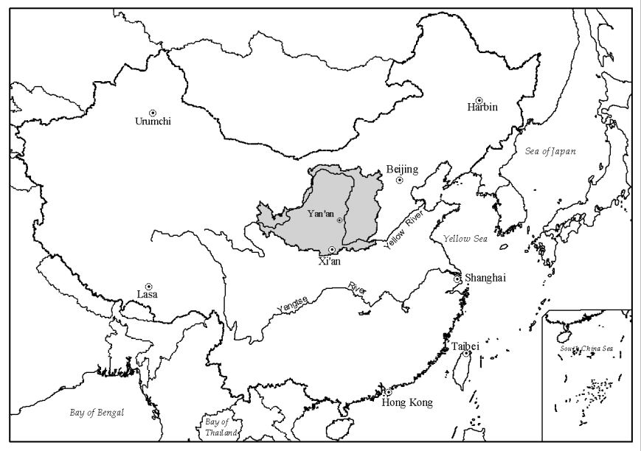
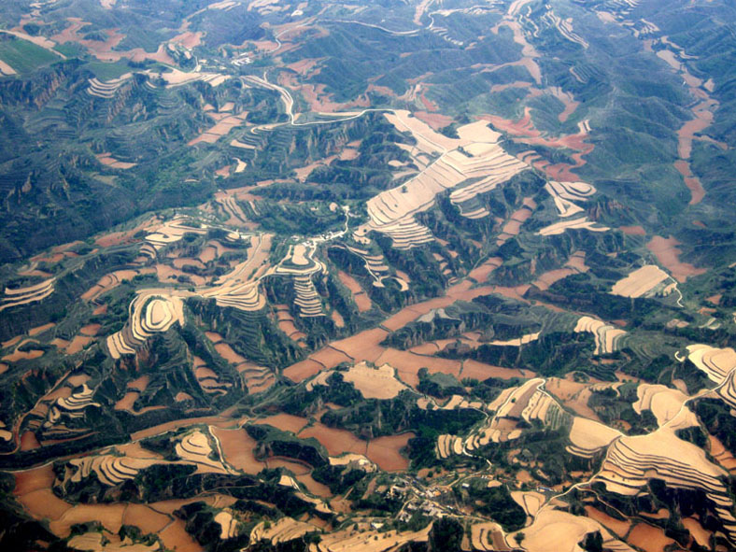

Slide 6
Quickwrite
How did Ancient China develop similarly to other ancient civilizations?

Slide 7
III. The Dynastic Cycle
Dynasties ruled China
These dynasties were advanced civilizations
Religion: Polytheistic
Oracle Bones used by priests to communicate with ancestors
Writing: Calligraphy, or fine handwriting, was used to communicate.
Silkmaking: a tedious process that created silk, a fine cloth that was an export for China.
Mandate of Heaven – allowed for the dynastic cycle to exist. Stated that the gods wanted families to rule China.

Slide 8
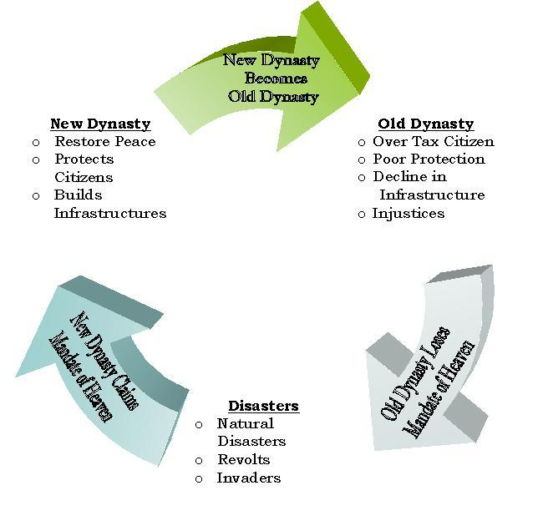

Slide 10
Essential Question
What geographic features of China allowed for the Dynastic Cycle to occur?

