Slide 1
Christianity
Global History and Geography I
Mr. Cox

Slide 2
Bellringer
Who was Abraham and what was the Torah?
Essential Question
Who was Jesus Christ and what are his main teachings?

Slide 3
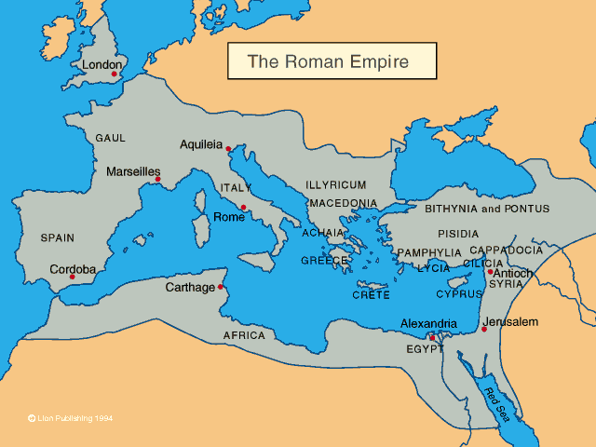
Origins: Roman Judea
Divisions in Judaism
Came under control of Rome
Other cultural ideas caused divisions within the faith
Revolts occurred
Some Jews believed a Messiah, or king appointed by god, would come to liberate them from Roman rule.

Slide 4
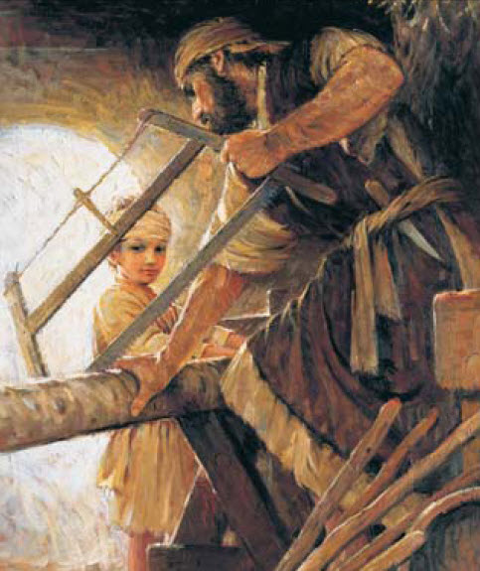
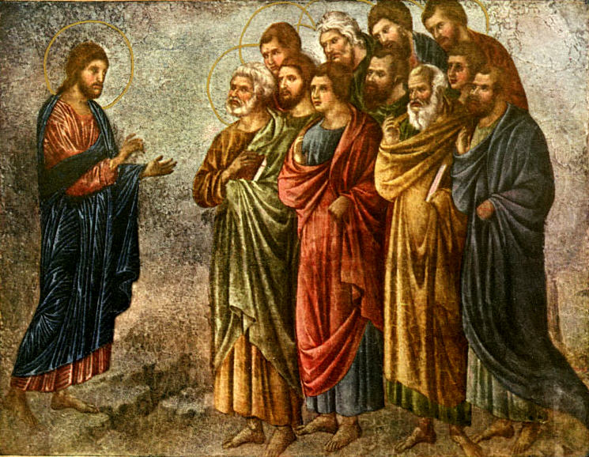
Jesus Christ
Life
Jewish carpenter from Palestine
Drifted away from traditional Jewish worship
Apostles – Twelve close followers of Jesus.

Slide 5
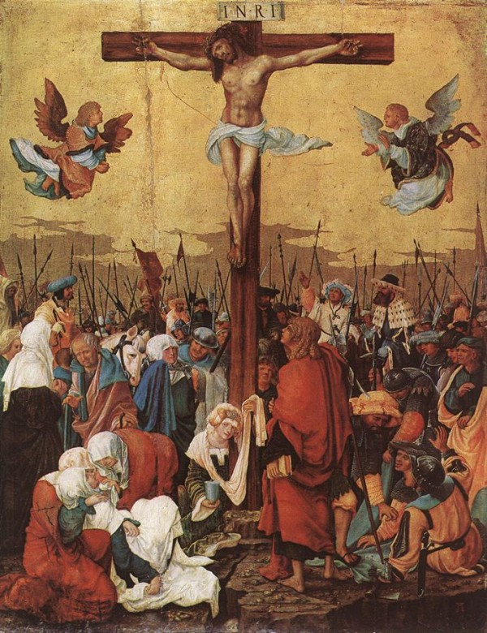
His Message
One God, Ten Commandments (similar to Judaism)
New Beliefs: He was the Son of God, love of god instead of obedience, holy trinity (father, son, holy spirit)
His Death
Roman oppression of Religion
Betrayed by one of his apostles
Crucified on the cross
‘Died for his people’ (martyr)

Slide 6
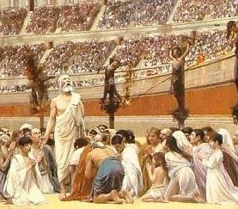
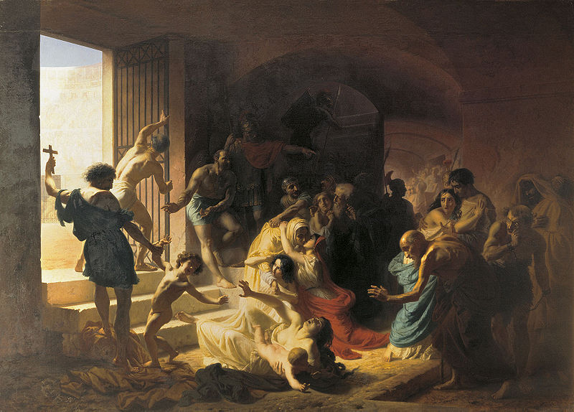
The Spread of Christian Faith
Paul – Missionary who spread the word of Christ all around Mesopotamia.
Persecution – Rome actively discriminated against Christians. Blamed them for Rome’s problems.
Christians became martyrs, or people who die for their beliefs.

Slide 7
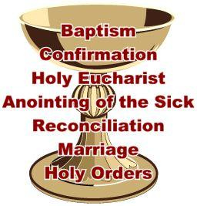
The Early Church
Patterns of Life and Worship – live life according to the teachings of Jesus and the Bible: the Old and New Testaments
Sacraments :
Role of Women
Well respected
Teachers, administrators
‘Goddess’ Figure in the Virgin Mary

Slide 8
Structure of the Church
Diocese – a geographic area of Catholic churches
Heresies – beliefs that do not align with church teachings

Slide 9
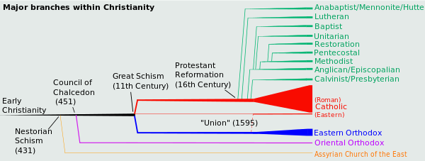
Christianity Today
Christianity is a divided faith with many sects, or divisions, worldwide

Slide 10
Structure of the Church (Roman Catholic)

Slide 11
http://www.youtube.com/watch?v=TG55ErfdaeY

Slide 12
Essential Question
Who was Jesus Christ and what are his main teachings?

Slide 13
https://nationalpostnews.files.wordpress.com/2013/01/fo0324_religion1200.jpg

