Slide 1
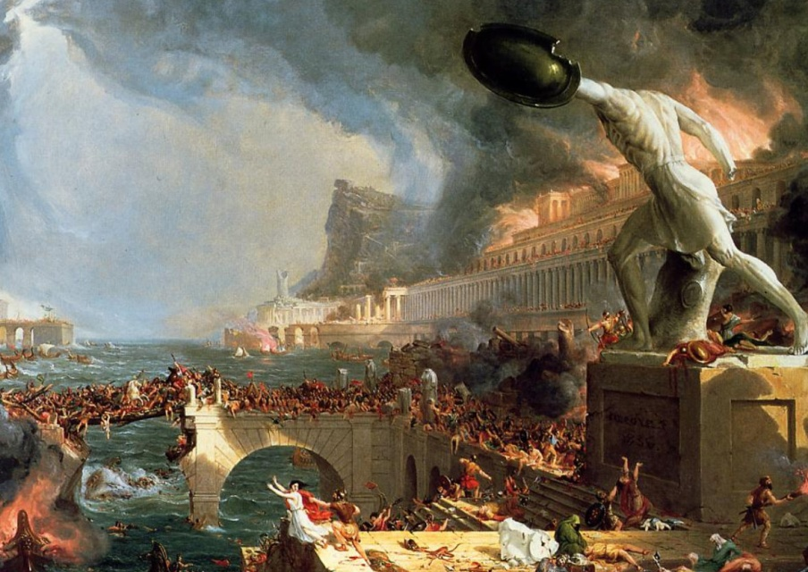
Collapse of Rome
Global History and Geography I
Mr. Cox

Slide 2
Bellringer
Why was the policy of bread and circuses implemented in the Roman Empire?
Essential Question
What were the causes of the collapse of the Roman Empire?

Slide 3
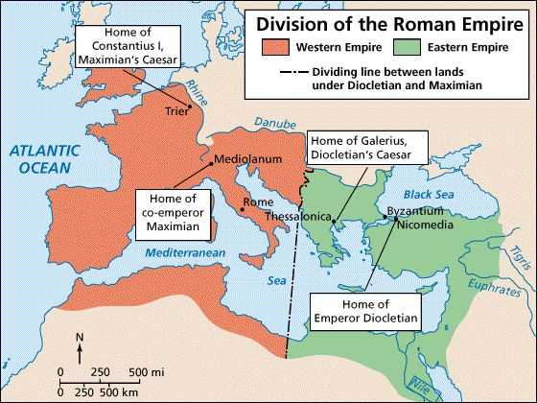
I. Internal Problems
Political instability (26 emperors in 50 years)
High taxes and low farm productivity
Diocletian: tried to slow the bleeding, split Empire
Tried to stop inflation: rapid rise of prices

Slide 4
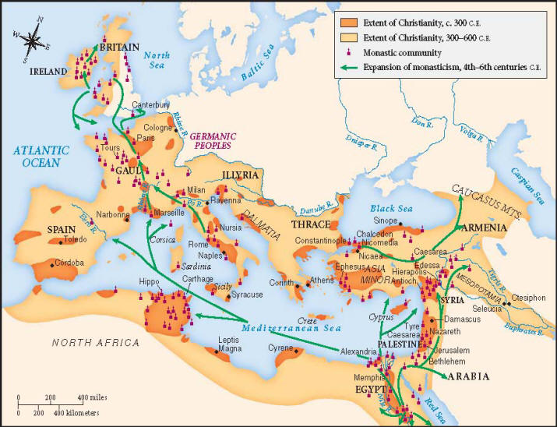
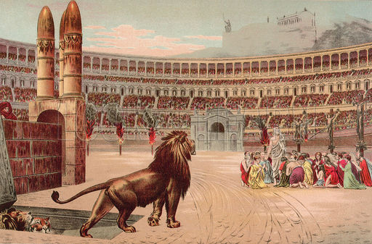
II. Constantine
General who continued reforms
Moved the capital to Constantinople
Shifted power of the Empire away from Rome
Spread Roman/Greek culture to the East
Granted tolerance to the ‘hated’ Christians

Slide 5
Quickwrite
What steps did Diocletian and Constantine take to reform Rome?

Slide 6
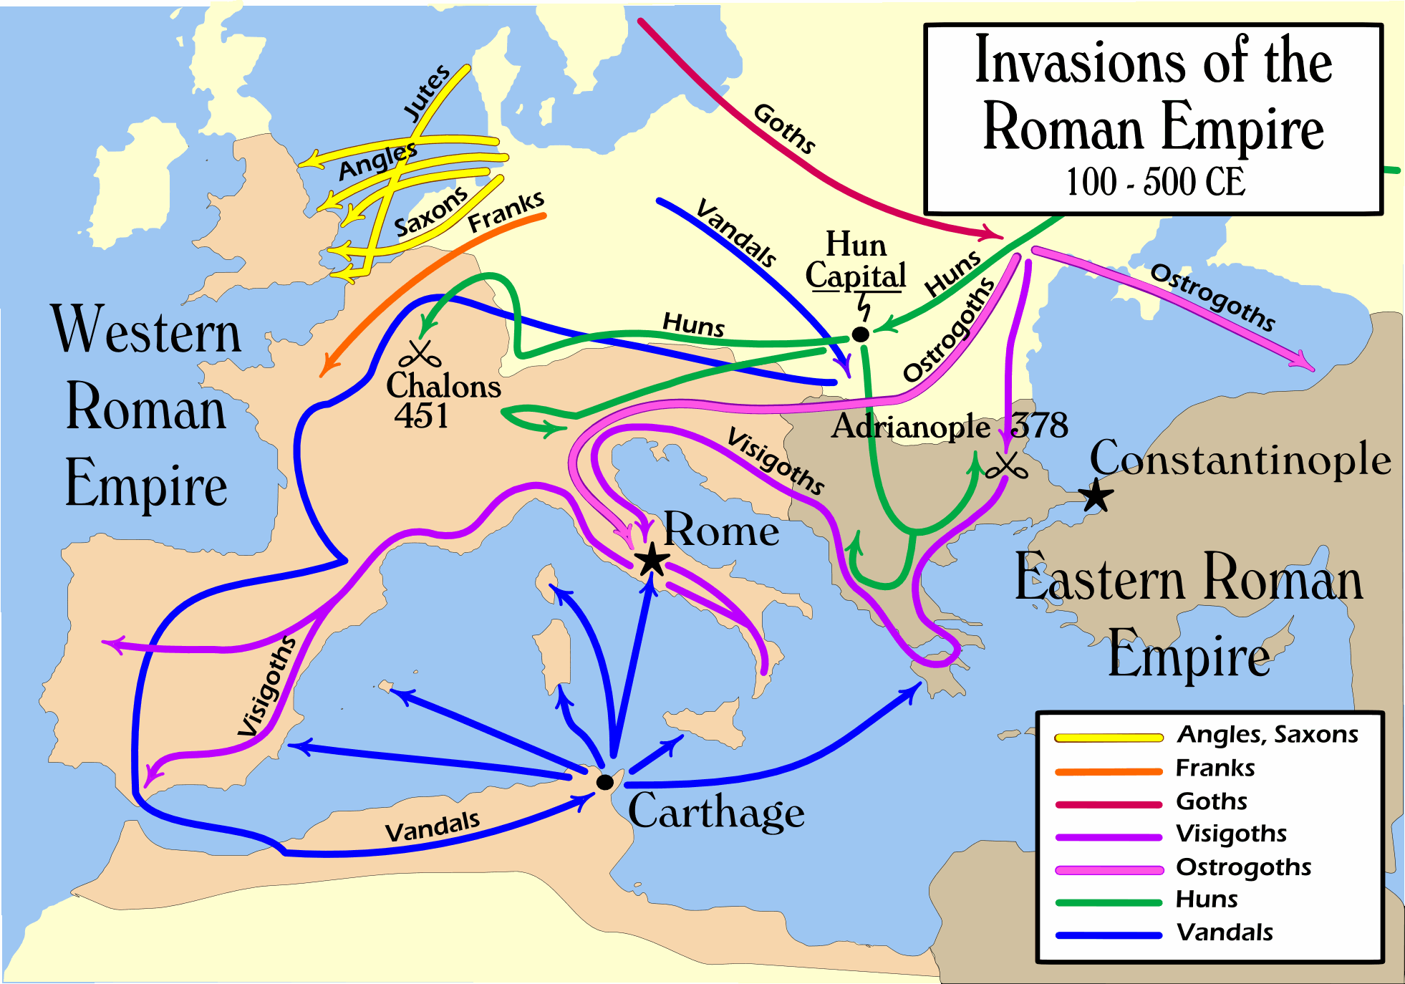
III. The Collapse
The reforms failed
Foreign attackers came
Huns from the East
Gauls from the North
Germanic tribes from Europe
Rome hired mercenaries
Hired soldiers
Felt little loyalty to Rome

Slide 7
Causes of the Fall of Rome
Military Causes | Economic Causes | Social Causes | Political Causes
Germanic invasions Weakened Roman Legions due to other problems | Heavy taxes Population decline | Loss of Roman values Divide in social classes spread discontent | Divided empire Unclear political goals
http://www.youtube.com/watch?v=3PszVWZNWVA

Slide 8
Essential Question
What were the causes of the collapse of the Roman Empire?

