Slide 1
Colonization of Africa
Global History and Geography I
Mr. Cox

Slide 2
Bellringer
What is this question actually asking?
Do the ends justify the means?
What was the causes and results of the Atlantic Slave trade?
Essential Question

Slide 3
http://www.youtube.com/watch?v=dnV_MTFEGIY

Slide 4
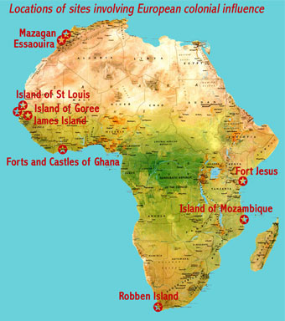
I. European Interests in Africa
Early exploration began when looking for routes to India
Many trade outposts were established on the coasts
Had very little profit with fighting Islamic peoples, but began enslaving the Natives

Slide 5
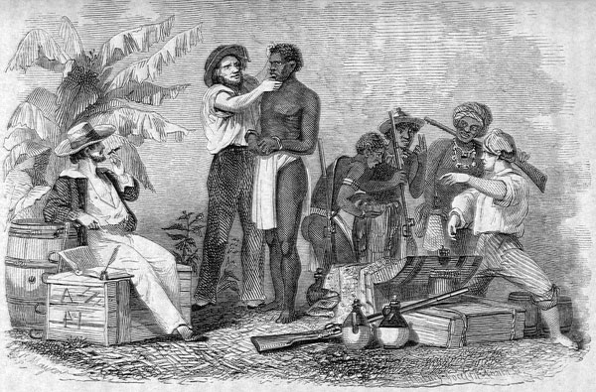
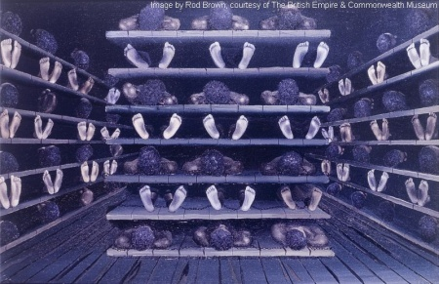
II. The Atlantic Slave Trade
Many European countries began exporting slaves
Cheap labor source
Other colonies were more profitable for Europe
Trade outposts began focusing on slaves and their primary commodity
Became known as the ‘Middle Passage’
Horrible experience for Africans

Slide 6
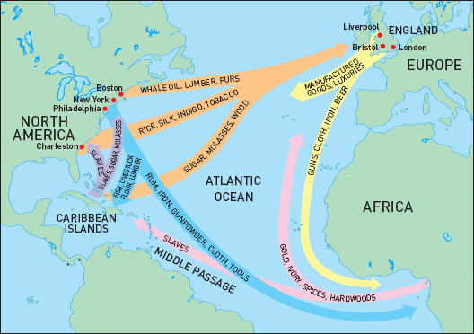
As a result of the Middle Passage, a three pronged trade route was established called the Triangle Trade Route
Africa, Europe, and Americas
Different goods from different regions were desired
Europe | Americas | Africa
Manufactured goods (guns, clothing, etc) | Tobacco, rum, cotton, molasses, furs | Slaves, gold, ivory

Slide 7
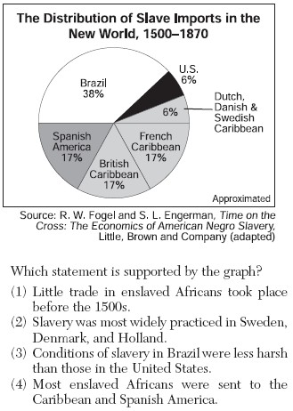

Slide 8
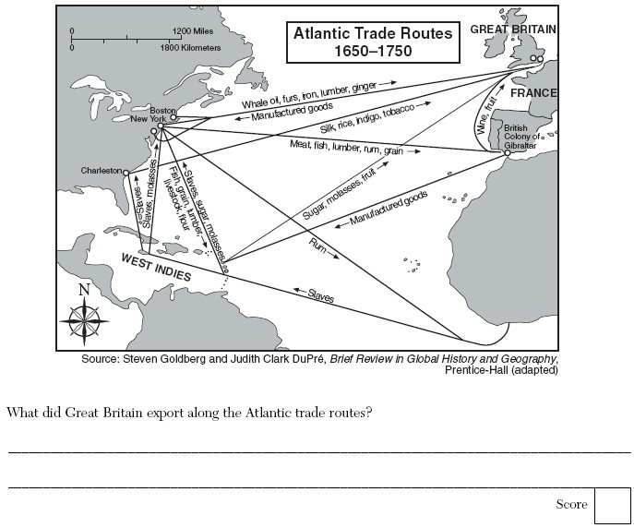

Slide 9
As a result, nearly the entire continent of Africa became settled by Europeans in order to make money
Europeans would capture Africans themselves or pay local lords to capture other tribesmen
Sent to almost every part of the New World
Destroyed the culture, economy, and society of a group of people

Slide 10
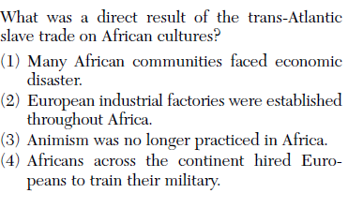

Slide 11
IV. Impacts
Short Term | Long Term
Population shift away from Africa Economic benefits for European nations, economic destruction for Africans Destruction of entire African nations Overall success of European colonies in America | Rise of new African nations (Oyo, Bornu, Dahomey, and Asante) Long term occupation of territory by Europeans Consistent disunity of African people (modern civil wars)

Slide 12
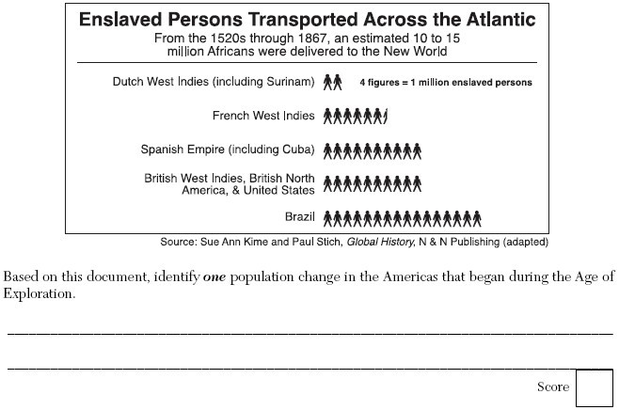

Slide 13
Essential Question
What was the causes and results of the Atlantic Slave trade?
Homework

