Slide 1
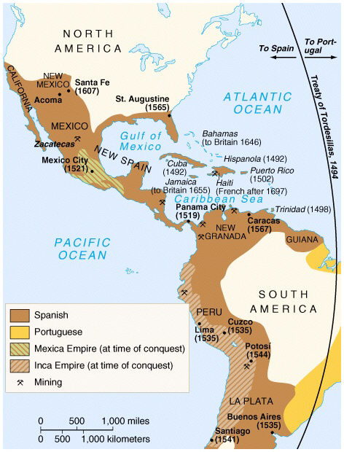
Colonization of Middle and South America
Global History and Geography I
Mr. Cox

Slide 2
Bellringer
Review: What was the name of the line drawn by the Pope dividing land between Spain and Portugal in the New World? Why was it drawn?
How did Spain rule its Empire in the Americas?
Essential Question

Slide 3
I. New Spanish Territory
Spain grew wealthy due to the Conquistadors
The Spanish Empire became divided into 5 provinces, most notably New Spain (Mexico) and Peru
Council of Indies was established in Spain to pass laws for the new provinces
Viceroys, or representatives who ruled with the king’s voice, governed each provinces

Slide 4
Spanish Missionaries
Spread Christianity (Roman Catholicism)
Power of the Vatican and the Pope greatly increased
Economy of the New World
Trade controlled by Spain (trade stayed within the Empire)
Established the first plantations, large farm estates
Conquistadors were granted ecomiendas, or the right to demand labor/tribute from Natives
Led to forced labor and the death of thousands of Natives

Slide 5
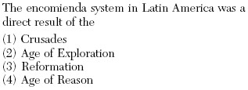

Slide 6
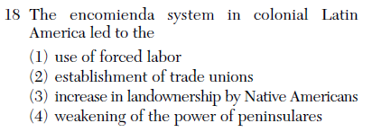

Slide 7
Life in Spanish Colonies
Social Structure
Cities
Education

Slide 8
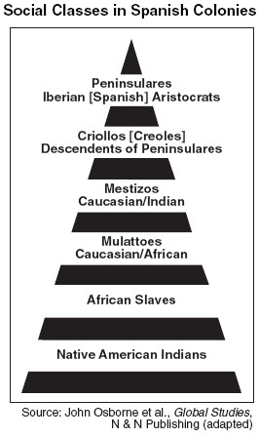
Social Structure
Peninsulares, men who were born in Spain. They were the only men who could run in office of the government.
Creoles, Spaniards born in Latin America. They couldn’t hold high-level in the political office.
Mestizos, the people of European and Native American ancestry.
Mulattos, people of both African and European descent.

Slide 9
Cities
Central cities emerged to centralize local power
Mexico City soon became the largest Spanish speaking city in the world
Universities emerged as the Church needed educated priests
Women could be educated by entering into the convent
Education

Slide 10
Education
Universities emerged as the Church needed educated priests
Women could be educated by entering into the convent

Slide 11
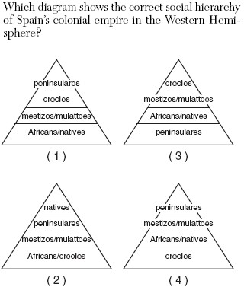

Slide 12
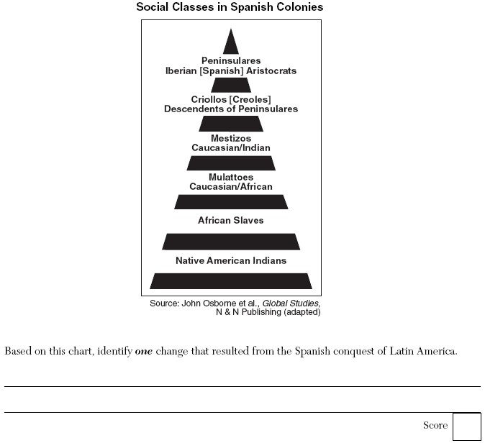

Slide 13
III. Portugal Colonizes Brazil
Brazil was granted to Portugal by a treaty with Spain
The interior of Brazil was inhospitable due to dense vegetation and climate
Exported timber and dyes, and also established plantations and cattle ranches
Natives were enslaved or displaced
Resulted in a blending of culture
Brazilians adopted Portuguese language and Catholic religion

Slide 14
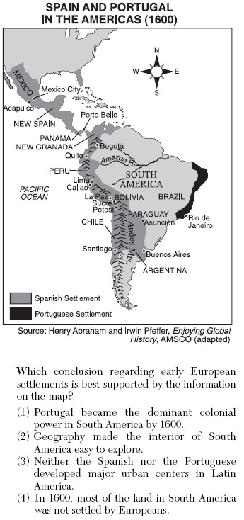

Slide 15
Essential Question
How did Spain rule its Empire in the Americas?
Homework

