Slide 1
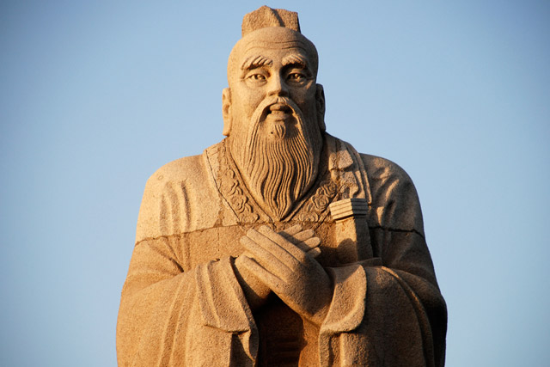
Confucianism
Global History and Geography I
Mr. Cox

Slide 2
Bellringer
What is the difference between a philosophy and a religion?
Essential Question
What were the characteristics of Confucianism?

Slide 3
I. The First Dynasties
Shang Dynasty
Zhou Dynasty
First Chinese Dynasty to control Huang He, ruled for about 600 years
Formed the foundation for the rest of the dynasties to follow.
Had similar social classes to other River Valley Civs
Problems led to downfall, and…
Zhou overthrew the Shang, used the Mandate of Heaven
Established a feudal state: local lords governed their own lands but owed military service and other support to a central ruler.
The economy greatly expanded during this time
Ironworks: tools, weapons
Coined a currency
Commerce expanded and silk was traded.
Literature was also developed

Slide 4
II. Chinese People
Referred to China as “The Middle Kingdom”
Ethnocentrism: The Chinese believed their culture was superior to all other cultures, or they were the center of the universe and all other cultures revolved around them
Occurred because of their isolation

Slide 5
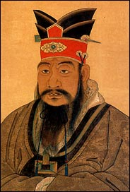
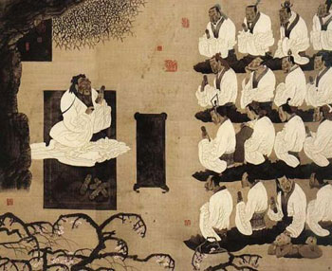
III. Confucius
Chinese philosopher – teacher of a system of ideas
Government official who became a teacher
Created a guide to understanding the nature of government and the structure of society, wrote The Analects.

Slide 6
Question to Consider….
Think about your relationships (family, friends, etc). Which is the most important to you? Why?

Slide 7
IV. Teachings
Preached the Five Key Relationships
Humanity depends on their realization
Father to son
Older brother to younger brother
Husband to wife
Ruler to subject
Friend to friend
In these relationships, he believed that the first was superior to the second.
Filial Piety – respect for parents or superiors (men were thought to be superior to women)
Civil Service: government jobs that civilians could obtain by taking an exam

Slide 8
IV. The Spread of Confucianism
Government
Ruler had an obligation to be good to people
People would then be loyal
Listen to counselors
His ideas were adapted by later emperors, especially the Han Dynasty
Legalism
Five Relationships and Filial Piety became a part of Chinese culture
Spread to the rest of the Orient, especially Korea and Japan
http://www.youtube.com/watch?v=ylWORyToTo4

Slide 10
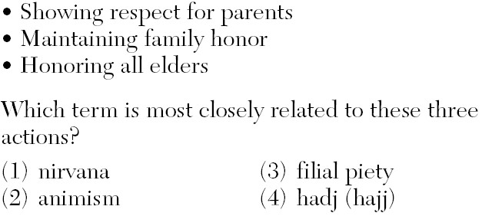

Slide 11
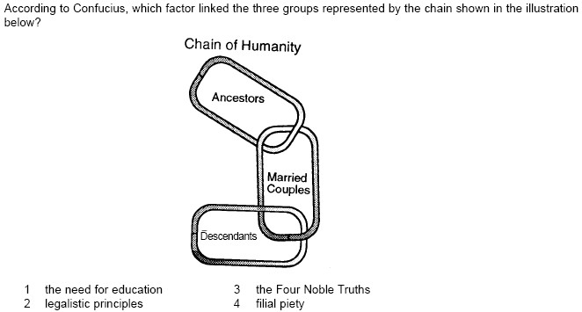

Slide 12
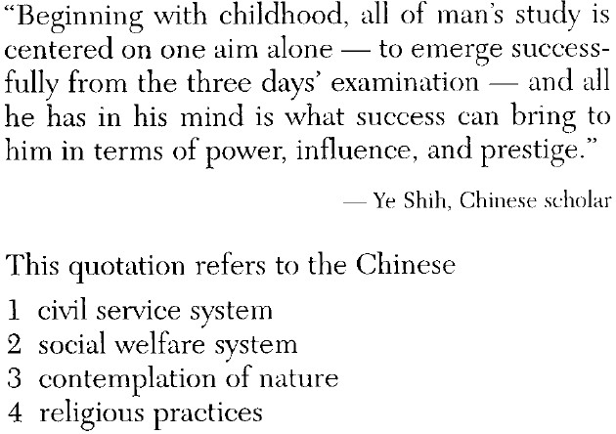

Slide 13
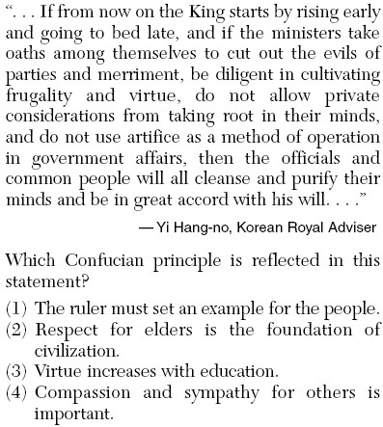

Slide 14
Essential Question
What were the characteristics of Confucianism?
https://www.youtube.com/watch?v=ylWORyToTo4

Slide 15
Reading
Confucianism today.

