Slide 1
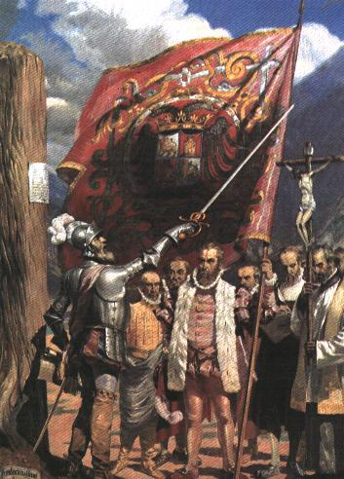
The Spanish in the Americas
Global History and Geography I
Mr. Cox

Slide 2
Bellringer
Why are Native Americans also known as ‘Indians’?
What effects did the Spanish interactions in the Americas have?
Essential Questions

Slide 3
I. First Europeans in America
Spain had first access to America because of Columbus
First meeting between Native Americans and Columbus was known as ‘The Encounter’
Friendly interactions weren't possible because of conquistadors
Occupied territory in Middle America
Converted locals to Christianity
Spread disease due to a lack of immunity, or resistance

Slide 4
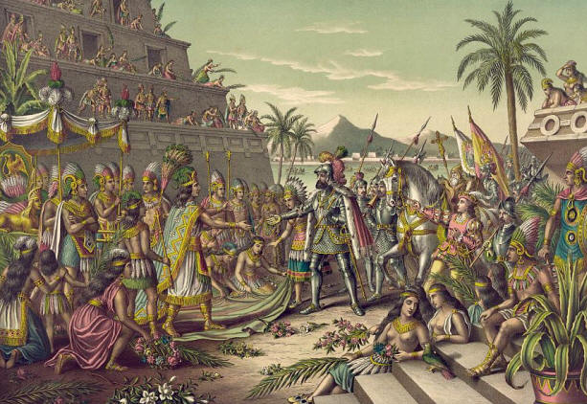
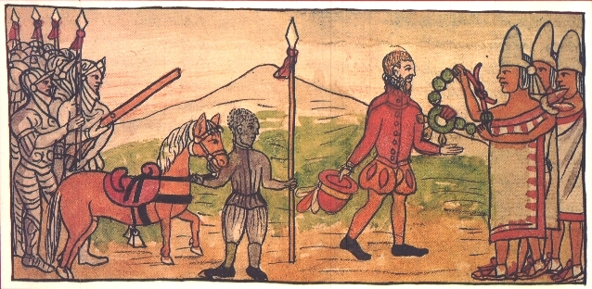
II. Conquistadors
Hernan Cortes
Landed in Mexico and rallied local people to his cause
Montezuma, the Aztec ruler, thought Cortes was a god
Spanish killed Montezuma, left to gather an army
Returned 2 years later, destroyed the capital city

Slide 5
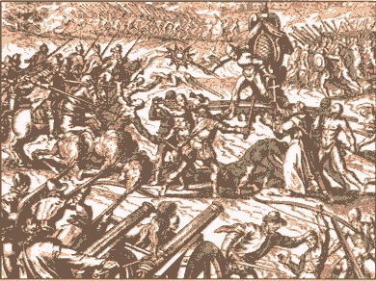
Francisco Pizarro
Arrived in Peru after an Incan civil war
Pizarro captured the Incan King and conquered the empire
By the time Pizarro was finished, Spain had occupied most of Western South America and most of Middle America

Slide 6
III. Reasons for Spanish Victory

Slide 7
III. Reasons for Spanish Victory
Superior military tactics: horse, metal armor, guns and cannons

Slide 8
III. Reasons for Spanish Victory
Superior military tactics: horse, metal armor, guns and cannons
Disunity amongst natives: rulers did not have total authority of locals

Slide 9
III. Reasons for Spanish Victory
Superior military tactics: horse, metal armor, guns and cannons
Disunity amongst natives: rulers did not have total authority of locals
Disease: no natural immunity to foreign illness allowed it to spread rapidly (i.e. Bubonic Plague)

Slide 10
III. Reasons for Spanish Victory
Superior military tactics: horse, metal armor, guns and cannons
Disunity amongst natives: rulers did not have total authority of locals
Disease: no natural immunity to foreign illness allowed it to spread rapidly (i.e. Bubonic Plague)
Native Religion: believed that the Spaniards were Gods, whose arrival marked the end of the world

Slide 11
III. Reasons for Spanish Victory
Native Religion: believed that the Spaniards were Gods, whose arrival marked the end of the world

Slide 12
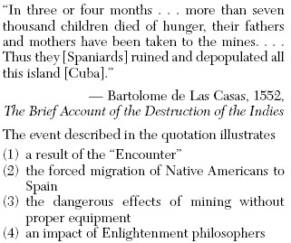

Slide 13
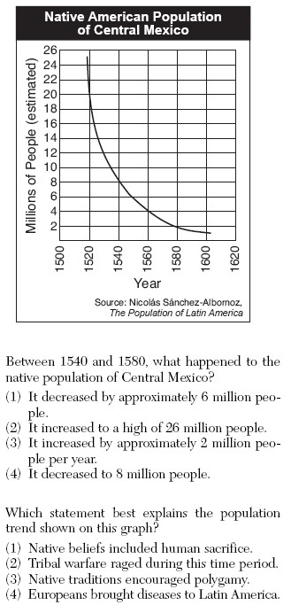

Slide 14
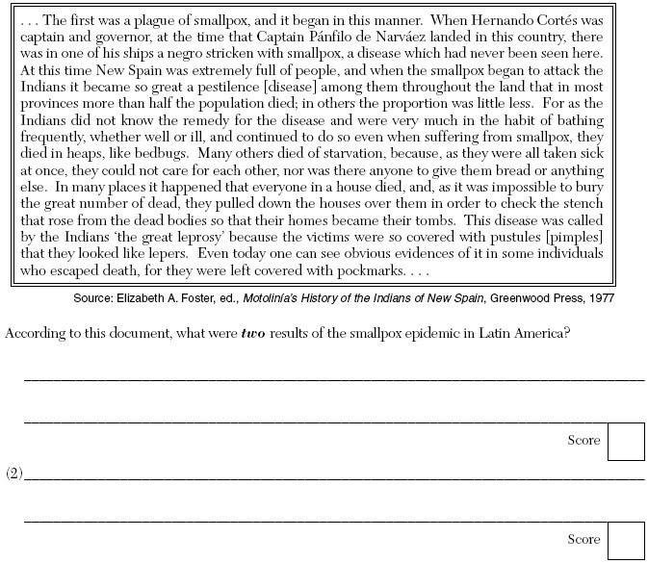

Slide 15
Essential Question
What effects did the Spanish interactions in the Americas have?
Homework

