Slide 1
Early Interactions in East Asia
Global History and Geography I
Mr. Cox

Slide 2
Bellringer
Why are Native Americans also known as ‘Indians’?
How did European countries differ in their early interactions in Asia?
What were the effects of Zheng He’s voyages?
Essential Questions

Slide 3
I. European Footholds in Asia
The Portuguese
The Dutch
The Spanish
Britain and France

Slide 4
The Portuguese
Established trading outposts throughout the Indian Ocean
Was not powerful enough to conquer large territories, but used military force when necessary to gain trading privileges with many Asian countries.

Slide 5
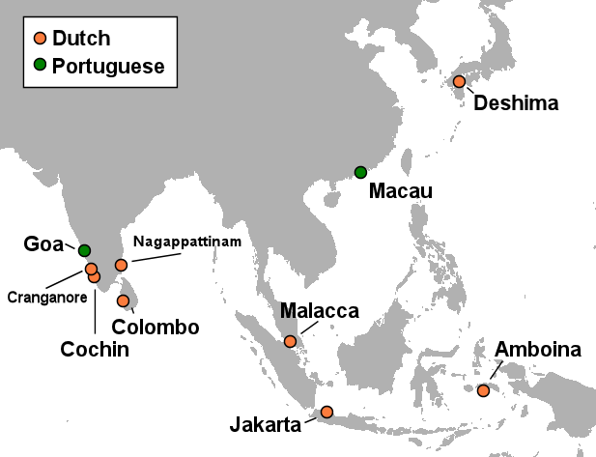
The Portuguese
The Dutch
Established trading outposts throughout the Indian Ocean
Was not powerful enough to conquer large territories, but used military force when necessary to gain trading privileges with many Asian countries.
First to challenge Portugal in Asia, they formed the Dutch East India Company to power their trade.
Established outposts, including Cape Town in modern day South Africa and much of the East Indies

Slide 6
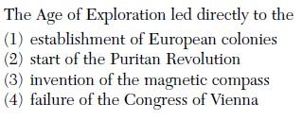

Slide 7
The Spanish
Due to the journeys of Magellan, Spain gained control of the Philippines
United the people
Spread Christianity
Linked Spanish colonies

Slide 8
Britain and France
Both countries established their own East India Trading Companies and sought control in India.
During the early-mid 1700’s Britain forced the French out and forced the Mughal Empire, which was divided between Hindu and Islamic sides, to accept them as trade partners

Slide 9
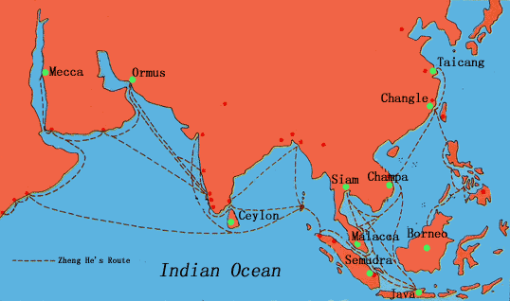
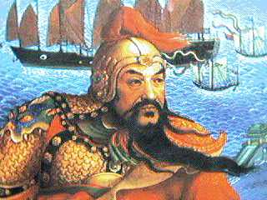
The Voyages of Zheng He
Admiral of Ming China Fleet in 1405 CE
Constructed a fleet of over 60 ships and 25,000 men
Journeyed from East China to the East Indies, SE Asia, India, Arabia, and East Africa
Establish trade with these regions
Display Chinese dominance
These voyages connected European outposts in the region to the Orient (China, Japan, Korea)

Slide 10
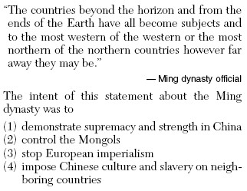

Slide 11
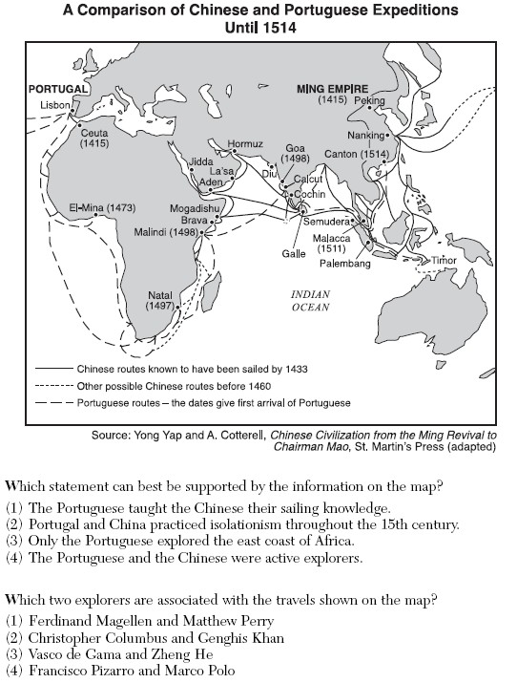

Slide 12
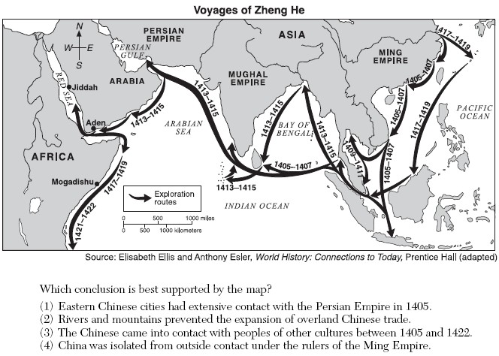

Slide 13
Essential Question
How did European countries differ in their early interactions in Asia?
What were the effects of Zheng He’s voyages?
Homework

