Slide 1
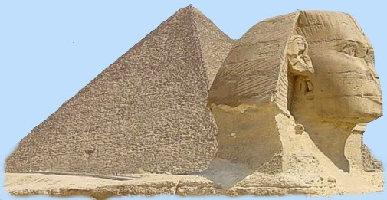
Egyptian Civilization
Global History and Geography I
Mr. Cox

Slide 2
Bellringer
What is a social structure? Do we have one in our society today?
Essential Question
How did Egyptian contributions allow historians to learn about their lives?

Slide 3
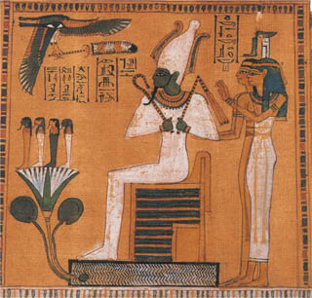
I. Egyptian Religion
Polytheistic
Amon-Re: chief god, linked to the Pharaoh.
Osiris: god of the Nile, very important to the Egyptian people.
Isis was the maternal goddess, empowering women.
Pharaoh: Had test to pass for afterlife

Slide 4
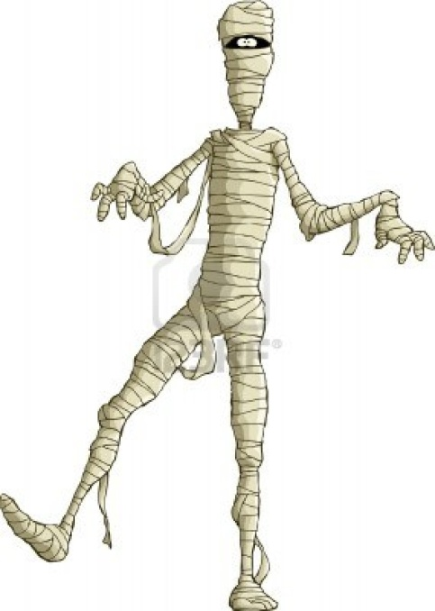
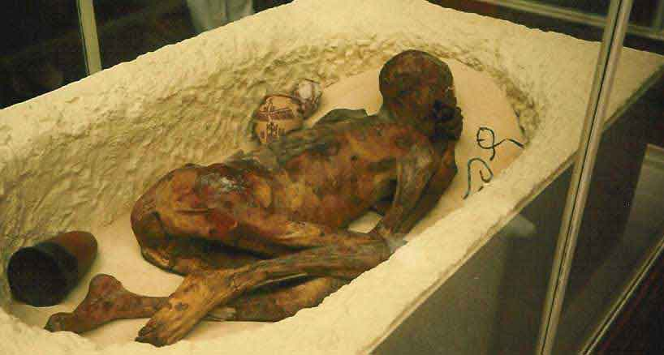
II. Mummification
Strong belief in an afterlife.
Pharaohs built Pyramids that “ascended towards the heavens.”
Mummification: preservation of the dead for their journey to the afterlife.
http://www.youtube.com/watch?v=-MQ5dL9cQX0

Slide 5
Quick Write
Why was the mummification process practiced in Egypt? Why is it significant for our study of ancient Egypt today?

Slide 6
III. Egyptian Society
Hierarchical – ranked in order
Most were peasant farmers
Slavery was very common
Prisoners of war, criminals, etc
Some women typically enjoyed a higher social rank.
Isis, goddess role

Slide 7
Draw a pyramid!

Slide 8
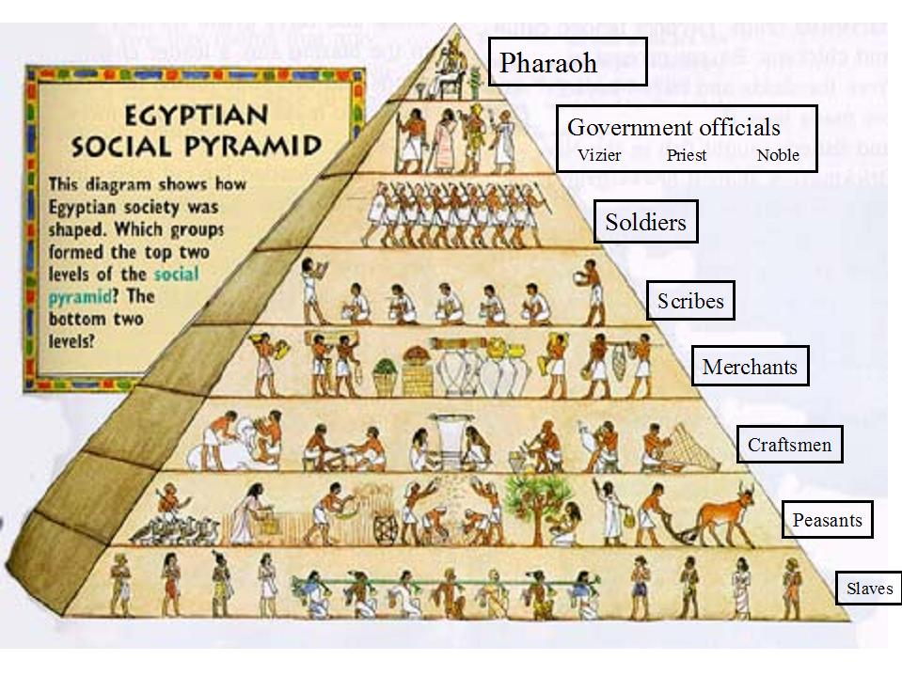

Slide 9
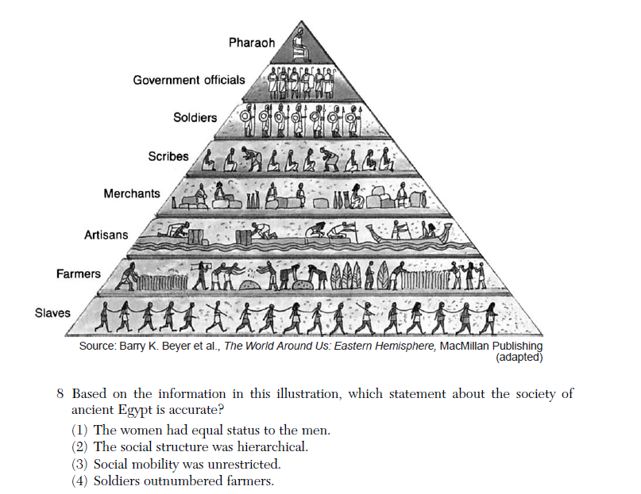

Slide 10
IV. Learning, Art, and Literature
Scribes were extremely important.
Hieroglyphics: symbol language of ancient Egypt
Papyrus: paper made from papyrus reed that grew along the Nile.
Many cultural advancements in medicine and science. (Surgery – anatomy)
Egyptian art and literature was significant, allowing historians to learn about the culture.

Slide 11
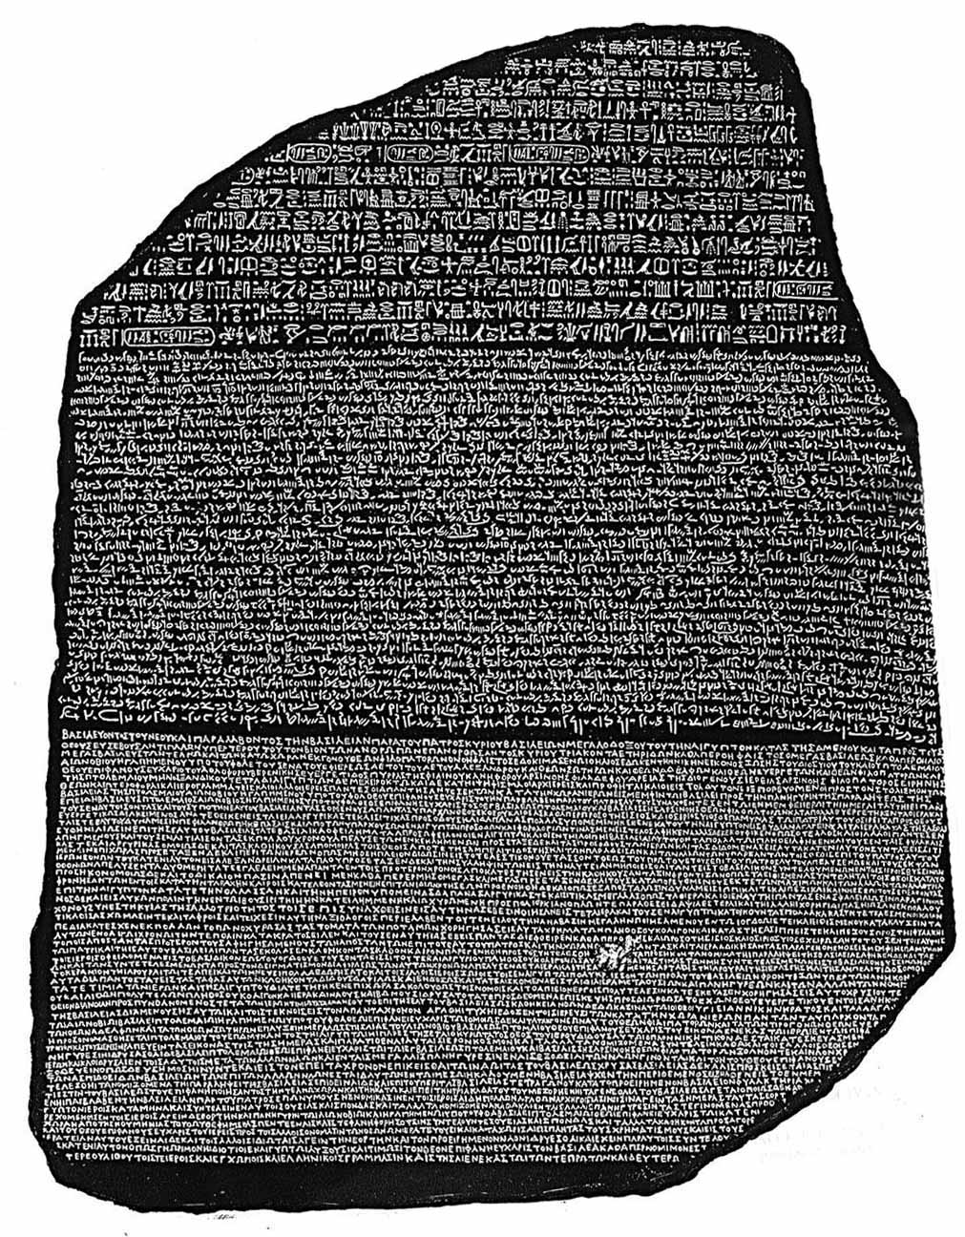
Rosetta Stone
Three written languages
Hieroglyphics
Demotic
Ancient Greek
Allowed for the learning of Egyptian writing

Slide 12
Essential Question
How did Egyptian contributions allow historians to learn about their lives?

Slide 13
