Slide 1
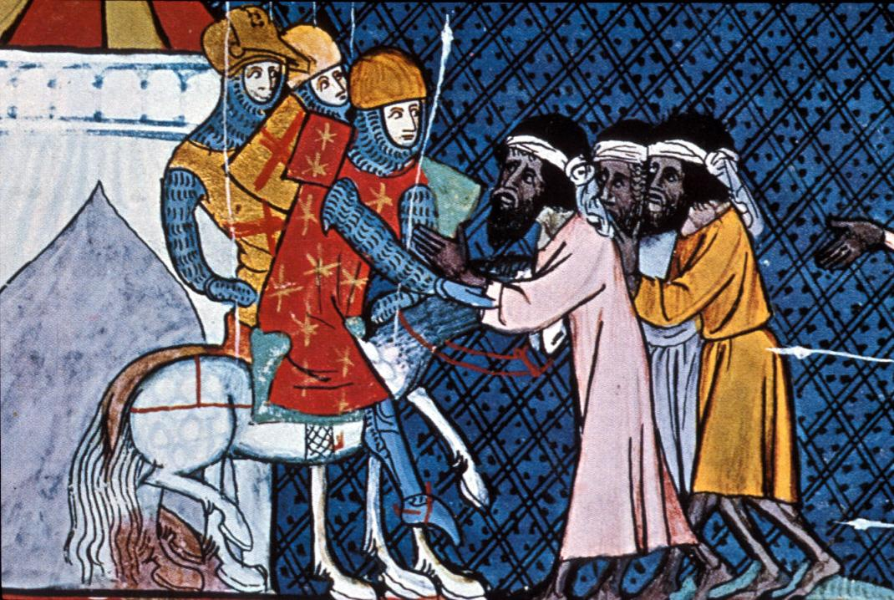
The Middle Ages Conclude (2 days)
Global History and Geography I
Mr. Cox

Slide 2
Bellringer
Review: define the term cultural diffusion.
Essential Question
Day 1 - What effect did the Crusades have on Medieval Europe?
Day 2 - How did the Crusades and Reconquista in Spain lead to cultural development in Western Europe? What effects did it have?

Slide 3
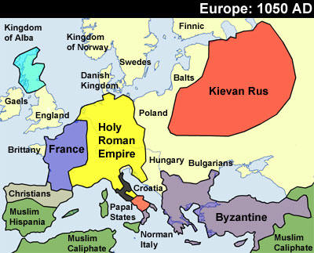
I. The ‘Dark Ages’
Compared to other civilizations of the same time period, Western Europe was far less developed.
Muslim Empires were expanding territory and trading heavily
Indian cities were thriving and developing mathematics
Chinese dynasties invented gunpowder and printing technology
West African kingdoms were spreading gold through the continent
Mayans in America were constructing huge temples and works of art
Byzantine Empire was prosperous and united, although Seljuk Turks had begun to expand into Byzantine Territory.

Slide 4
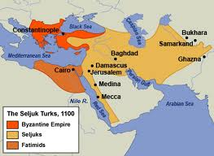
II. Europeans Begin to Expand
Seljuk Turks occupied Jerusalem and closed in on Constantinople
Pope Urban II called on nobles for aid
“God Wills It!”
Western European lords supplied knights and soldiers to reclaim the Holy Land
Why go on the Crusades?
- Pope wanted to reunite Christian Church
- Lords desired riches and new trade partners
- Serfs wished to escape poor quality of life

Slide 5
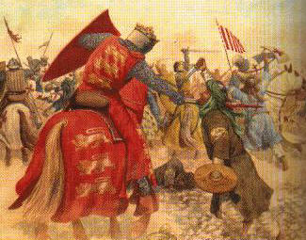
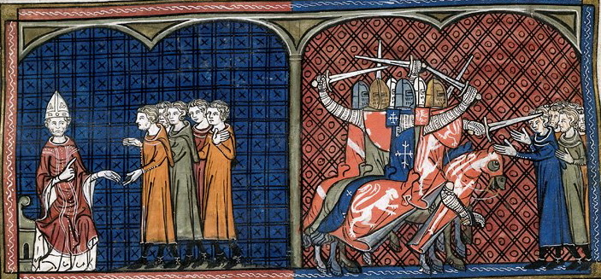
The Crusades (Cont’d)
1st Crusade
Only successful crusade, recaptured Jerusalem and slaughtered Jews and Muslims
2nd Crusade
Launched to defend Christian Kingdoms in the Middle East
3rd Crusade
Launched to defeat Salah al-Din, Muslim King who took over the Holy Land
4th Crusade
Did not even make it to Holy Land, launched to defeat Byzantine trade enemies of Venice.
Constantinople was sacked.
Many minor crusades were launched, but no further large unified efforts

Slide 6
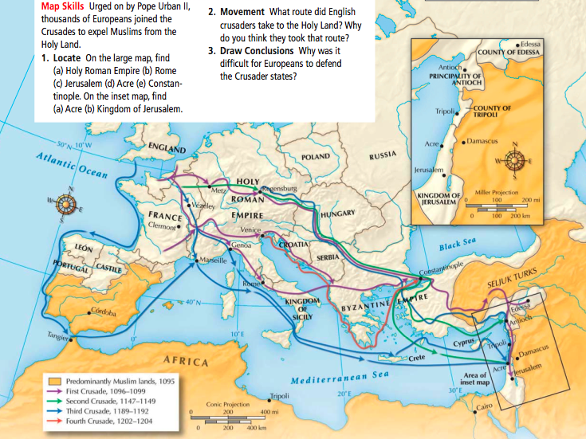

Slide 7
III. Effects of the Crusades
Economic Expansion | Increased Power for Monarchs and the Church |  | Cultural Diffusion

Slide 8
III. Effects of the Crusades
Economic Expansion | Increased Power for Monarchs and the Church |  | Cultural Diffusion
Increased trade with Muslim and Byzantine Empires Italian cities built large navies and traded extensively A common currency emerged throughout Europe

Slide 9
III. Effects of the Crusades
Economic Expansion | Increased Power for Monarchs and the Church |  | Cultural Diffusion
Increased trade with Muslim and Byzantine Empires Italian cities built large navies and traded extensively A common currency emerged throughout Europe | Monarchs began to levy, or collect, taxes in order to support the wars. Kings led crusades, which added to their honor

Slide 10
III. Effects of the Crusades
Economic Expansion | Increased Power for Monarchs and the Church |  | Cultural Diffusion
Increased trade with Muslim and Byzantine Empires Italian cities built large navies and traded extensively A common currency emerged throughout Europe | Monarchs began to levy, or collect, taxes in order to support the wars. Kings led crusades, which added to their honor | Public support for the crusades increased power of the Church. Did not end split in Christianity, however

Slide 11
III. Effects of the Crusades
Economic Expansion | Increased Power for Monarchs and the Church |  | Cultural Diffusion
Increased trade with Muslim and Byzantine Empires Italian cities built large navies and traded extensively A common currency emerged throughout Europe | Monarchs began to levy, or collect, taxes in order to support the wars. Kings led crusades, which added to their honor | Public support for the crusades increased power of the Church. Did not end split in Christianity, however | Europeans became exposed to new cultures, goods, etc Explorers and traders began to reach new cultures, most notably Marco Polo with China
http://www.youtube.com/watch?v=X0zudTQelzI

Slide 12
Essential Question
What effect did the Crusades have on Medieval Europe?
Crusades map (pg. 217)
Homework

Slide 13
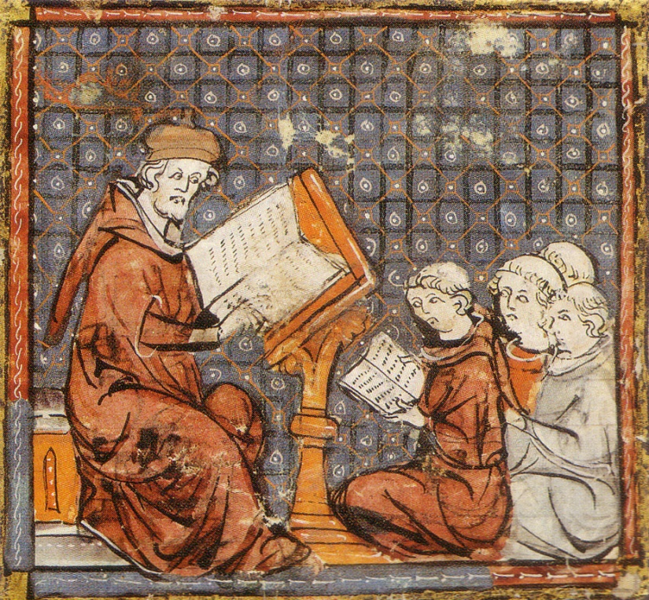
The Middle Ages Conclude (2 days)
Global History and Geography I
Mr. Cox

Slide 14
Bellringer
Review: What effect did the Crusades have on Medieval Europe?
Essential Question
How did the Crusades and Reconquista in Spain lead to cultural development in Western Europe? What effects did it have?

Slide 15
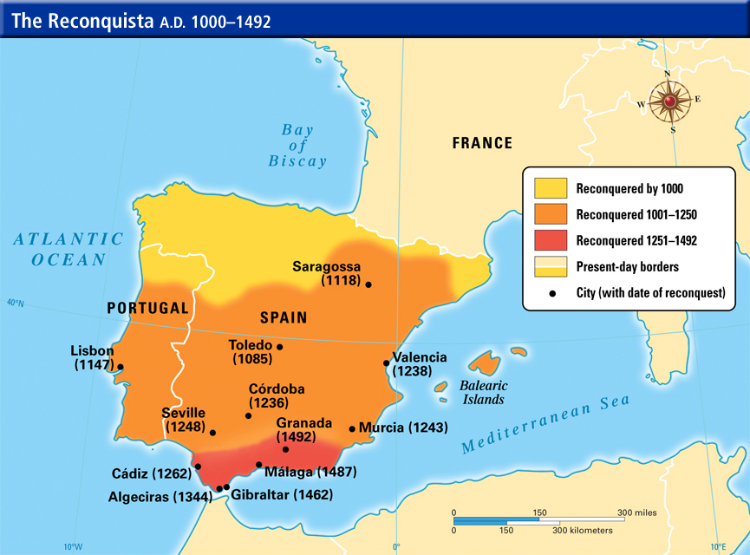
IV. Reconquista in Spain
Muslims and Christian Kingdoms in Spain
Crusades occur and begin to arouse Christian efforts to re-conquer Spain
Christians gain further advantages as Ferdinand and Isabella, Christian Spanish royals, marry and unite Spanish Christians
Under the rule of Ferdinand and Isabella, Spanish Christians and Muslims live together under a policy of religious toleration

Slide 16
V. Medieval Contributions: Effects of Cultural Diffusion
Learning | Literature | Architecture and Art

Slide 17
V. Medieval Contributions: Effects of Cultural Diffusion
Learning | Literature | Architecture and Art
Universities, or academic guilds, began to emerge to educate people for state and Church positions. Europeans began to adopt many Muslim, Greek, and Roman ideas into their learning Scholasticism: use of reason and logic to support Christian ideas. Thomas Aquinas, Summa Theologica – faith and reason exist in harmony

Slide 18
V. Medieval Contributions: Effects of Cultural Diffusion
Learning | Literature | Architecture and Art
Universities, or academic guilds, began to emerge to educate people for state and Church positions. Europeans began to adopt many Muslim, Greek, and Roman ideas into their learning Scholasticism: use of reason and logic to support Christian ideas. Thomas Aquinas, Summa Theologica – faith and reason exist in harmony | Began to be written for the everyday person, or vernacular These writings were epics, or long narrative poems about lords and ladies Geoffrey Chaucer’s Canterbury Tales and Dante’s Divine Comedy

Slide 19
V. Medieval Contributions: Effects of Cultural Diffusion
Learning | Literature | Architecture and Art
Universities, or academic guilds, began to emerge to educate people for state and Church positions. Europeans began to adopt many Muslim, Greek, and Roman ideas into their learning Scholasticism: use of reason and logic to support Christian ideas. Thomas Aquinas, Summa Theologica – faith and reason exist in harmony | Began to be written for the everyday person, or vernacular These writings were epics, or long narrative poems about lords and ladies Geoffrey Chaucer’s Canterbury Tales and Dante’s Divine Comedy | Buildings were built using solid stone influenced by Rome with thick walls and high ceilings. Gothic style featured the flying buttress, or external stone supports Churches began to feature stained glass designs Books became illuminated, or extensively illustrated in an artistic fashion

Slide 20
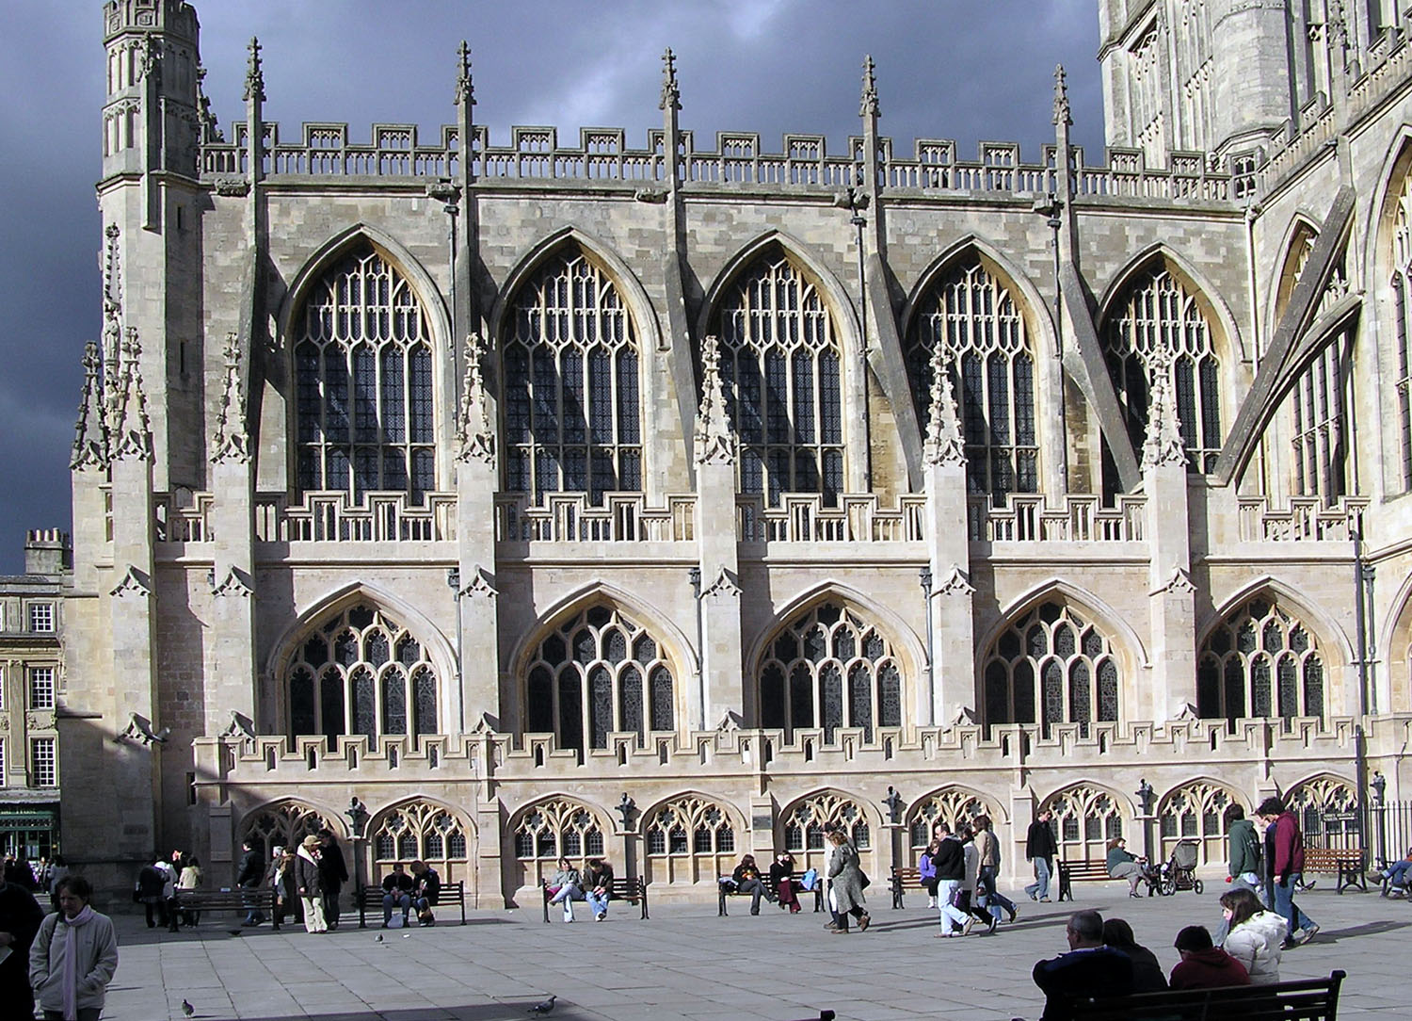
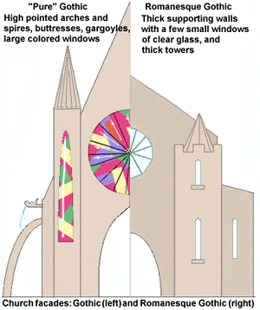
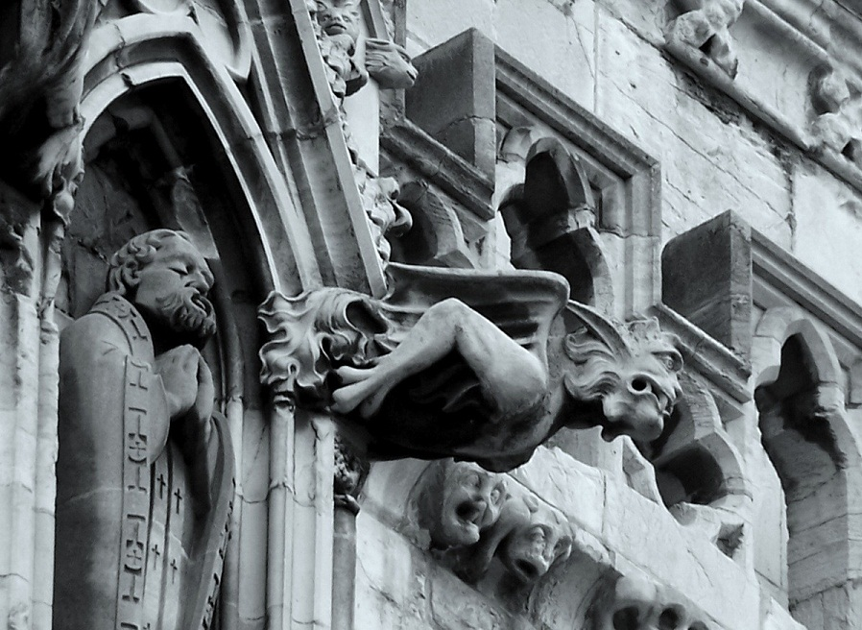

Slide 21
Essential Question
How did the Crusades and Reconquista in Spain lead to cultural development in Western Europe? What effects did it have?
Homework

