Slide 1
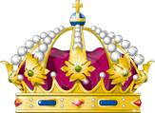
The Age of Absolute Monarchs in Europe: Charles V, Phillip II, and The Spanish Empire
Global History and Geography I
Mr. Cox

Slide 2
Bellringer
Review: What was the Mandate of Heaven in Dynastic China?
How did Absolute Monarchs in Spain gain power?
Essential Question

Slide 3
I. Age of Absolutism
Same time as Renaissance and Global Age
Expansion of the power of Monarchs in Europe
Became ‘Absolute’, or total, rulers of their individual kingdoms
Legitimized their reign by claiming divine right, or the belief that the monarch’s authority to rule came from God
Occurred in England, France, Prussia, Spain, Russia, Austria, Poland, and Sweden.

Slide 5
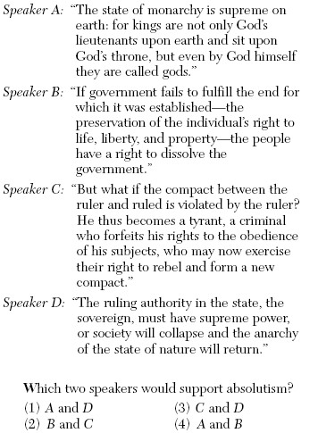

Slide 6
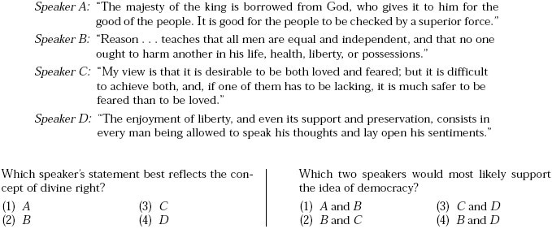

Slide 7
II. Charles V of Spain and Austria
Son of Ferdinand/Isabella as well as heir to the Austrian Hapsburg Empire, attempted to rule both
In Spain, Charles continued the trend of funding global exploration
The Hapsburg Empire was under duress
Invasions from the Ottoman Turks
German protestant rebellions
Charles divided his empire
The Hapsburg lands in Central Europe to his brother, Ferdinand
Spanish territory in Europe and overseas to his son, Phillip II
https://www.youtube.com/watch?v=MRYzW3BSj0I

Slide 8
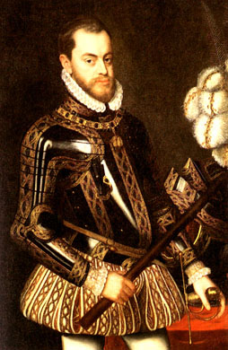
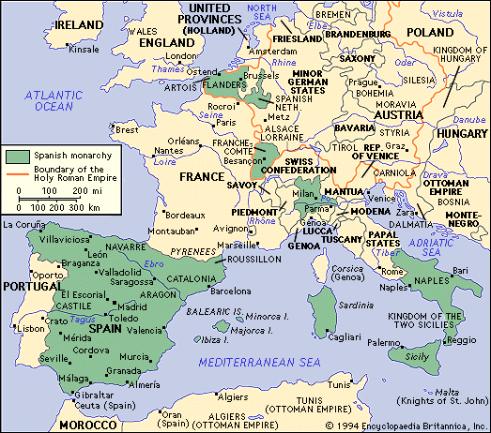
III. Phillip II
Greatly expanded his empire during his 42 year reign
Saw himself as a guardian of the Catholic Church, continued inquisition against any non-Catholics
Fought many wars during his reign
Ottoman naval fleet
Suppressed protestant revolts in the Netherlands

Slide 9
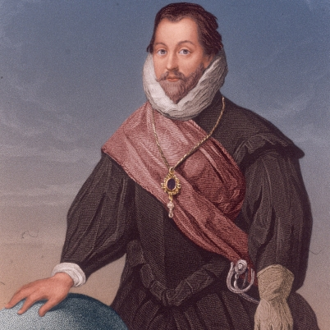
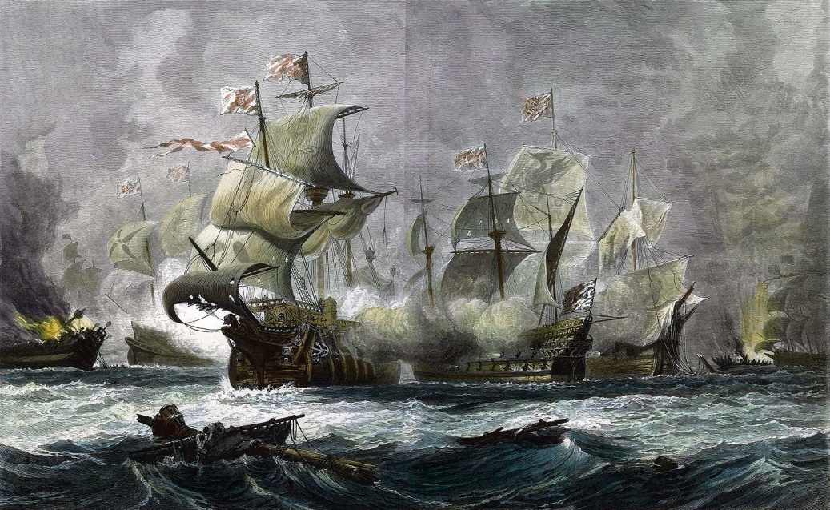
Clashes with England
Phillip despised Elizabeth I
English ‘Sea Dogs’ raided Spanish ships and cities
In response, Phillip prepared a massive armada, or naval fleet, to attack England
Fleet was destroyed by the weather of the English Channel and by Sir Francis Drake
Spanish naval power still remained supreme for a number of years, however

Slide 10
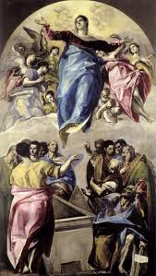
IV. Accomplishments and Decline
Spanish Empire reigned supreme globally from 1550-1650
Painters: El Greco (‘The Greek’)
Writers: Cervantes (Don Quixote)
Decline
Costly overseas wars
Inflation (silver)
Domestic Economic issues
Few capable rulers after Phillip II

Slide 11
Essential Question
How did Absolute Monarchs in Spain gain power?
Homework

