Slide 1
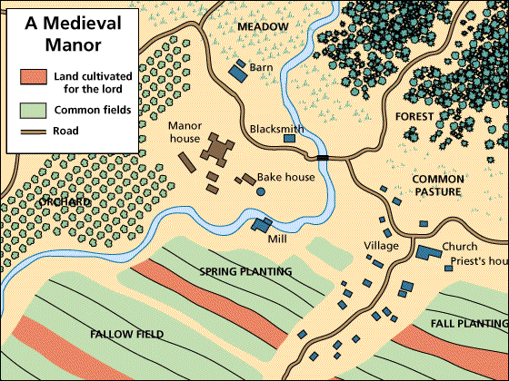
Feudal Life on the Medieval Manor
Global History and Geography I
Mr. Cox

Slide 2
Bellringer
With your partner, provide two examples of a contract.
What was the manorial system of the middle ages?
Essential Question

Slide 3
I. Reemergence of Feudalism
Feudalism – system of government where kings divided land amongst local lords.
Became necessary to fight off foreign invaders (Muslims, Vikings, etc).
Lords divided land into local estates, or fiefs, and were given to , Vassals, or land owning nobles who served as knights.

Slide 4
I. Reemergence of Feudalism
This forged a feudal contract the lords and the vassals.
Lord granted fief to vassal, and in exchange the vassal would govern and farm the land as well as protecting those who worked it

Slide 5
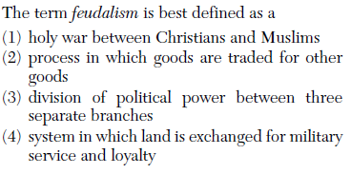

Slide 6
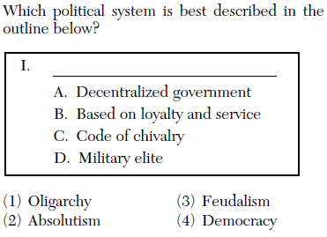

Slide 8
II. Medieval Class Structure
King
Vassal (Knights)
Serfs (Peasants)
Lord

Slide 9
II. Medieval Class Structure
King
Vassal (Knights)
Serfs (Peasants)
Lord
Land

Slide 10
II. Medieval Class Structure
King
Vassal (Knights)
Serfs (Peasants)
Lord
Land
Land (Fief)

Slide 11
II. Medieval Class Structure
King
Vassal (Knights)
Serfs (Peasants)
Lord
Land
Land (Fief)
Protection

Slide 12
II. Medieval Class Structure
King
Vassal (Knights)
Serfs (Peasants)
Lord
Land
Land (Fief)
Goods/Services
Protection

Slide 13
II. Medieval Class Structure
King
Vassal (Knights)
Serfs (Peasants)
Lord
Land
Military Service
Land (Fief)
Goods/Services
Protection

Slide 14
II. Medieval Class Structure
King
Vassal (Knights)
Serfs (Peasants)
Lord
Money and Knights
Land
Military Service
Land (Fief)
Goods/Services
Protection

Slide 15
Quickwrite
What is a feudal contract?

Slide 16
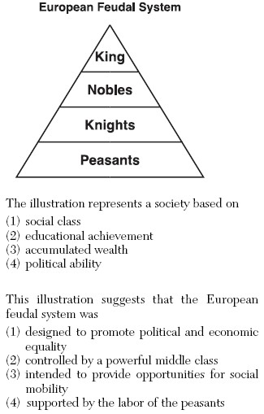

Slide 17
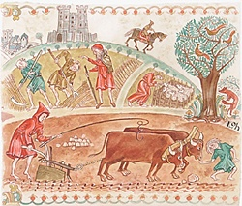
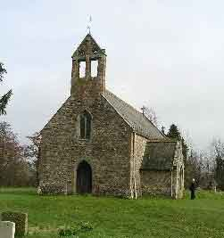
III. The Manor System
The heart of the Medieval society and economy
The manor was the Vassal’s fief upon which the serfs, or peasants, lived.
These serfs were bound to the land, though they were not slaves either.
They were required to work in order to obtain protection and food, or face death as the alternative.

Slide 18
III. The Manor System
Manors were self sufficient, containing most anything necessary to life, including a church.

Slide 19
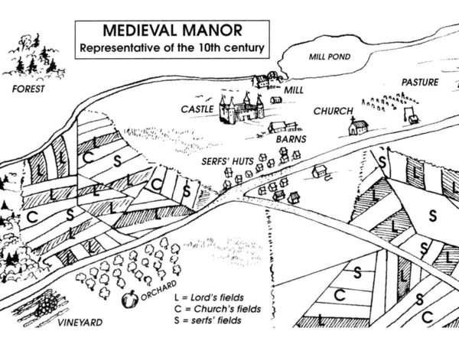

Slide 20
IV. The Church in Medieval Life
Lets face it, serfs did not really have a great life during this time.
The Christian church was a source of hope for salvation and a promise of a better life after they die.
Chapels began to arise on many manors
Social centers
Schools
Required members of the parish, or religious community, to pay a tithe, or tax equal to a tenth of their income

Slide 21
Essential Question
What was the manorial system of the middle ages?
Homework

