Slide 1
Mesopotamia
Global History and Geography I
Mr. Cox

Slide 2
Bellringer
Define the term fertile in your own words.
Essential Question
How did Civilization emerge in the fertile crescent?

Slide 3
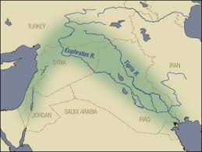
I. The Fertile Crescent
“The Land Between the Rivers”
Tigris and Euphrates Rivers
Modern day Iraq
Flooding + irrigation = agriculture
City-states emerged

Slide 4
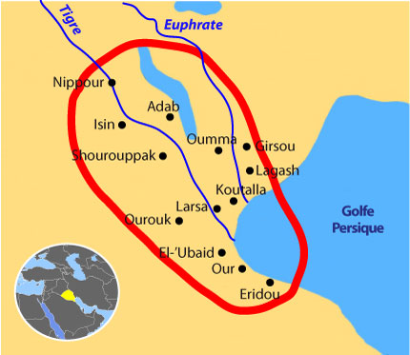
II. Sumer
A collection of city-states
Had a social hierarchy, or ranking system.
Peasants – Middle Class (scribes/merchants) – Ruling Class (Emperor, ruling family, priests)

Slide 5
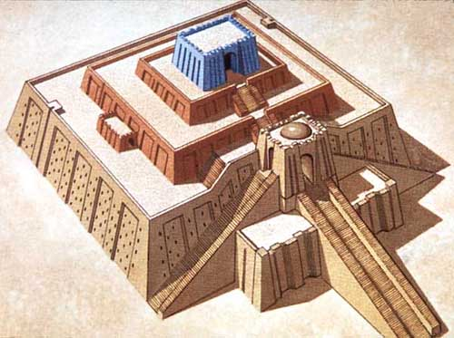
Religion – polytheistic
Ritualistic in nature
Sacrifices to the gods
Ziggurats: large temple in the center of cities

Slide 6
Quick Write
What are some similarities between the ancient Egypt and Sumer? Compare your answers with your neighbor when finished.

Slide 7
III. Fall of Sumer
Lack of unity, were exposed to attack
Fell to foreign invaders
The Babylonian Empire then controlled the Fertile Crescent for many years after.

Slide 8
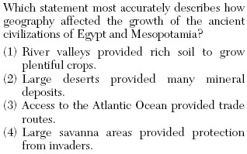

Slide 9
http://www.youtube.com/watch?v=w8v2vRlLL58

Slide 10
Essential Question
How did Civilization emerge in the fertile crescent?

