Slide 1
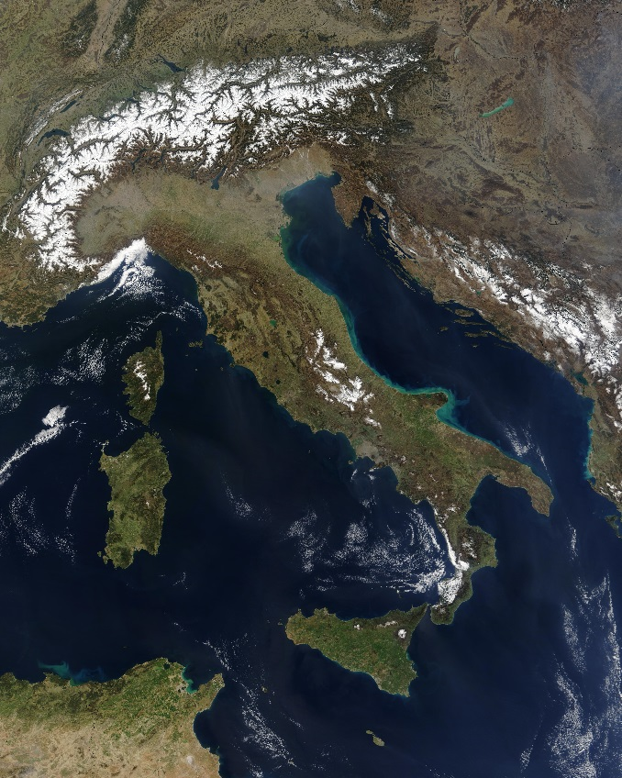
The Rise of Rome
Global History and Geography I
Mr. Cox

Slide 2
Bellringer
What kind of government do we have in America today?
Essential Questions
How did the geography of Italy contribute to the rise of ancient Rome?
How was Rome’s Republic different from the Athenian Democracy?

Slide 3
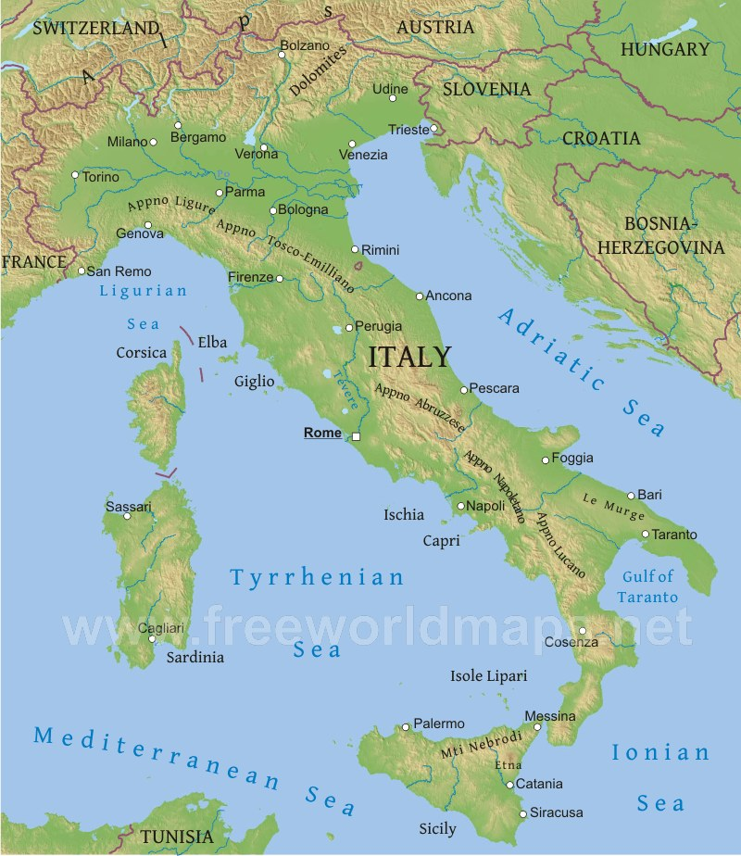
I. The Italian Peninsula
South Central Europe, “The Boot”
Four Seas: Adriatic, Ionian, Tyrrhenian, Mediterranean
Apennine Mountains, center.
Fertile plains on either side, Rome on the west coast
Easier to unite, not an archipelago

Slide 4
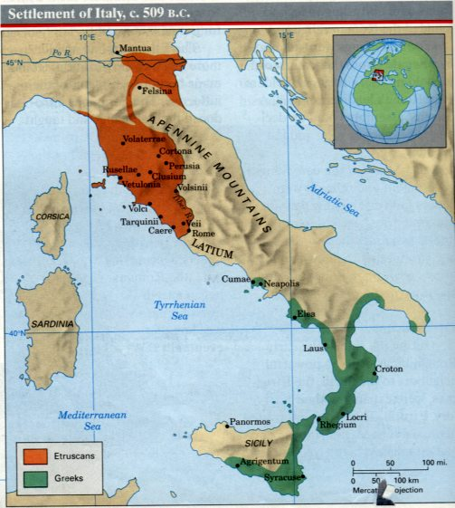
II. Early Peoples
The Latins, 800 BC on Tiber River
The Etruscans ruled much of Italy, and Greeks settled in the south
Carthaginians from North Africa settled on islands of Sicily and Sardinia
Romans forced them both out in 509 BC

Slide 5
Quickwrite
How did the geography of Italy allow Romans to unite?

Slide 6
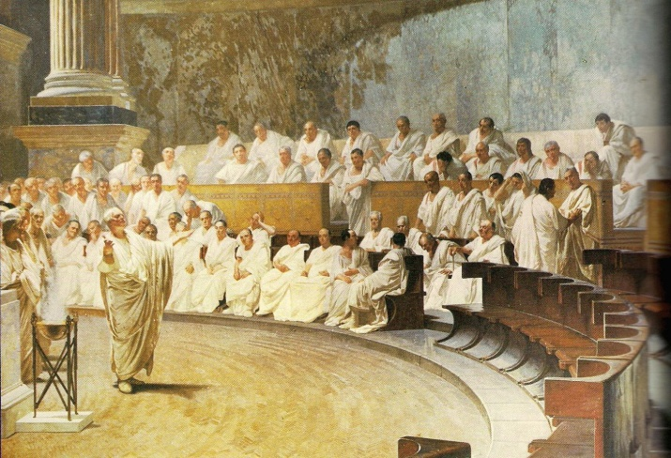
III. Early Society
Social Structure
Plebeians: “working class”
Patricians: land-owning upper class
The Republic
Government of the people
Law makers were mostly patricians
Governing body called the Senate, could choose a dictator, or ruler with complete control, in war time
Tribunes: elected by the plebeians to veto, or block, the acts of the patricians

Slide 7
Essential Question
How did the geography of Italy contribute to the rise of ancient Rome?
How was Rome’s Republic different from the Athenian Democracy?
Homework
Google Docs: Research the following topics and submit a one paragraph summary of each. Be sure to provide a link to a reputable source (library databases!!) for each paragraph.
The Myth of Romulus and Remus
The Twelve Tables

