Slide 1
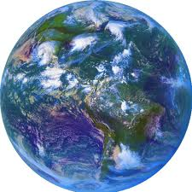
Geography
Global History and Geography I

Slide 2
Bellringer
What is Geography? Define the term in your own words.
Essential Question
What is Geography and what are the proper ways to read a map?

Slide 3
I. What is Geography?

Slide 4
I. What is Geography?
Geo – the earth

Slide 5
I. What is Geography?
Geo – the earth graphy – to describe

Slide 6
I. What is Geography?
Geo – the earth graphy – to describe
Geography = to describe the earth

Slide 7
I. What is Geography?
Geo – the earth graphy – to describe
Geography = to describe the earth
Geography can include the following fields of study

Slide 8
I. What is Geography?
Geo – the earth graphy – to describe
Geography = to describe the earth
Geography can include the following fields of study
Physical (landforms, plants/animals, tectonics, etc)

Slide 9
I. What is Geography?
Geo – the earth graphy – to describe
Geography = to describe the earth
Geography can include the following fields of study
Physical (landforms, plants/animals, tectonics, etc)
Human (Populations, countries, cities, culture, etc)

Slide 10
I. What is Geography?
Geo – the earth graphy – to describe
Geography = to describe the earth
Geography can include the following fields of study
Physical (landforms, plants/animals, tectonics, etc)
Human (Populations, countries, cities, culture, etc)
Cartography (maps, GIS, etc)

Slide 11
I. What is Geography?
Geo – the earth graphy – to describe
Geography = to describe the earth
Geography can include the following fields of study
Physical (landforms, plants/animals, tectonics, etc)
Human (Populations, countries, cities, culture, etc)
Cartography (maps, GIS, etc)
Focuses on the study of human’s relationship with the Earth (Human-Environmental Interactions)

Slide 13
II. The Tools of a Geographer

Slide 14
II. The Tools of a Geographer
Maps – a visual representation of real world phenomena on a condensed scale.

Slide 15
II. The Tools of a Geographer
Maps – a visual representation of real world phenomena on a condensed scale.
Large Scale Maps – cities and villages

Slide 16
II. The Tools of a Geographer
Maps – a visual representation of real world phenomena on a condensed scale.
Large Scale Maps – cities and villages
Small Scale Maps – States and Countries

Slide 17
II. The Tools of a Geographer
Maps – a visual representation of real world phenomena on a condensed scale.
Large Scale Maps – cities and villages
Small Scale Maps – States and Countries
Physical Maps – shows natural boundaries

Slide 18
II. The Tools of a Geographer
Maps – a visual representation of real world phenomena on a condensed scale.
Large Scale Maps – cities and villages
Small Scale Maps – States and Countries
Physical Maps – shows natural boundaries
Political Map – shows boundaries based on political designation

Slide 19
II. The Tools of a Geographer
Maps – a visual representation of real world phenomena on a condensed scale.
Large Scale Maps – cities and villages
Small Scale Maps – States and Countries
Physical Maps – shows natural boundaries
Political Map – shows boundaries based on political designation
Maps are organized by lines of longitude and latitude

Slide 20
II. The Tools of a Geographer
Maps – a visual representation of real world phenomena on a condensed scale.
Large Scale Maps – cities and villages
Small Scale Maps – States and Countries
Physical Maps – shows natural boundaries
Political Map – shows boundaries based on political designation
Maps are organized by lines of longitude and latitude
Longitude – measure the distance East and West of the Prime Meridian (Greenwich)

Slide 21
II. The Tools of a Geographer
Maps – a visual representation of real world phenomena on a condensed scale.
Large Scale Maps – cities and villages
Small Scale Maps – States and Countries
Physical Maps – shows natural boundaries
Political Map – shows boundaries based on political designation
Maps are organized by lines of longitude and latitude
Longitude – measure the distance East and West of the Prime Meridian (Greenwich)
Latitude – measure the distance North and South of the Equator (Ecuador)

Slide 22
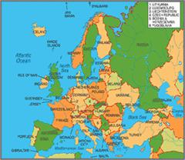
Small Scale

Slide 23
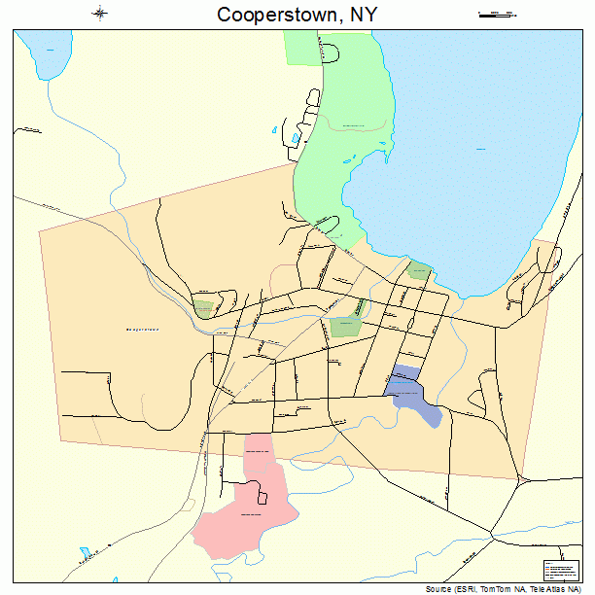
Small Scale Large Scale

Slide 24
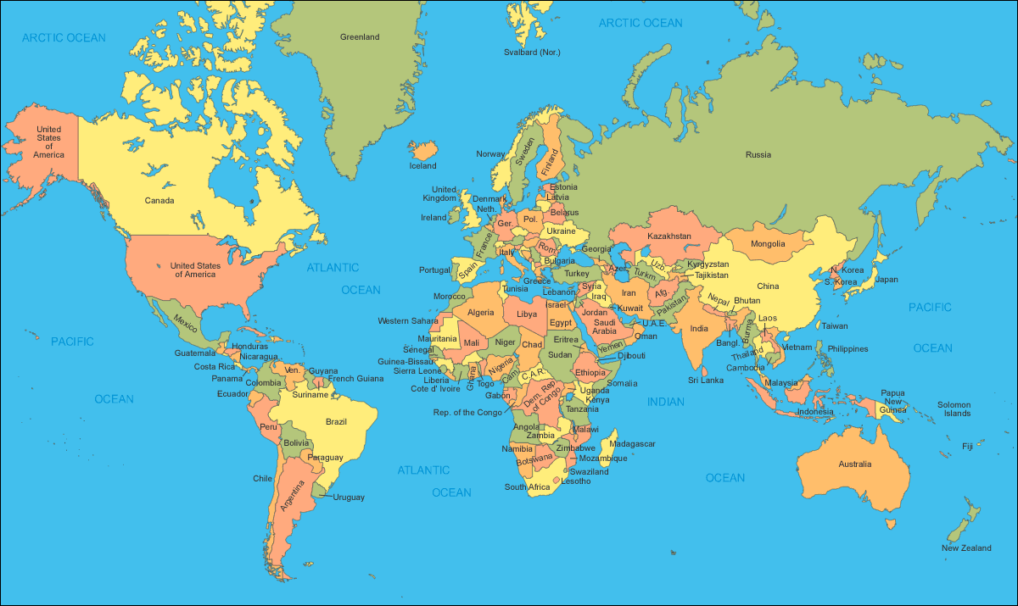
Small Scale Large Scale
Political

Slide 25
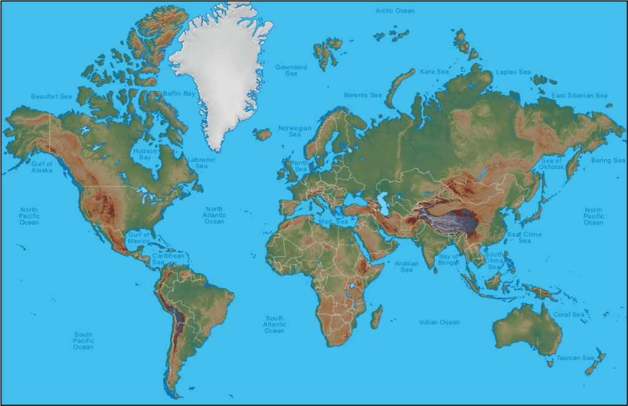
Small Scale Large Scale
Political Physical

Slide 26
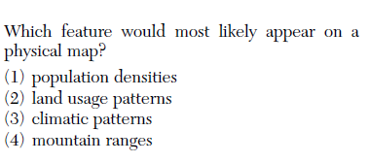

Slide 27
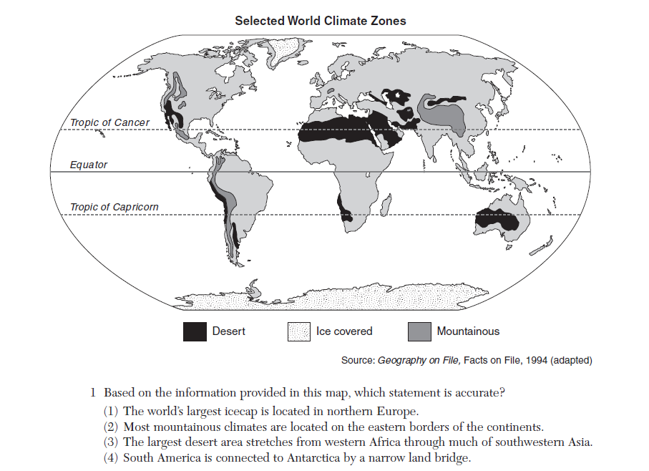

Slide 28
III. Using a Map

Slide 29
III. Using a Map (Cont’d)

Slide 30
VI. Five Themes of Geography
Location – where things are on Earth
Place – Described in Physical or human characteristics
Human-Environment Interaction – The ways in which people and the environment have impacted each other over time
Movement – The movement of people, goods, and ideas
Region – many types of regions that the world can be divided into.
Quick Write – List and explain 3 regions

Slide 31
V. Our Globe

Slide 32
V. Our Globe
Continents
Oceans

Slide 33
V. Our Globe
Continents
North America
Oceans

Slide 34
V. Our Globe
Continents
North America
South America
Oceans

Slide 35
V. Our Globe
Continents
North America
South America
Europe
Oceans

Slide 36
V. Our Globe
Continents
North America
South America
Europe
Asia
Oceans

Slide 37
V. Our Globe
Continents
North America
South America
Europe
Asia
Africa
Oceans

Slide 38
V. Our Globe
Continents
North America
South America
Europe
Asia
Africa
Australia
Oceans

Slide 39
V. Our Globe
Continents
North America
South America
Europe
Asia
Africa
Australia
Antarctica
Oceans

Slide 40
V. Our Globe
Continents
North America
South America
Europe
Asia
Africa
Australia
Antarctica
Subcontinents
Oceans

Slide 41
V. Our Globe
Continents
North America
South America
Europe
Asia
Africa
Australia
Antarctica
Subcontinents
India
Oceans

Slide 42
V. Our Globe
Continents
North America
South America
Europe
Asia
Africa
Australia
Antarctica
Subcontinents
India
Middle East
Oceans

Slide 43
V. Our Globe
Continents
North America
South America
Europe
Asia
Africa
Australia
Antarctica
Subcontinents
India
Middle East
Indonesia (Southeast Asia)
Oceans

Slide 44
V. Our Globe
Continents
North America
South America
Europe
Asia
Africa
Australia
Antarctica
Subcontinents
India
Middle East
Indonesia (Southeast Asia)
Oceans
Atlantic

Slide 45
V. Our Globe
Continents
North America
South America
Europe
Asia
Africa
Australia
Antarctica
Subcontinents
India
Middle East
Indonesia (Southeast Asia)
Oceans
Atlantic
Pacific

Slide 46
V. Our Globe
Continents
North America
South America
Europe
Asia
Africa
Australia
Antarctica
Subcontinents
India
Middle East
Indonesia (Southeast Asia)
Oceans
Atlantic
Pacific
Indian

Slide 47
V. Our Globe
Continents
North America
South America
Europe
Asia
Africa
Australia
Antarctica
Subcontinents
India
Middle East
Indonesia (Southeast Asia)
Oceans
Atlantic
Pacific
Indian
Artic

Slide 48
V. Our Globe
Continents
North America
South America
Europe
Asia
Africa
Australia
Antarctica
Subcontinents
India
Middle East
Indonesia (Southeast Asia)
Oceans
Atlantic
Pacific
Indian
Artic
Southern

