Slide 1
The Geography and Early People of the Aegean
Global History and Geography I
Mr. Cox

Slide 2
Bellringer
Define: Archipelago
Essential Question
Who were the first peoples of the Aegean? Where did their civilization develop and how did it spread?

Slide 3
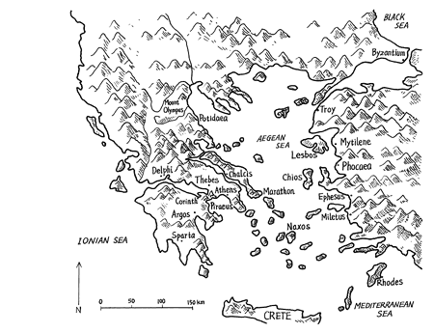
I. The Balkan Peninsula
Southeastern Europe
Mountains and valleys caused by glaciers
Seas: Aegean, Mediterranean
Gave rise to separated city states.
Seafaring people who traded (olive oil, wine, marble)

Slide 4
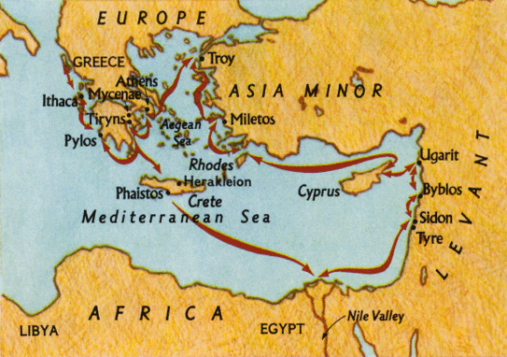
II. Phoenicians, Minoan, Mycenaean
Phoenicians
Minoan
Mycenaean
Migrated from Fertile Crescent
City-States
Rich trading culture
“Traders in Purple”
Based on the Island of Crete
Extensive trade
Palace at Knossos
Religious shrines
Colorful frescos
Migrated to Greek isles
Trojan War
- Troy: located in Turkey
Helen of Troy,
Trojan Horse

Slide 5
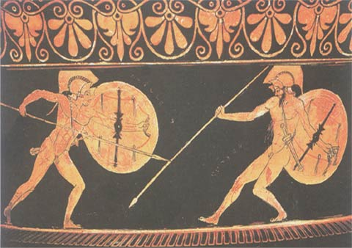
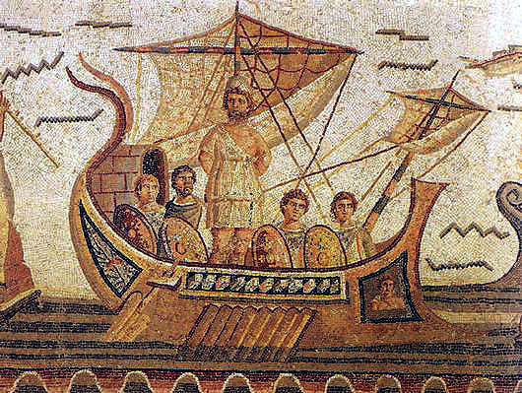
III. Homer’s Epics
Most of what we know of the war, and Greek Culture, comes from these poems
Illiad – the tale of the Trojan War
Achilles leads the Greeks to victory
Odyssey – the return journey of Odysseus, another war hero

Slide 6
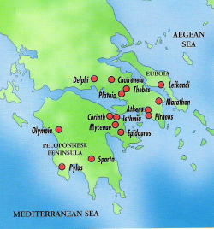
IV. The City-State
Polis: Greek term for city-state
Acropolis: ‘high city’
Contained religious temples (polytheistic)
On a hilltop
Parthenon
Main city lied below
Ruled by different governments

Slide 7
V. Early Governments
First: Monarchy
Second: Aristocracy
Third: Oligarchy
Rule by the few
Rule by the elite
Rule by a king
Fourth: Democracy
Rule by the people

Slide 8
V. Early Governments
Monarchy
Second: Aristocracy
Third: Oligarchy
Rule by the few
Rule by the elite
Rule by a king
Fourth: Democracy
Rule by the people

Slide 9
V. Early Governments
Monarchy
Aristocracy
Third: Oligarchy
Rule by the few
Rule by the elite
Rule by a king
Fourth: Democracy
Rule by the people

Slide 10
V. Early Governments
Monarchy
Aristocracy
Oligarchy
Rule by the few (small group)
Rule by the elite
Rule by a king
Rule by the people
Fourth: Democracy

Slide 11
V. Early Governments
Monarchy
Aristocracy
Oligarchy
Rule by the few (small group)
Rule by the elite
Rule by a king
Democracy
Rule by the people

Slide 12
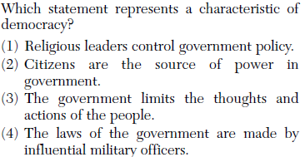

Slide 13
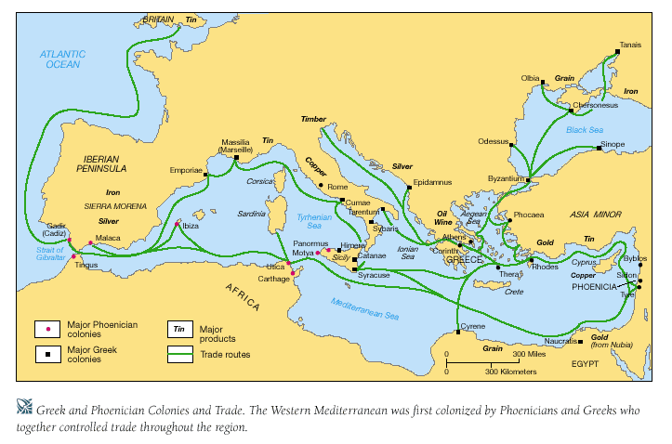
IV. The City States Unite
Common Religion
Mount Olympus
Festivals and temples
View of Non-Greeks
Barbaroi: ‘Barbarians”, those who didn’t speak Greek
Created as Greeks traded across the seas

Slide 14
Essential Question
Who were the first peoples of the Aegean? How did their civilization spread?

