Slide 1
Geography Terminology
Global History and Geography I

Slide 2
Bellringer
Define the term landform and provide three examples of what you think a landform is.
Essential Question
How does Geography terminology help us to better define and understand the Earth?

Slide 3
I. Geography Terms and Landforms

Slide 4
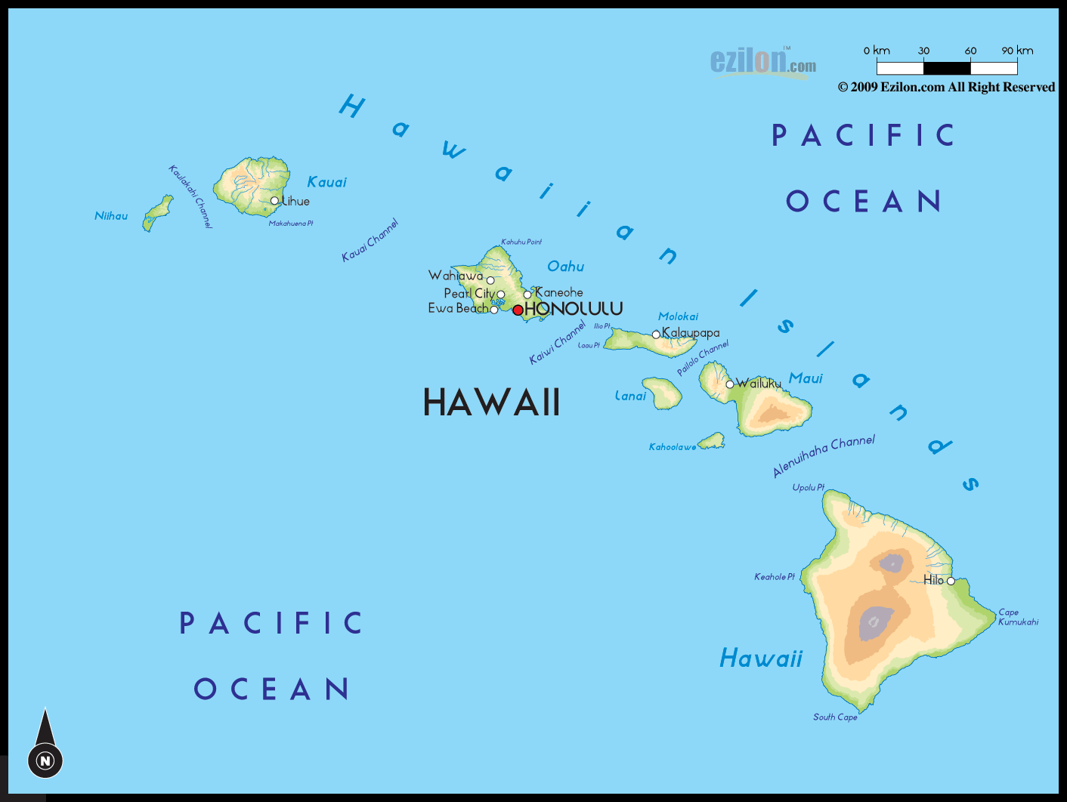
Archipelago*
A collection of islands that are close together.

Slide 5
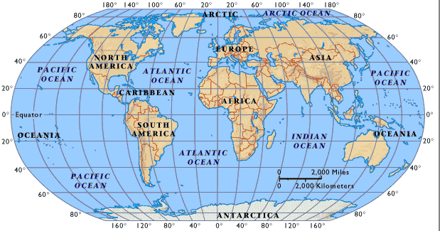
Atlas
A collection of maps with specific qualities.

Slide 6
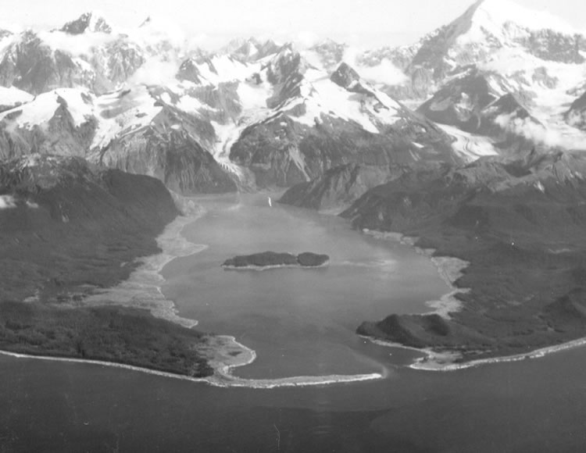
Bay and Inlet
A body of water connected to an ocean by a small waterway (inlet).

Slide 7
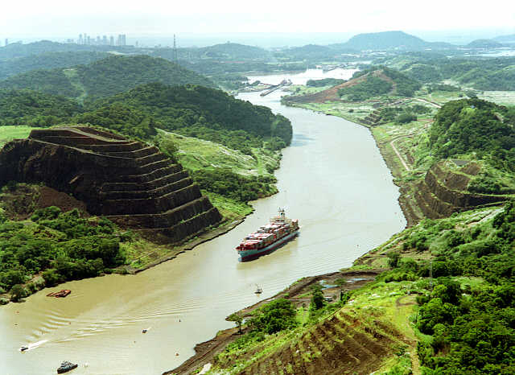
Canal
A man made river or tributary.

Slide 8
Cardinal Directions
North
East
South
West

Slide 9
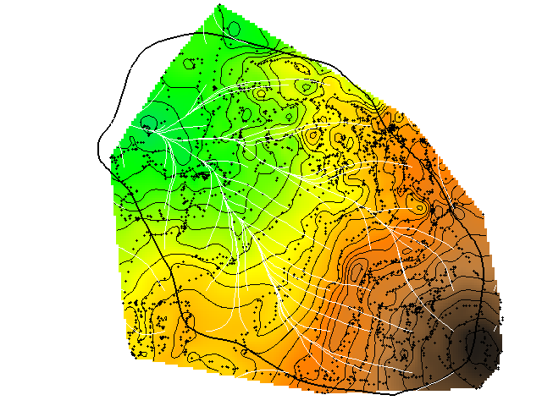
Elevation
Height or depth of land from sea level.
Elevation Map: darker brown is higher from sea level, green is closer

Slide 10
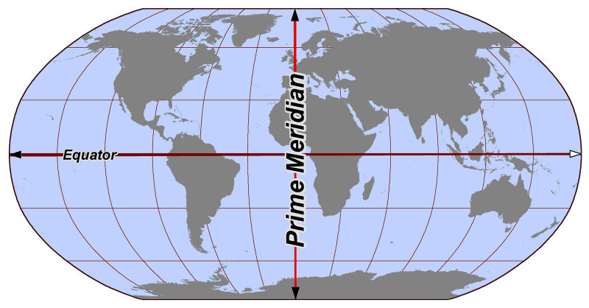
Equator and Prime Meridian
0 degrees latitude 0 degrees longitude

Slide 11
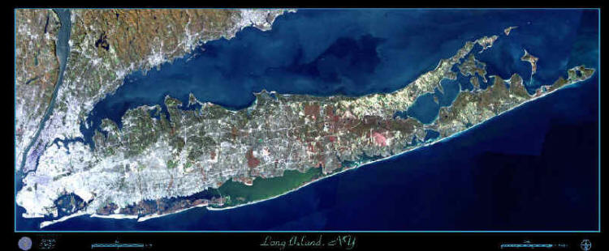
Island*
Piece of land completely surrounded by water

Slide 12
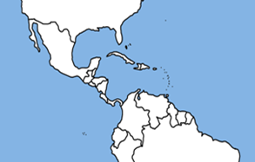
Isthmus*
Small piece of land that connects two larger land masses

Slide 13
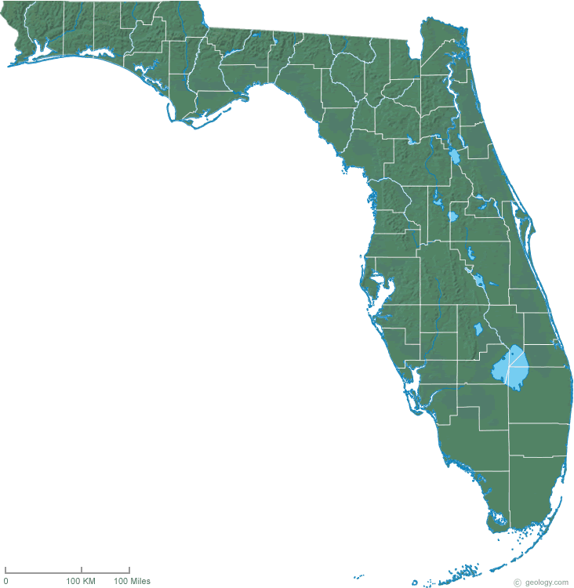
Peninsula*
A piece of land surrounded by water on three sides

Slide 14
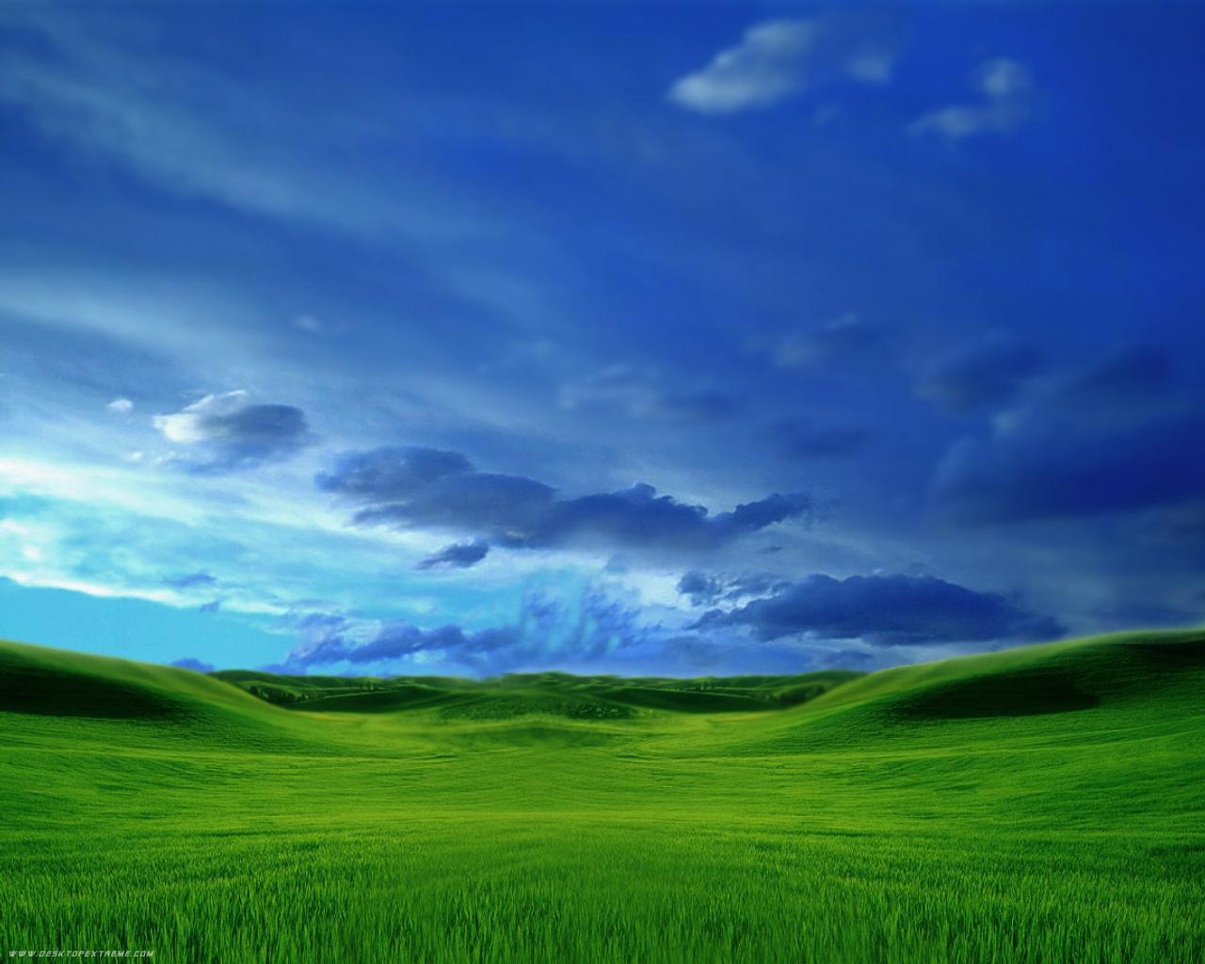
Plains*
A large flat area of land

Slide 15
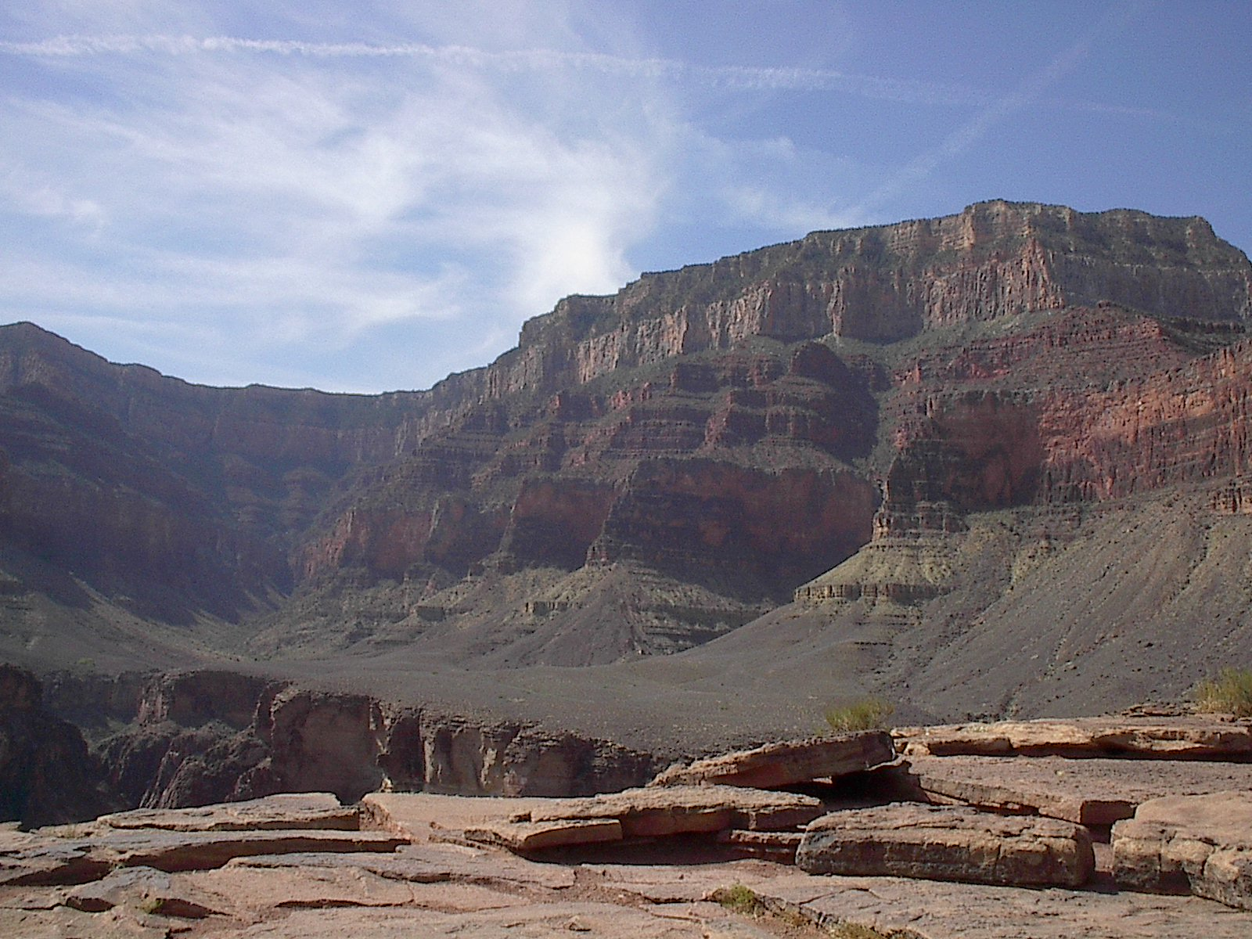
Plateaus*
A raised piece of land with a flat top

Slide 16
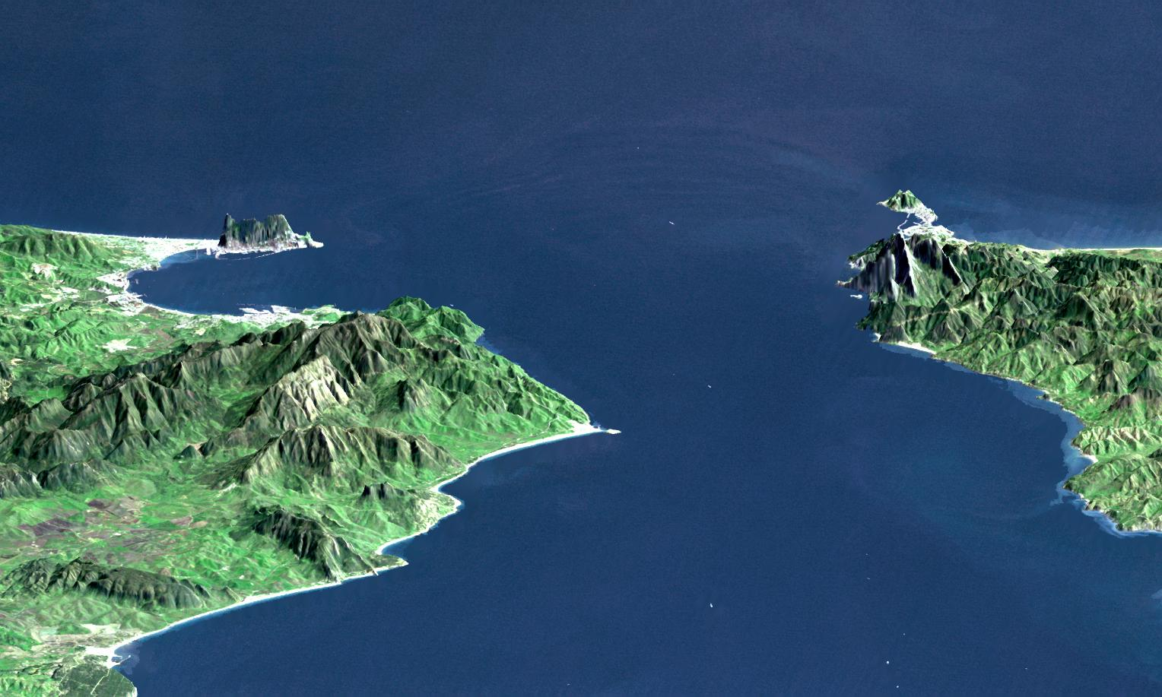
Strait*
a narrow passage of water connecting two seas or two large areas of water

Slide 17
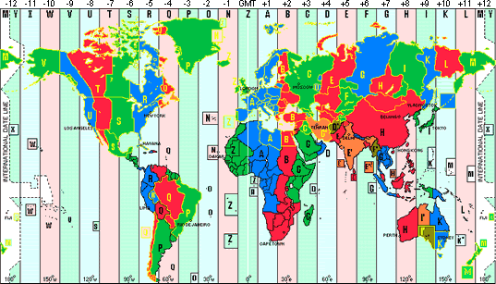
Timezones
24 time zones exist and are broken up by lines of longitude

Slide 18
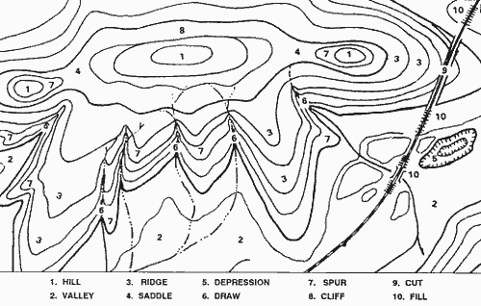
Topographical Maps
Shows elevation, closer lines depict steeper areas

Slide 19
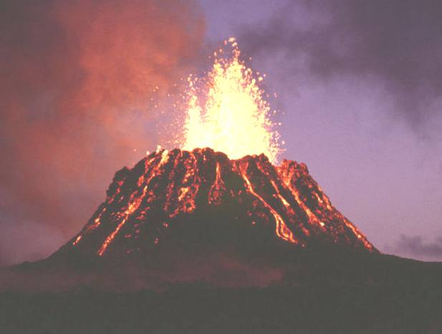
Volcano*
A raised conic hill or mountain with an opening through which magma or ash erupts through

Slide 20
Homework
Find one example of each landform mentioned in the notes on a map for homework. Only a simple label is required.

