Slide 1
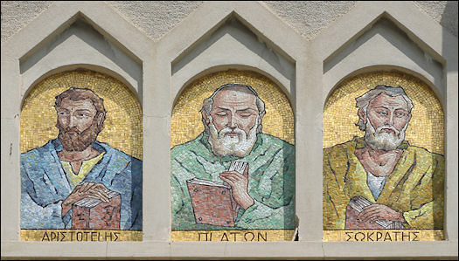
Greek Thinkers and Contributions
Global History and Geography I
Mr. Cox

Slide 2
Bellringer
Define: philosophy
Essential Question
Who were the Greek philosophers and what were their major thoughts/contributions?

Slide 3
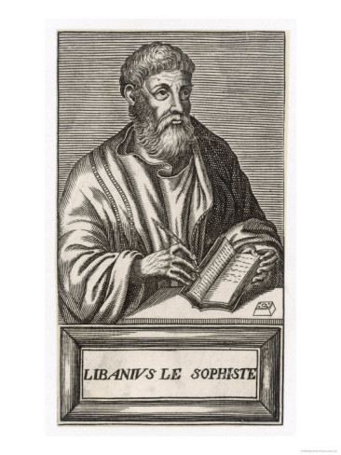
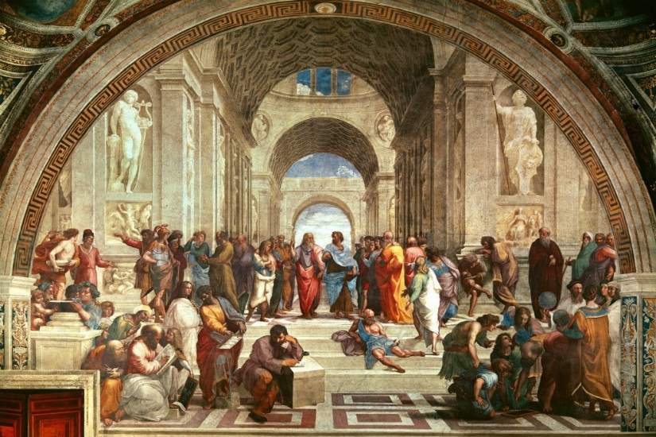
I. Sophists
Early Greek thinkers
Logic – rational thinking through reason/observation
Questioned accepted ideas
Rhetoric – art of skillful speaking

Slide 4
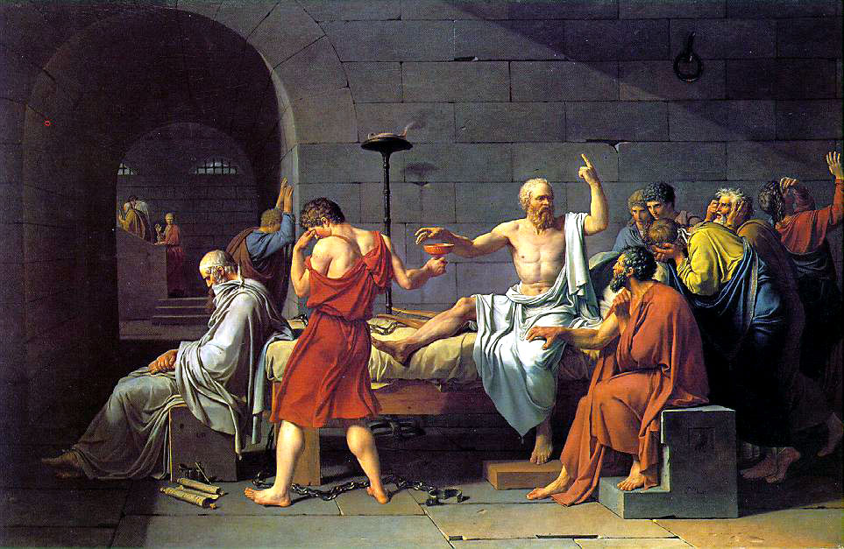
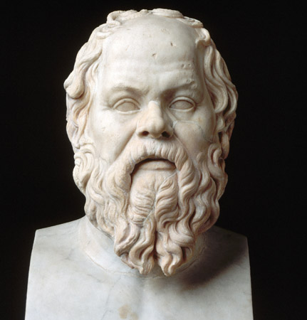
II. Socrates
Stonemason who challenged Sophists
Socratic Method – question the implications of answers
Seen as a threat to Athens
Put on trial for ‘corrupting the city’s youth’, found guilty and was put to death

Slide 5
Quickwrite
What is the Socratic method? Why was it received so poorly in ancient Greece?

Slide 6
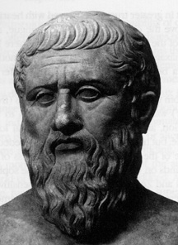
III. Plato
Socrates’ student, distrust of democracy because of his death trial
Emphasized the use of reason and rational thought. Established the Academy
The Republic – Plato describes his ideal state: heavy government, rigid classes, men better than women

Slide 7
http://www.youtube.com/watch?v=sAu-CNSh9F0

Slide 8
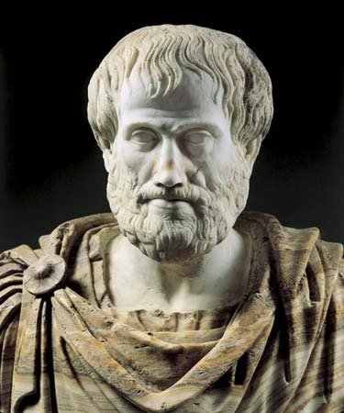
IV. Aristotle
Plato’s student at the Academy
Focused on governments
Suspicious of democracy, said a strong and moral ruler was best
‘Golden Mean’ – use reason to balance life’s extremes
Left many writings, used throughout history
The ‘Ons’

Slide 9
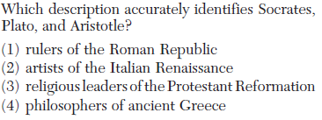

Slide 10
V. Greek Contributions
Athenian Democracy
Poetry, Drama, and Theater
Tragedies: plays that told of human suffering
Antigone, The Oresteia, Oedipus
Comedies: humorous, mocking plays
Lysistrata

Slide 11
Detailed accounts of history
Homer (Iliad, Odyssey)
Architecture: Corinthian, Doric Columns
Cultural Diffusion
Trade around the Mediterranean
The Olympic Games

Slide 13
VI. End of Ancient Greece
Athenian domination ended
In fighting amongst city-states continued
A new power arose in Macedonia that would overtake the peninsula

Slide 14
Essential Question
Who were the Greek philosophers and what were their major thoughts/contributions?

