Slide 1
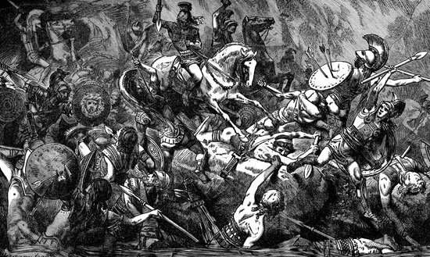
Greek Wars
Global History and Geography I
Mr. Cox

Slide 2
Bellringer
Define: Civil War
Essential Question
What were the causes and outcomes of the Persian and Peloponnesian Wars?

Slide 3
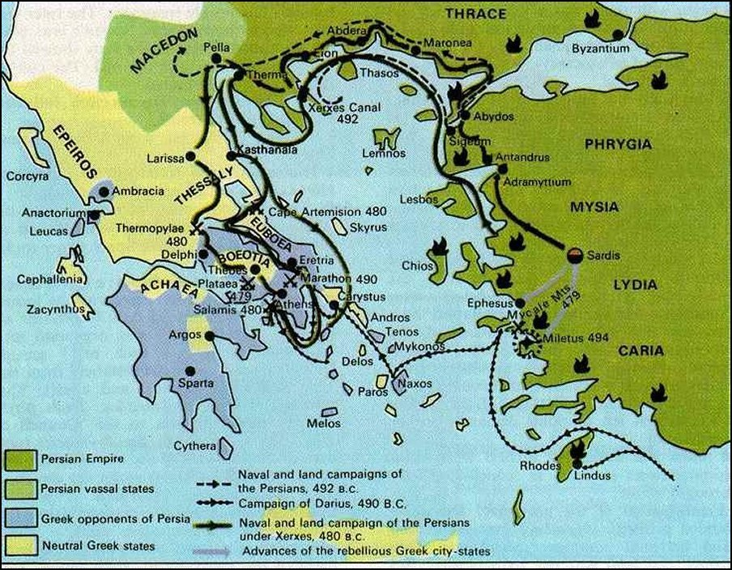
I. The Persian Wars
Persia invaded Greek city-states
The city-states formed an alliance
Agreement to cooperate in a war and provide aid
Victory at Marathon
Pheidippides ran 26.2 miles to Athens
“Rejoice, we conquer”

Slide 4
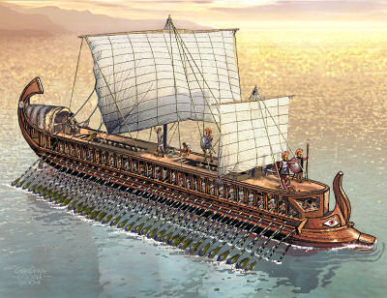
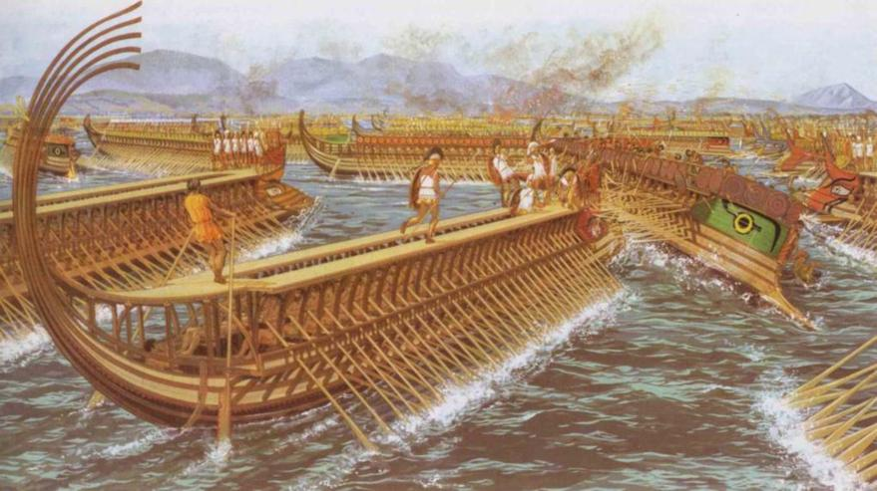
Battle of Thermopylae
Stand of the 300 Spartans
Spartan King Leonidas led the defense
Themistocles: Athenian leader and military commander: built up the Athenian navy
Turning Point
Persians were pushed out of Greece

Slide 5
II. Alliances Emerge
Athens emerged as the dominant city-state
Formed the Delian League
Prevent Persian invasions
Benefit its own city
Forced membership
Sparta formed the Peloponnesian League
To counter Athens
Supported oligarchy, not Athenian Democracy

Slide 6
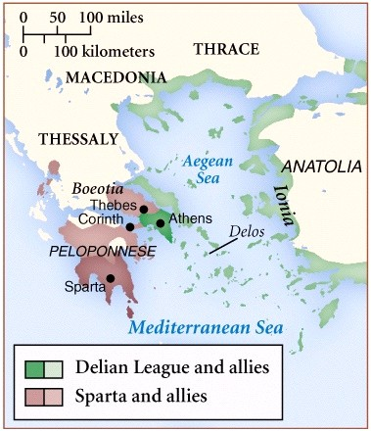

Slide 7
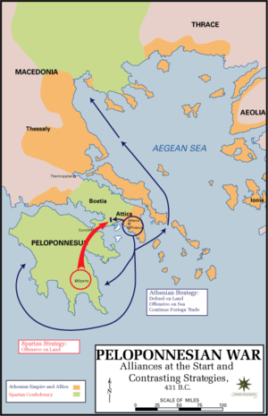
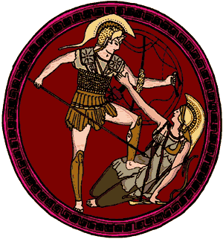
III. The Peloponnesian War
Dragged on for 27 years
Athens
Geographic disadvantage
Sparta attacked the city
Plague, disease, death
Sparta allied with Persia
Sacked the city
Did not destroy it all

Slide 8
IV. End of Ancient Greece
Athenian domination ended
In fighting amongst city-states continued
A new power arose in Macedonia that would overtake the peninsula

Slide 9
Essential Question
What were the causes and outcomes of the Persian and Peloponnesian Wars?
http://www.youtube.com/watch?v=ykF5yyJmnAo

