Slide 1
Unit III The Classical Civilizations

Slide 2
Classical Civilizations
The next period in history is classified as the Age of Classical Civilizations
This time period featured golden ages in both the Western and Eastern Worlds
East: Gupta Empire in India, Qin and Han Dynasties in China
West: Greek and Roman Civilizations in Europe
It is important to understand that these Empires were not only in existence at the same time, but very much in contact as well.
Other world cultures at this time: Persia (Middle East), Carthage (North Africa), Mesoamerica (Latin America), Ghana (West Africa).

Slide 3
The Indian Empires
Global History and Geography I
Mr. Cox

Slide 4
Bellringer
What is a contribution? How can an ancient civilization contribute to us today?
Essential Question
What did the Gupta Empire contribute to modern society?

Slide 5
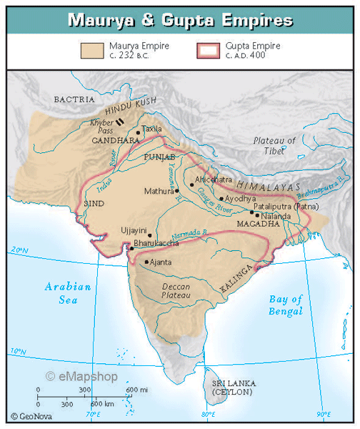
I. Rise of Maurya Empire
Emerged after the Indus River Cities collapsed/Aryans
Chandragupta and Asoka were powerful rulers who united people through religion (Buddhism)
Influenced by Alexander of Macedon

Slide 6
II. Asoka the Great
Sent missionaries, or religious travelers, to spread the word of religion (Buddhism) and peace across India.
Stone pillars with laws displayed were erected across India, and a brief Golden Age ensued.
After Asoka’s death, the Mauryan Empire collapsed from within.

Slide 7
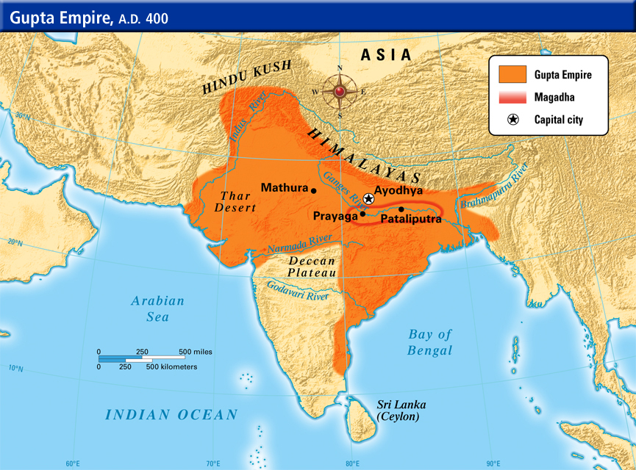
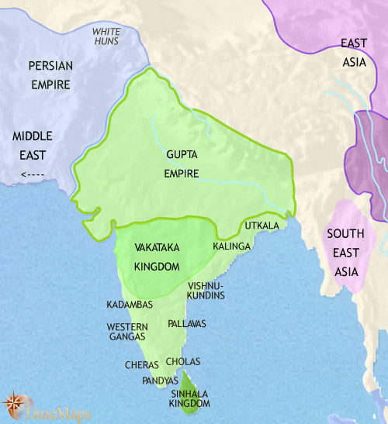
III. The Gupta Empire Rises
Coming from the Deccan Plateau, the Gupta Empire ruled much of India during the early years B.C.E.
Women had a higher social status.
Trade and the seasonal monsoons were important to the development of the Gupta.
Declined due to repeated invasions

Slide 8
IV. Gupta Contributions
Learning | Architecture | Art | Literature

Slide 9
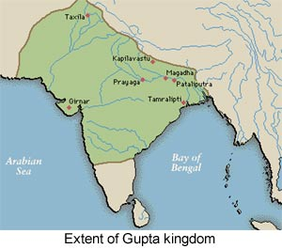
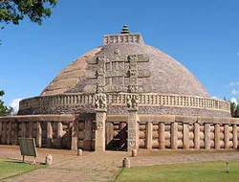
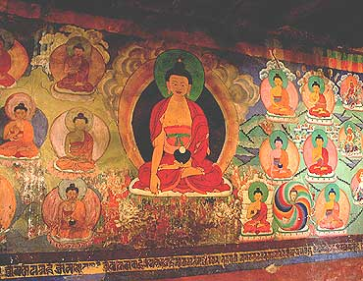
IV. Gupta Contributions
Learning | Architecture | Art | Literature
Centers were established by priests. Created “Arabic” numeric system Created our modern decimal system and zero! | Large stone religious temples. Stupas: large dome shaped shrines. | Carvings adorned stupas and religious centers. Painting were found in caves of indigenous Indians. These wall paintings are called murals. | Sanskrit language Folk tales were written and carried west. Shakuntala

Slide 10
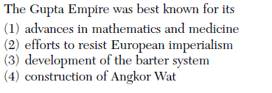

Slide 11
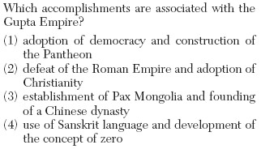

Slide 14
Essential Question
What did the Gupta Empire contribute to modern society?

