Slide 1
The Han Dynasty: Golden Age of China
Global History and Geography I
Mr. Cox

Slide 2
Bellringer
Review: What is a Golden Age?
Essential Question
Why is the Han Dynasty considered to be the Golden Age of Chinese Civilization?

Slide 3
I. Liu Bang (Gao Zu)
Claimed power after Shi Huangdi died
Mandate of Heaven
Lowered taxes
Eased policies
Appointed Confucian scholars to government positions, pleased the people
Began the Han dynasty

Slide 4
II. Emperor Wudi and the Golden Age
Expanded Economy
Improved Canals and Roads
Government Monopoly on industry
Complete control f a product or business
Source of income for government
Expansionism – adding of territory
Manchuria, Vietnam, Tibet, Korea, and Central Asia

Slide 5
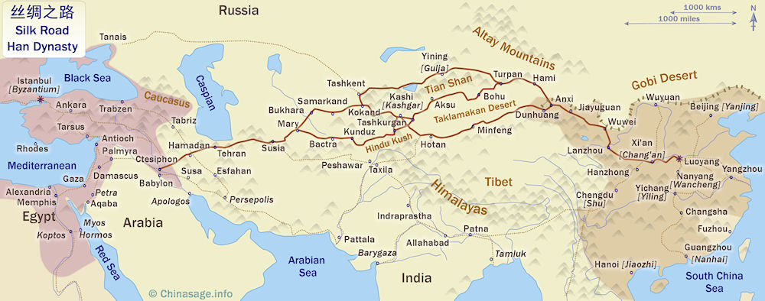
III. Silk Road
The Han dynasty opened a trade route called the ‘Silk Road’
Silk and other Chinese goods moved west, and Indian spices eventually became very desirable
Connected Han China with Rome
The silk road stretched for 4000 miles. Few merchants traveled the entire distance. Most of the good that were traded were done at markets along the way.

Slide 6
IV. Golden Age Cont’d
Accomplishments
Silk Road | Civil Service Exams | Science | Medicine | Technology | The Arts

Slide 7
IV. Golden Age Cont’d
Accomplishments
Silk Road | Civil Service Exams | Science | Medicine | Technology | The Arts
Trade route to the west. Brought new goods to China Multiple trading locations Cultural Diffusion

Slide 8
IV. Golden Age Cont’d
Accomplishments
Silk Road | Civil Service Exams | Science | Medicine | Technology | The Arts
Trade route to the west. Brought new goods to China Multiple trading locations Cultural Diffusion | For government positions Based on merit Required much study, for the wealthy

Slide 9
IV. Golden Age Cont’d
Accomplishments
Silk Road | Civil Service Exams | Science | Medicine | Technology | The Arts
Trade route to the west. Brought new goods to China Multiple trading locations Cultural Diffusion | For government positions Based on merit Required much study, for the wealthy | Chemistry, zoology, botany, astronomy Challenged traditional beliefs

Slide 10
IV. Golden Age Cont’d
Accomplishments
Silk Road | Civil Service Exams | Science | Medicine | Technology | The Arts
Trade route to the west. Brought new goods to China Multiple trading locations Cultural Diffusion | For government positions Based on merit Required much study, for the wealthy | Chemistry, zoology, botany, astronomy Challenged traditional beliefs | Diagnosed disease Created anesthetics Acupuncture: The use of needles to relieve pain or treat an illness

Slide 11
IV. Golden Age Cont’d
Accomplishments
Silk Road | Civil Service Exams | Science | Medicine | Technology | The Arts
Trade route to the west. Brought new goods to China Multiple trading locations Cultural Diffusion | For government positions Based on merit Required much study, for the wealthy | Chemistry, zoology, botany, astronomy Challenged traditional beliefs | Diagnosed disease Created anesthetics Acupuncture: The use of needles to relieve pain or treat an illness | Paper for record keeping Smelting of metal Ideas were spread through the Silk Road

Slide 12
IV. Golden Age Cont’d
Accomplishments
Silk Road | Civil Service Exams | Science | Medicine | Technology | The Arts
Trade route to the west. Brought new goods to China Multiple trading locations Cultural Diffusion | For government positions Based on merit Required much study, for the wealthy | Chemistry, zoology, botany, astronomy Challenged traditional beliefs | Diagnosed disease Created anesthetics Acupuncture: The use of needles to relieve pain or treat an illness | Paper for record keeping Smelting of metal Ideas were spread through the Silk Road | Poetry and artisans depict traditional Chinese art Carvings and metalworks were created

Slide 13
Quickwrite
What were some of the accomplishments of the Han Dynasty?

Slide 14
III. Internal Collapse
Internal scheming by politicians
Local warlords fought
Infrastructure failed
Peasants revolted
China fell under the control of outsiders

Slide 15
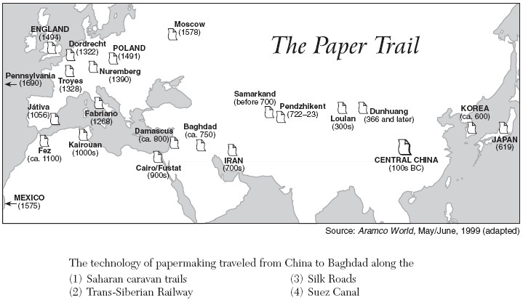

Slide 18
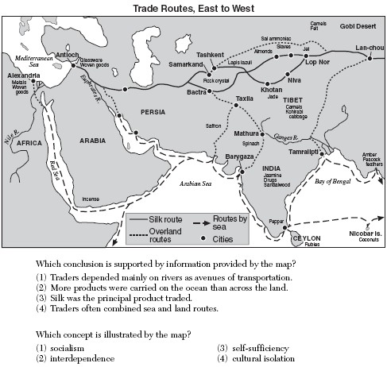

Slide 19
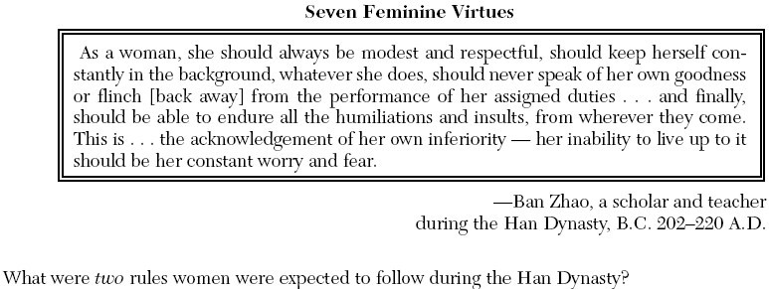

Slide 20
Essential Question
Why is the Han Dynasty considered to be the Golden Age of Chinese Civilization?

