Slide 1
Hinduism
Global History and Geography I
Mr. Cox

Slide 2
Bellringer
Define the term polytheism.
Essential Question
What are the similarities and differences between Hinduism and Buddhism?

Slide 3
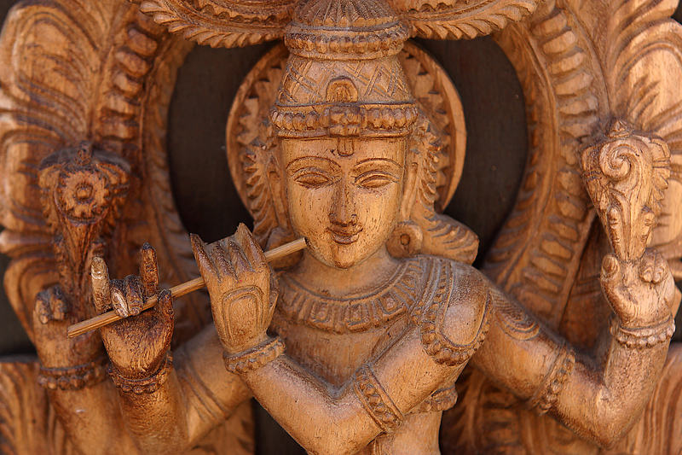
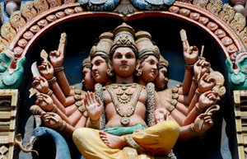
Origins: Hinduism
A Single Founder?
No clear founder, no central religious text
Blending of many beliefs in India
Different ways to worship
The Vedic Age
The Vedas: collection of sacred Hindu teachings, not a holy text
Spells out ethical teachings and a code of morals

Slide 4
Characteristics
“God is one, but wise people know it by many names”
The entire universe is part of an unchanging spiritual force called Brahman.
The many Gods are the manifestations of Brahman.
Atman – essential self, a life force or soul
Goal of life is to achieve moksha, or union with the chief god Brahman.
Moksha is difficult to achieve in a single lifetime, thus making reincarnation essential.
Rebirth of the atman in another body

Slide 5
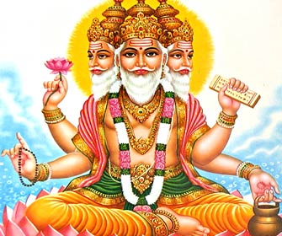
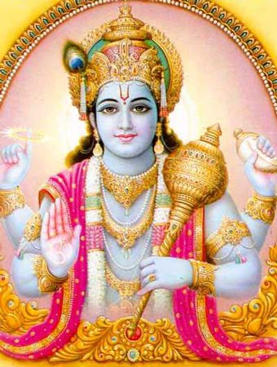
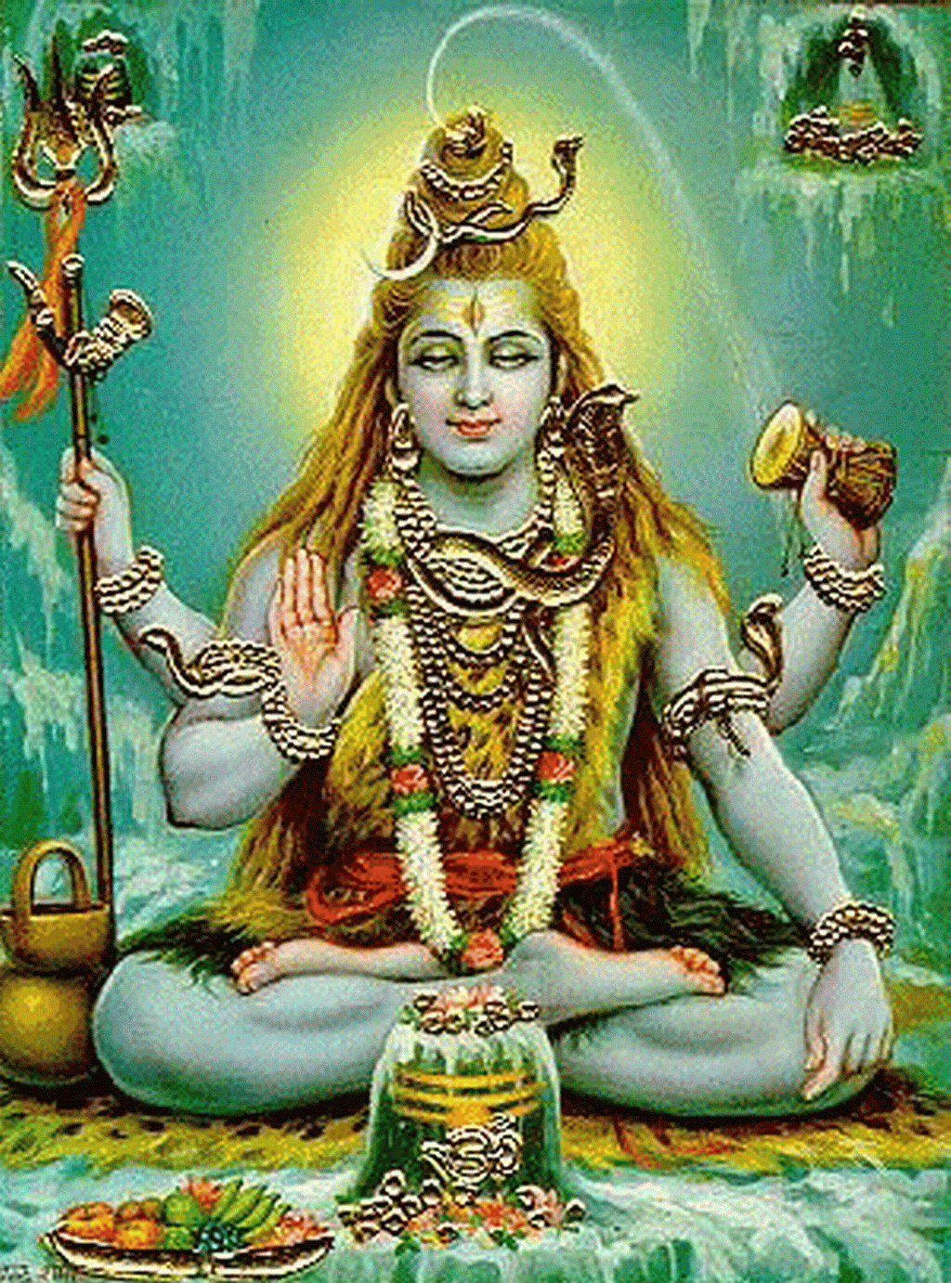
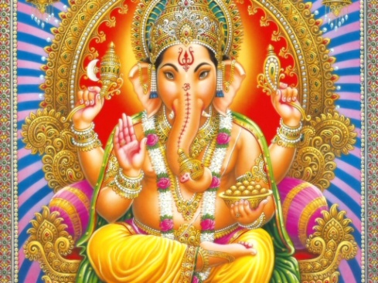
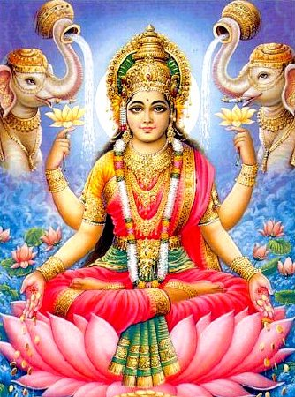
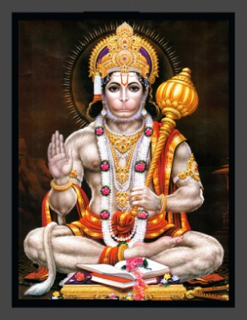
Hindu Gods
Brahma: four faced creator god, first living thing | Vishnu: kind and benevolent, preserves the world | Shiva: destroys worn out things to create new life
Ganesha: elephant God of wisdom and good fortune | Lakshmi: Goddess of good luck, wealth, and prosperity. | Hanuman: Monkey god symbolizes loyalty and dedication

Slide 6
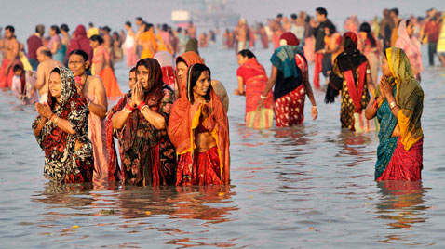
To achieve moksha, a Hindu must spend his or her life achieving positive karma.
Any action that affects a person’s status in the next life.
In order to achieve positive karma, the importance of dharma is stressed.
The religious and moral duties of an individual.
Ahimsa: nonviolence

Slide 7
Buddhism
Global History and Geography I
Mr. Cox

Slide 8
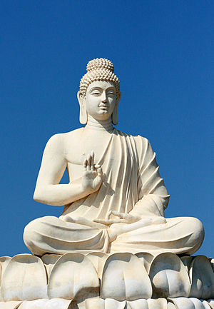
Origins
Siddhartha Gautama Buddha
Life
Born into a high caste
Married, had children, but little outside experiences
Left life to find the place where “neither suffering nor death”
Observed the horrors of the world: the sick, the old, and the dead.

Slide 9
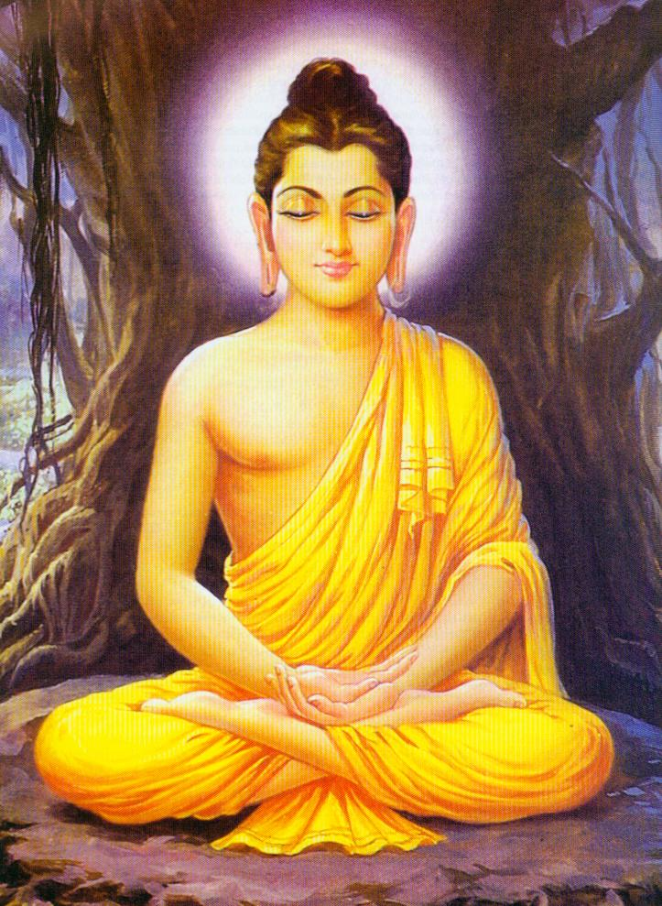
The Enlightened One
Did not receive the answers he demanded from Hinduism
Left his life in order to find answers, began meditation
Awoke from 48 days of meditation not as a man, but as the Buddha, the Enlightened One.

Slide 10
Beliefs
Four Noble Truths

Slide 11
Beliefs
Four Noble Truths
All life is full of suffering, pain, sorrow

Slide 12
Beliefs
Four Noble Truths
All life is full of suffering, pain, sorrow
Suffering is caused by worldly desires (riches, desires, long life, love)

Slide 13
Beliefs
Four Noble Truths
All life is full of suffering, pain, sorrow
Suffering is caused by worldly desires (riches, desires, long life, love)
The only cure for suffering is to overcome desire

Slide 14
Beliefs
Four Noble Truths
All life is full of suffering, pain, sorrow
Suffering is caused by worldly desires (riches, desires, long life, love)
The only cure for suffering is to overcome desire
The only way to overcome desire is to follow the Eightfold Path

Slide 15
Beliefs
Four Noble Truths
All life is full of suffering, pain, sorrow
Suffering is caused by worldly desires (riches, desires, long life, love)
The only cure for suffering is to overcome desire
The only way to overcome desire is to follow the Eightfold Path
Nirvana: Final goal of the Eightfold Path
Union with the universe and freedom from the cycle of rebirth

Slide 16
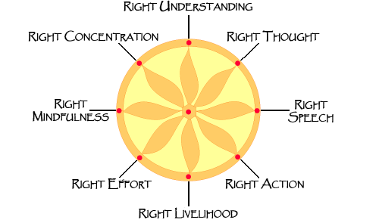

Slide 17
Spread of Buddhism
Tripitaka – Collection of Buddha’s teachings
Put together by his followers
Two Sects (smaller groups)
Theraveda
Close following of Buddha’s teachings
Only through this could nirvana be achieved
Mahayana
For a common practitioner
Compares Buddha to a God instead of a figure to model

Slide 18
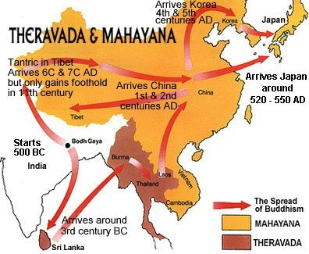

Slide 19
http://www.youtube.com/watch?v=8Nn5uqE3C9w

