Slide 1
Islam
Global History and Geography I
Mr. Cox

Slide 2
Bellringer
What is the geographic area that is considered to be holy for Jews and Christians? Why is it considered holy?
Essential Question
What are the 5 pillars of the Islamic faith?

Slide 3
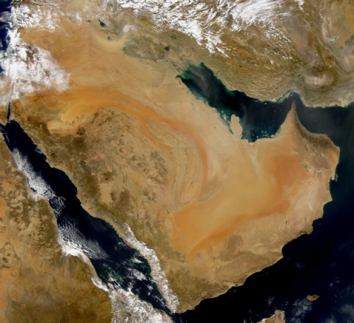
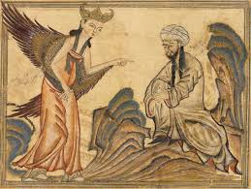
Origins:
Prophet Muhammad
Sheppard living in Arabia
Arabs: ethnic group of people, not a religion, disagreed with current religious practices
Kaaba: ancient shrine believed to have been built by Abraham

Slide 4
His Vision
Was spoken to by an angel, told to submit and spread new beliefs
Converted many Arabs
One true God: Allah
Holy book of teachings and prayers Quran (Koran)
The Hijra
Muhammad’s pilgrimage from Mecca to Medina
Gained many followers and political power
Used power to spread Islam across Arabia and Mesopotamia (Jerusalem)
Created a united group in a nation

Slide 5
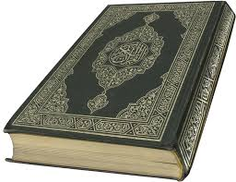
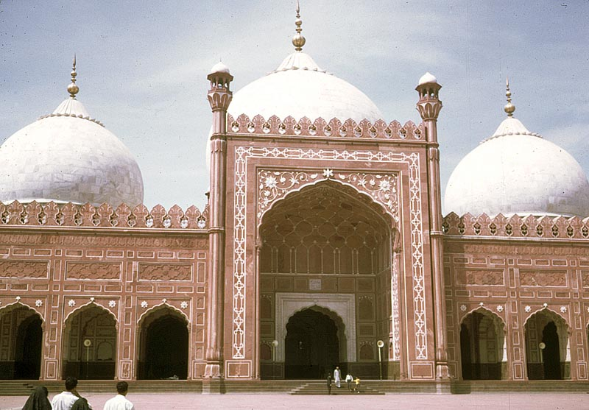
Mosques – Islamic houses of Worship
Jihad – “struggle in God’s service”

Slide 6
Five Pillars of the Islamic Faith
Essential beliefs/practices of everyday Muslims

Slide 7
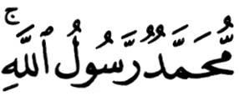
1. The Shahada
The testimony.
The declaration of faith:
There is no god worthy of worship except God, and Muhammad is His Messenger [or Prophet].
1

Slide 8
2. The Salat
The mandatory prayers performed 5 times a day: * dawn * noon * late afternoon * sunset * before going to bed
Wash before praying.
Face Mecca and use a prayer rug.
2

Slide 9
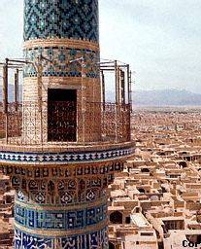
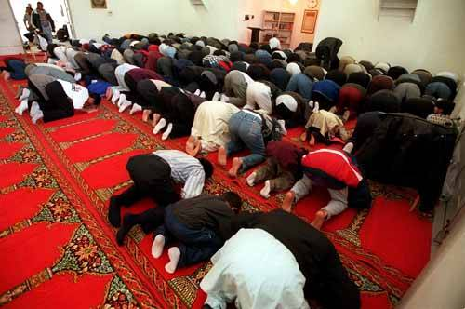
2. The Salat
The call to prayer by the muezzin in the minaret.
Pray in the mosque on Friday.
2

Slide 10
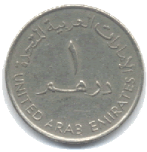
3. The Zakat
Almsgiving (charitable donations).
Muslims believe that all things belong to God.
Zakat means both “purification” and “growth.”
About 2.5% of your income.
3

Slide 11
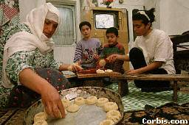
4. The Sawm
Fasting during the holy month of Ramadan.
Considered a method of self- purification.
No eating or drinking from sunrise to sunset during Ramadan.
4

Slide 12
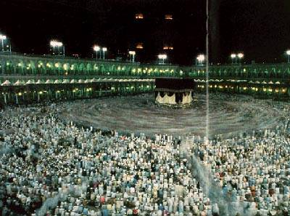
5. The Hajj
The pilgrimage to Mecca.
Must be done at least once in a Muslim’s lifetime.
2-3 million Muslims make the pilgrimage every year.
5

Slide 13
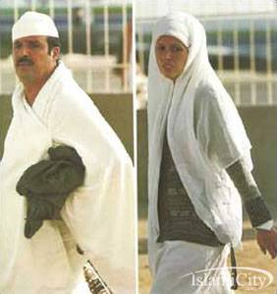
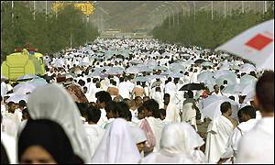
5. The Hajj
Those who complete the pilgrimage can add the title hajji to their name.
5

Slide 14
Islam Today
Where?

Slide 15
Countries with the Largest Muslim Population

Slide 16
Countries with the Largest Muslim Population
1. | Indonesia | 183,000,000 | 6. | Iran | 62,000,000
2. | Pakistan | 134,000,000 | 7. | Egypt | 59,000,000
3. | India | 121,000,000 | 8. | Nigeria | 53,000,000
4. | Bangladesh | 114,000,000 | 9. | Algeria | 31,000,000
5. | Turkey | 66,000,000 | 10. | Morocco | 29,000,000

Slide 17
Countries with the Largest Muslim Population
* Arabs make up only 20% of the total Muslim population of the world.
1. | Indonesia | 183,000,000 | 6. | Iran | 62,000,000
2. | Pakistan | 134,000,000 | 7. | Egypt | 59,000,000
3. | India | 121,000,000 | 8. | Nigeria | 53,000,000
4. | Bangladesh | 114,000,000 | 9. | Algeria | 31,000,000
5. | Turkey | 66,000,000 | 10. | Morocco | 29,000,000

Slide 18
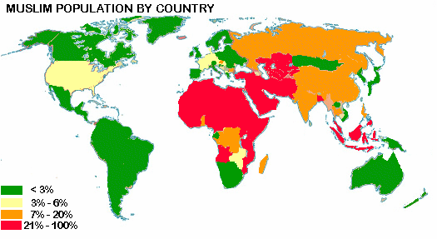
Islam Today
Where?

Slide 19
Events
Largely associated with the 9/11 terrorist attacks
Arab =/= Muslim, Terrorist =/= Every Muslim
Recipients of Constant Prejudice
“Towelhead”
Civil War in Syria, War in Iraq, ISIS, Boko Haram
These events do not characterize the people of a religion but rather a small minority

Slide 20
Essential Question
What are the 5 pillars of the Islamic faith?

Slide 21
http://www.youtube.com/watch?v=TpcbfxtdoI8

