Slide 1
Islamic Culture and Contributions
Global History and Geography I
Mr. Cox

Slide 2
Bellringer
Define the following terms: culture, society, education, and economy
Essential Question
What were the major social, economic, cultural, and academic contributions of the Islamic empires?

Slide 3
Islamic Contributions and Accomplishments
Far more advanced that Christian cultures that were around at the same time (Byzantine, Medieval)
Islamic Contributions and Accomplishments
Cultural
Economic
Social
Academic

Slide 4
Cultural Contributions and Accomplishments
Influenced by Greeks, Romans, Persians, and Indians
Art and Architecture
  Arabesque: design that features curves and floral shapes
  Many illustrated works, including writing and scientific works
  Adapted dome structures from the Byzantine
Literature and Poetry
  Stemmed from the Quran, featured many interpretations
  Poetry had strict rules and reflected religious values
  Storytelling was also considered a venerated art or skill, as was calligraphy

Slide 5
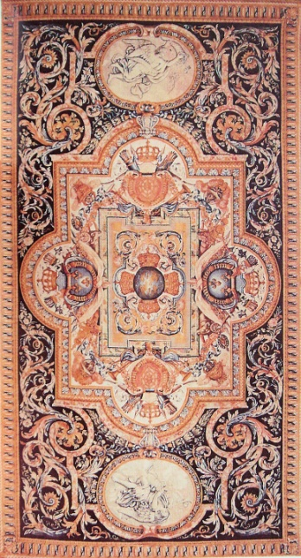
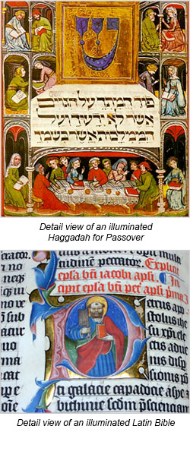

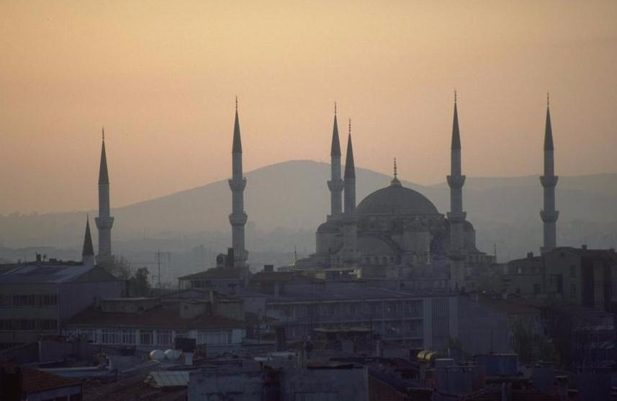
₌

Slide 6
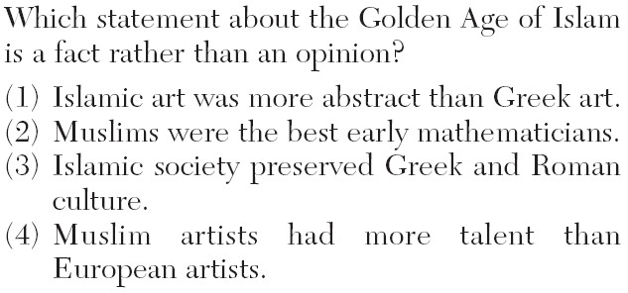

Slide 7
Economic Contributions and Accomplishments
Trade Network
  Established trade routes that connected Western Europe and Africa with India and China
  Brought about a great amount of cultural diffusion
Created the concept of a check and established a unified banking system
Had a similar guild system
Large cities with unique goods produced/traded

Slide 8
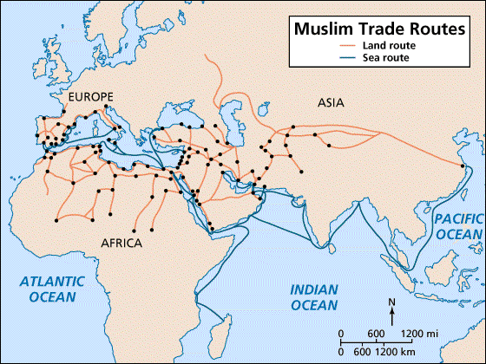

Slide 9
Quick Write
How did the cultural and economic accomplishments of the Islamic Empire contribute to cultural diffusion?

Slide 10
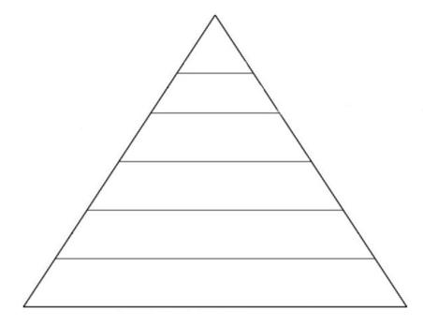
Social Contributions and Accomplishments
Less strictly defined social classes compared to Medieval Europe and Byzantium
Social Mobility: the ability to move in between the social classes
  Through military, religious, economic, academic means
Slavery was largely outlawed

Slide 11
Academic Contributions and Accomplishments
Established centers of learning in many cities studying the Quran and translating texts into their vast libraries
  Many accomplishments were based off of the advancements made by previous civilizations!

Slide 12
Philosophy: tried to harmonize knowledge with religion
  Ibn Rushd: put knowledge to reason, studied Aristotle
  Ibn Khaldun: Established regulations for studying history, including sourcing, bias, exaggeration, and studying in depth on topics

Slide 13
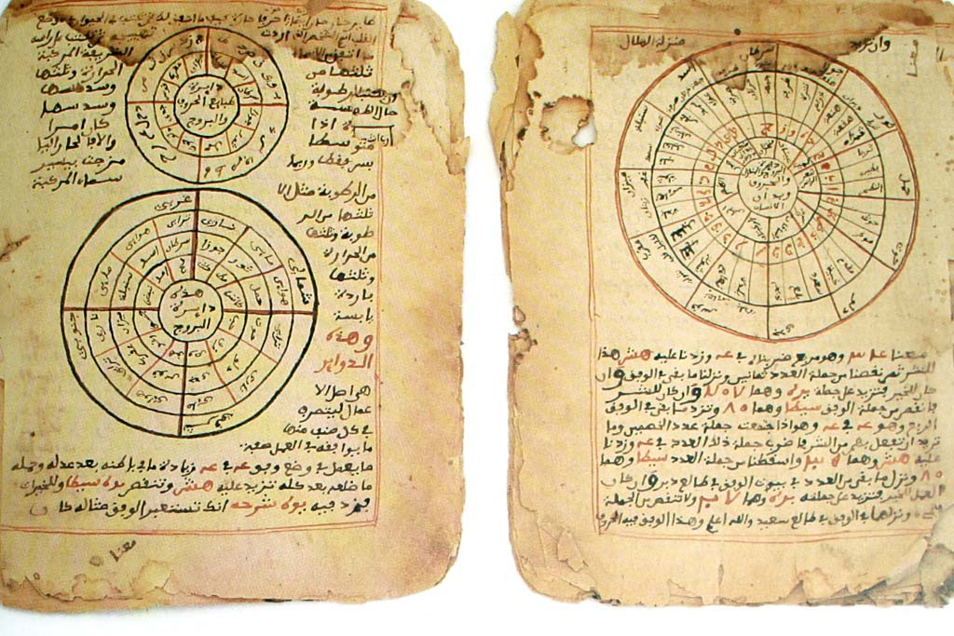
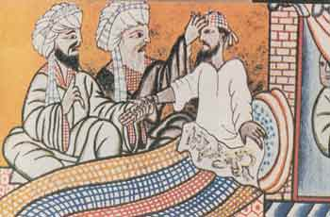
Mathematics: al-Khwarizmi pioneered modern algebra
Astronomy: Studied eclipses, rotations, and even determined the Earth’s circumference
Medicine: made medicine a profession, studied disease, made encyclopedias of prescriptions, and even began to establish standards for safe surgery!

Slide 14
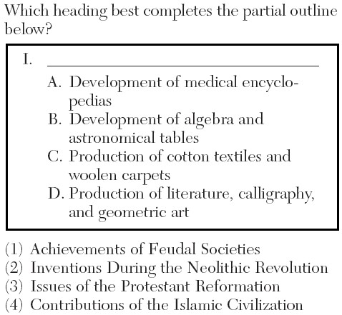

Slide 15
Essential Question
What were the major social, economic, cultural, and academic contributions of the Islamic empires?
Homework

