Slide 1
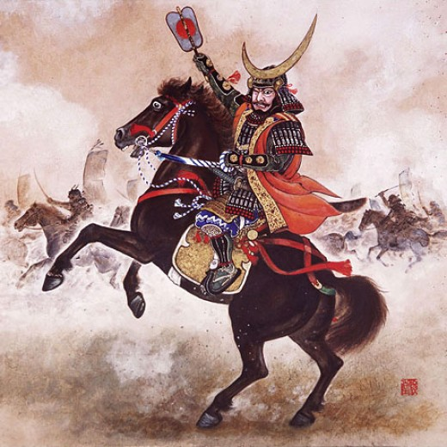
Feudal Japan
Global History and Geography I
Mr. Cox

Slide 2
Bellringer
Review: Describe the feudal system in Medieval Europe.
How did the shoguns shape feudal Japan?
Essential Question

Slide 3
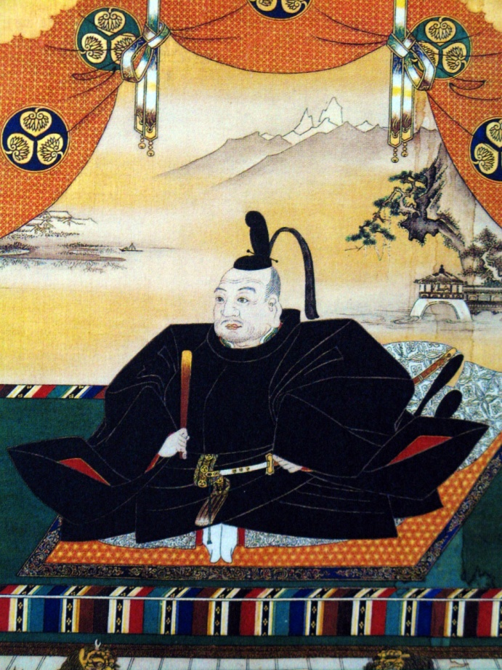
I. Feudalism
During the Heian period, Emperors had little power
Stood as a figure head
Real power was in the hand of shoguns, or supreme military leader
Established Shogunates, or periods of military rule
Three shogunates would rule Japan for 700 years
These periods were characterized by constant fighting amongst

Slide 4
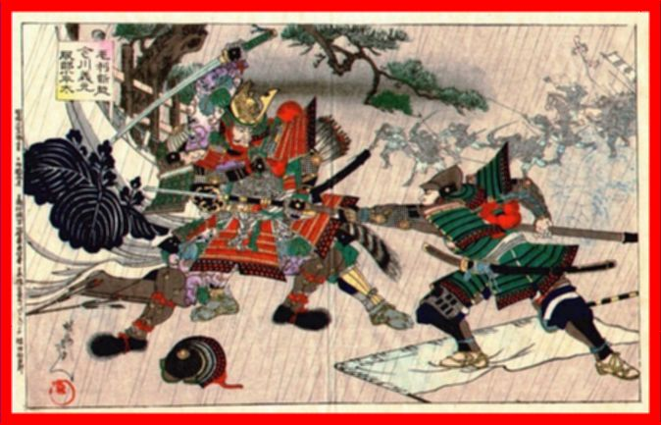
The shogun would distribute land to daimyo, or Japanese vassal lords, to govern.
The daimyo would then grant land to samurai, or the fighting aristocracy who were also essentially the daimyo’s bodyguards
Followed a code of honor called bushido
“Way of the warrior”
Honor, bravery, loyalty

Slide 5
Quickwrite
With a partner, fill into two pyramids comparing the feudal classes of Medieval Europe and Feudal Japan.
Western Europe Japan

Slide 6
Quickwrite
With a partner, fill into two pyramids comparing the feudal classes of Medieval Europe and Feudal Japan.
Western Europe Japan
King
Merchants/Artisans
Peasants/Serfs
Lord
Vassal Knight
Emperor
Samurai
Peasants
Shogun
Daimyo

Slide 7
Knights and Samurais

Slide 8
II. The Tokugawa Shogunate
As the first shogunate crumbled, a period of internal war lasted until 1600
Tokugawa Ieyasu seized control and united Japan until 1868
Centralized government by centralizing power to Edo (Tokyo) and expanding shogun’s power over the daimyo
Emperor was still a figure head

Slide 9
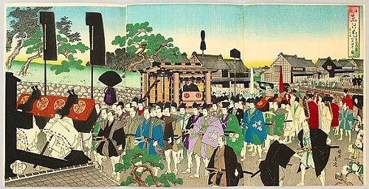
Strict Policies
No foreign involvement or trade
Held daimyo’s family in Edo to secure loyalty
New laws enforced Confucian moral code
Women’s rights were severely restricted, comparable to the women of ancient Athens

Slide 10
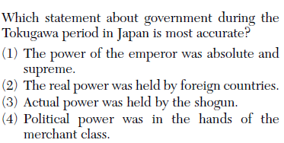

Slide 12
Essential Question
How did the shoguns shape feudal Japan?
Pg. 325, #5
Homework

