Slide 1
The Geography and People of Japan
Global History and Geography I
Mr. Cox

Slide 2
Bellringer
Review: What is an archipelago?
How has geography played a role in the development of Japanese culture?
Essential Question

Slide 3
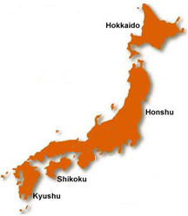
I. Geography of Japan
Archipelago: collection of closely located islands
Honshu, Hokkaido, Shikoku, Kyushu
Similar to Korea, most of Japan is made up of mountainous terrain
Difficulty for agriculture (terrace farming)
Did not unify for a long time
Plenty of natural harbors
Sea was a large part of economy

Slide 4
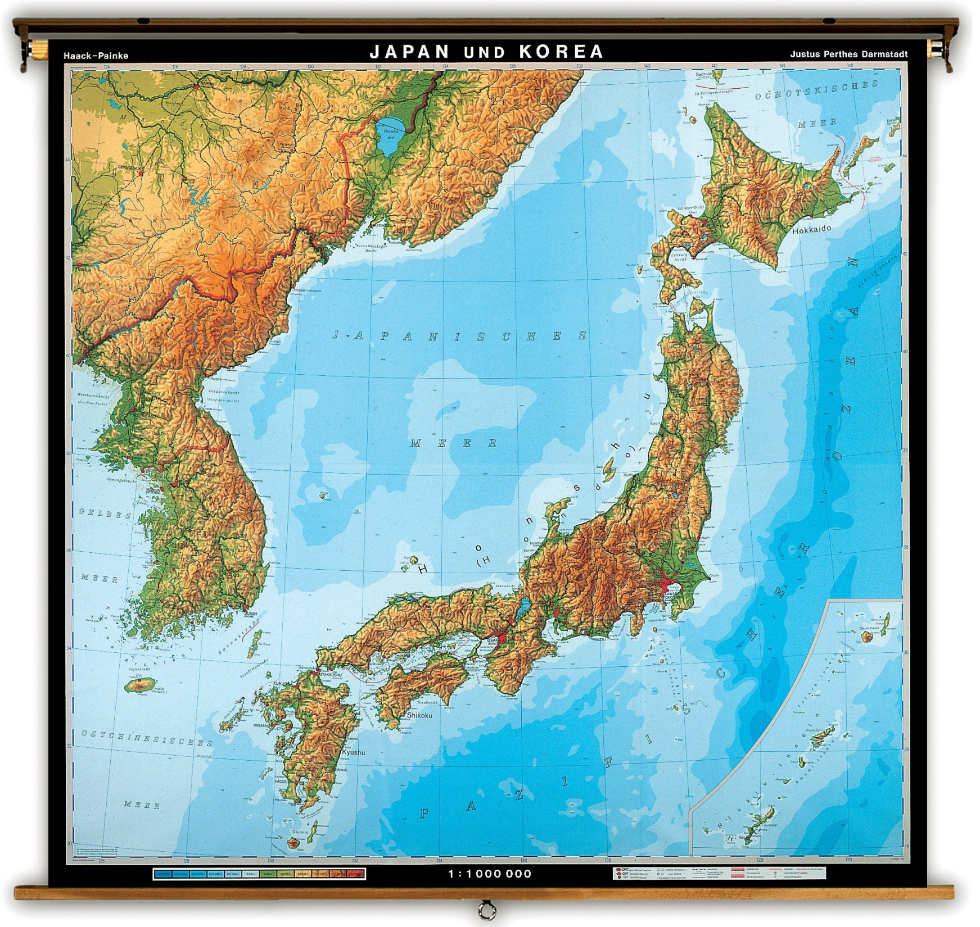

Slide 5
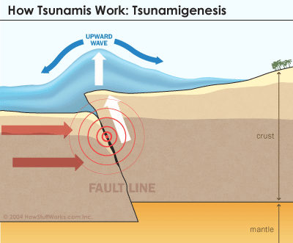
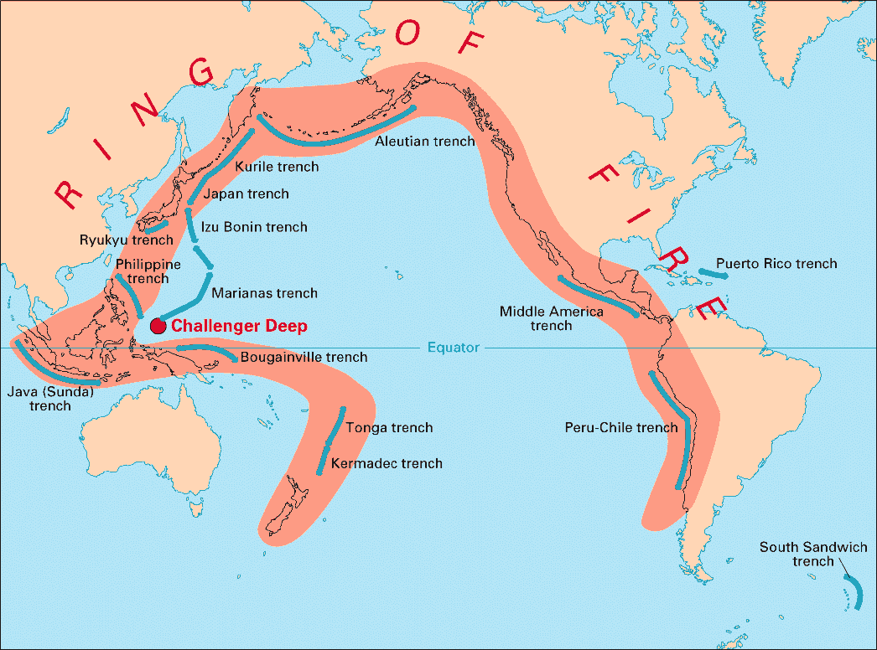
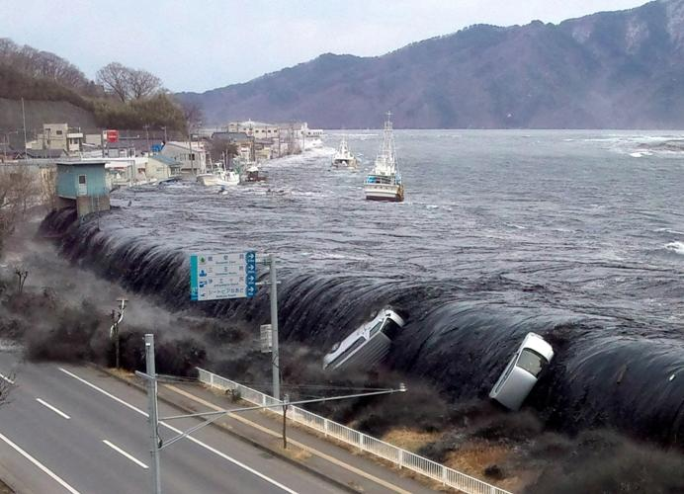
Natural Disasters
“Ring of Fire”
Outer Pacific region of tectonic activity
Frequent earthquakes and tsunamis
Tsunamis: large tidal waves caused by underground collisions of tectonic plates

Slide 6
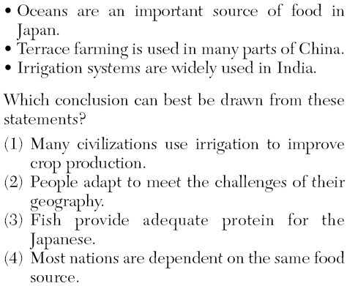

Slide 7
II. Early Traditions
Influences from China, but geography allowed Japan its own culture
People settled close to the coasts
Ujis (clans)
Shinto Religion
Relation to Korea
Distantly related languages
Spread of Buddhism

Slide 8
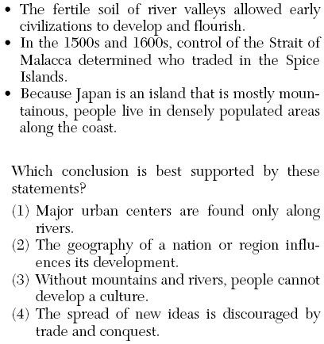

Slide 9
III. Influences from China
Yamato missions to China (794-1185 CE)
Agricultural, technological advancements
Resulted in partial absorption of Chinese culture
Selective Borrowing: kept some Chinese ways, but not others
Kept Confucian governance, Buddhism, and pagoda architecture
Rejected writing system and civil service exam

Slide 10
Essential Question
How has geography played a role in the development of Japanese culture?
Homework

