Slide 1
Judaism
Global History and Geography I
Mr. Cox

Slide 2
Bellringer
What is monotheism? Define the term in your own words.
Essential Question
Who are the important people in Judaism and what are the main teachings of the faith?

Slide 3
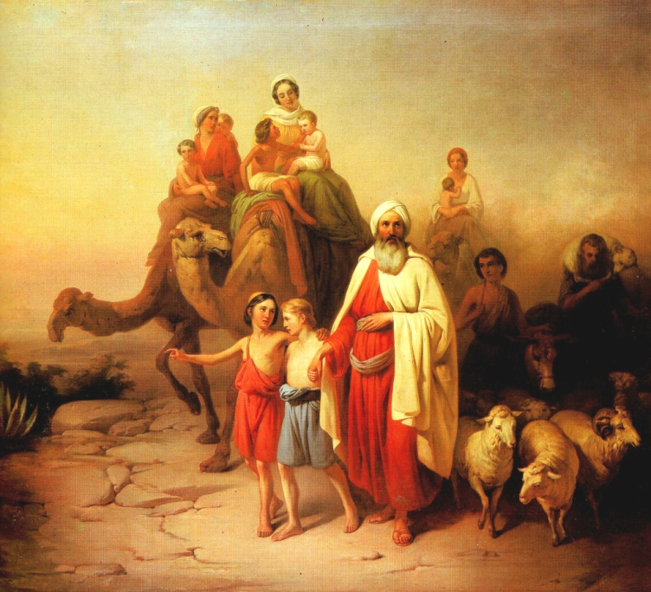
Origins: Fertile Crescent
Abraham – Sheppard and prophet of the Jewish faith
Migrated and settled his people in Canaan (Palestine)
Founder of Israelite nation
Famine caused these people to migrate over time to Egypt
Moses – Savior of the Israelites
Led the exodus from Egypt to Canaan

Slide 4
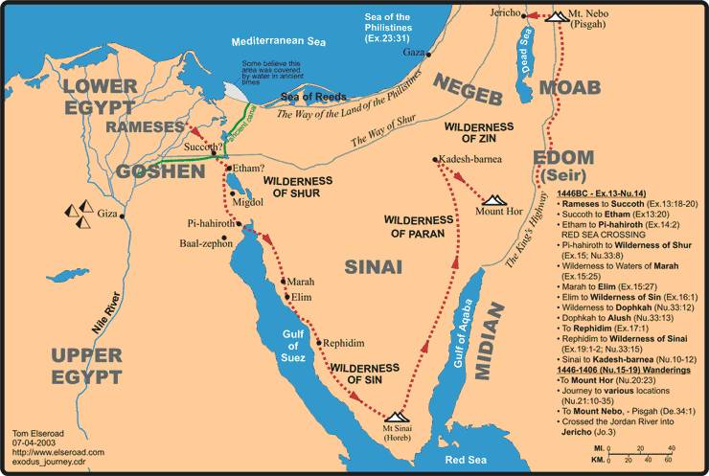
The Exodus

Slide 5
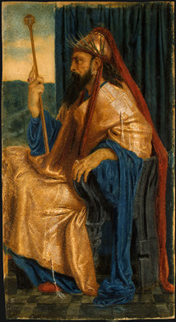
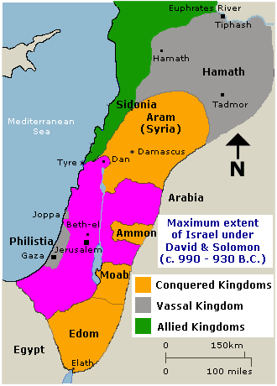
Kingdom of Israel
Established by followers of Moses (David)
David’s son, Solomon, expanded the empire, was conquered by Romans eventually

Slide 6
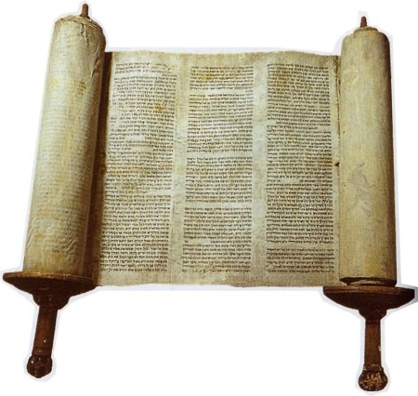
II. Covenant With God
Monotheism – belief in a single god (Yahweh)
Covenant – Abraham had a binding agreement with God
“One True God” – Abraham and his followers would only praise this God, and he would take care of them in return.
The Torah – Jewish holy book, set out laws to live by in Hebrew script, read right to left

Slide 7
III. Teachings
Patriarchal – fathers/husbands held great legal and moral authority
Ten Commandments – set of laws Jews believe God gave them (Moses)
Sabbath – a holy day for rest and worship (Sunday)

Slide 8
Prophets – interpreters of ‘God’s will”. Warn that failure to obey God could be disastrous
Ethics – moral standards of behavior. In the Torah and from prophets
Diaspora – Jews left their homeland over 2000 years ago, only recently to return

Slide 9
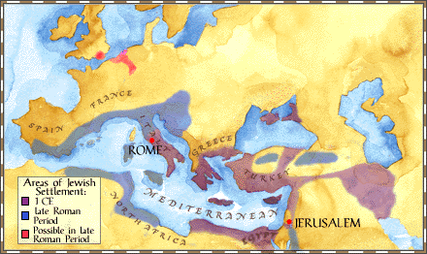
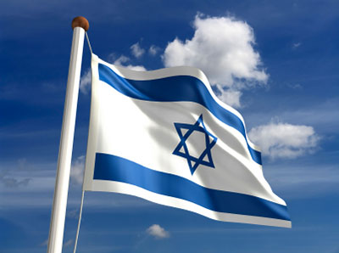
Diaspora
A Diaspora is a dispersion of a people from their original homeland. In Global History, the Diaspora of the Jews from their homeland in Canaan (Israel) in 77 C.E.
Was a significant point in history.
According to tradition, the Jews were given Israel by “God” in about 2000 B.C.E. In about 77 C.E., the Romans attacked Jerusalem and destroyed the temple. With Jerusalem now being controlled by the Romans, Jews dispersed throughout Eurasia in search of a place where they could practice freely.
In 1948 A Jewish state of Israel was crated although many Jews still live in other parts of the world.

Slide 10
Judaism
One true God Present everywhere
God made covenant with Abraham
Torah is a sacred recording of laws & events in Jewish History
Prophets taught about moral standards & justice
God gave Ten Commandments through Moses
God chose Hebrews as his People

Slide 11
1. Who was Abraham & what role did he play in Judaism?
2. How did the religious beliefs of the Hebrews differ from other groups?
3. What was the “new covenant” between God & the Hebrews after they fled Egypt?
A shepherd chosen by God to be the “father” of the Hebrew people, led his people to their homeland.
They were monotheists, most others were polytheists.
God promised to protect the Hebrews, and they promised to obey his commandments.

Slide 12
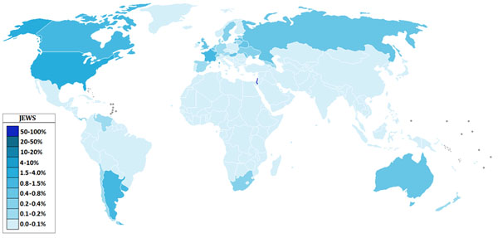
Judaism Today
Where? – Worldwide, Israel, Western Europe and America

Slide 13
Events Today
Zionist Movement – returning of Jews to Israel after World War II
Palestine – new country to accommodate displaced Muslims
Constant fighting in the Middle East, America supports Israel militarily
http://www.youtube.com/watch?v=fW5EhSYOYCQ

Slide 14
Essential Question
Who are the important people in Judaism and what are the main teachings of the faith?

