Slide 1
Justinian
Global History and Geography I
Mr. Cox

Slide 2
Bellringer
Review: What was the Code of Hammurabi?
Essential Question
Why is Justinian’s Code historically significant?

Slide 3
I. The Emperor Justinian
Expanded empire farther than any other Emperor
Autocrat: ruler with complete power
Spread from Eastern Europe throughout the Mediterranean
Also had strict control of the Orthodox Church

Slide 4
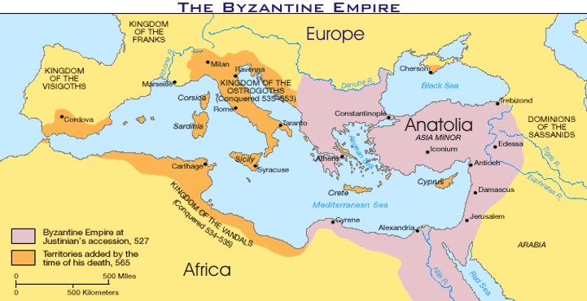

Slide 5
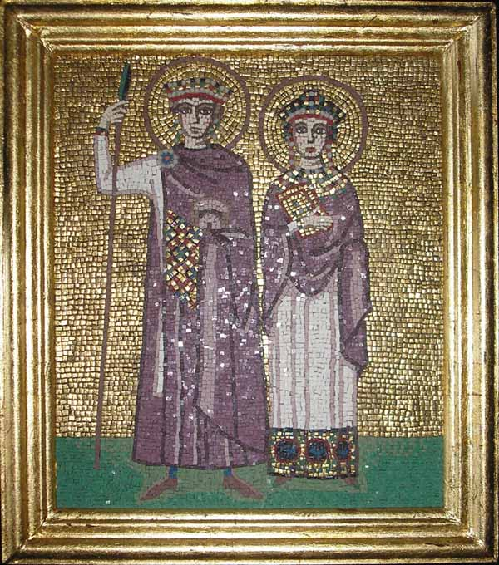
II. Theodora
Justinian’s wife
Adviser and co-ruler
Had substantial political power
Suppressed riots
Instituted reforms
Advanced women’s social status

Slide 6
III. Justinian’s Code
“Body of Civil Law”
Revised collection of Roman Laws
Served as a model for much of Europe
Set strict social, criminal, moral, and civil laws

Slide 7
After its completion the code consisted of four parts:
1. The Code contained about 5,000 Roman laws.
2. The Digest quoted and summarized the opinions of Rome’s greatest legal thinkers about the laws. This work was ran to a total of 50 volumes.
3. The Institutes was a textbook that told law students how to use the laws.
4. The Novellae (New Laws) presented legislation passed after 534.

Slide 8
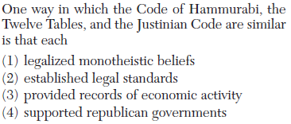

Slide 9
Compare and Contrast
How was Justinian’s Code similar and different from the Code of Hammurabi?

Slide 10
Essential Question
Why is Justinian’s Code historically significant?

