Slide 1
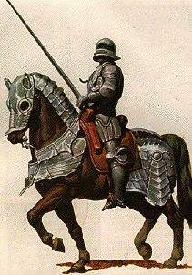
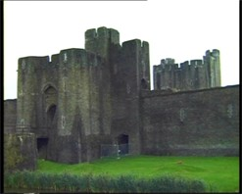
Knights and Castles
Global History and Geography I
Mr. Cox

Slide 2
Bellringer
Review: What is the feudal contract?
What was the role of the knight and the castle in medieval Europe?
Essential Question

Slide 3
I. Knights
Knights, or Vassals, were governed local manors and owed loyalty to their lords.
Required to provide money payments, crops grown on the manor, and military service when needed.
This requirement for military service led to the training of young noble boys into knighthood.

Slide 4
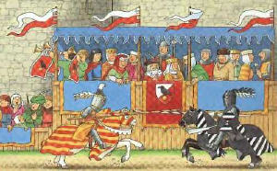
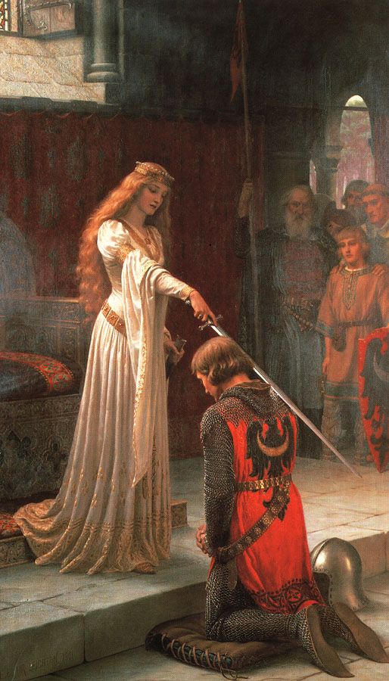
Knights (Cont’d)
These knights warded off invaders, leading to a decrease in true battle and a rise to a fake alternative.
Tournaments: staged encounters, held for entertainment and honor amongst nobles.

Slide 5
Knights (Cont’d)
Knights also adopted a moral code called chivalry
Bravery, loyalty, and honesty, as well as honorable in battle and polite towards women
Troubadours: wandering poets who spread romantic stories of lords and ladies.

Slide 6
Quickwrite
What was the role of the knight during the middle ages?

Slide 7
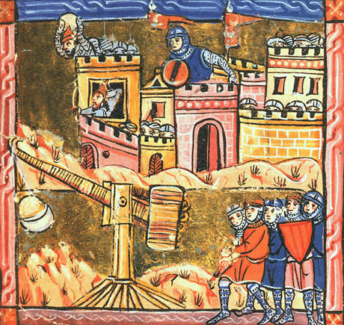
II. Castles
Were built by lords and kings to protect their holdings.
Included a keep, or central wooden tower, surrounded by thick stone walls and a water filled ditch called a moat.
Castles grew over time, and warfare frequently featured the sieging of castles.
http://www.youtube.com/watch?v=n75PgMSxAOw

Slide 8
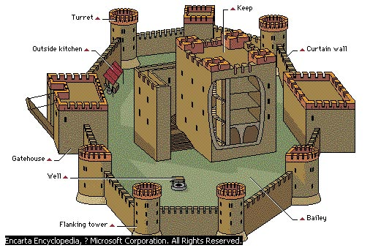
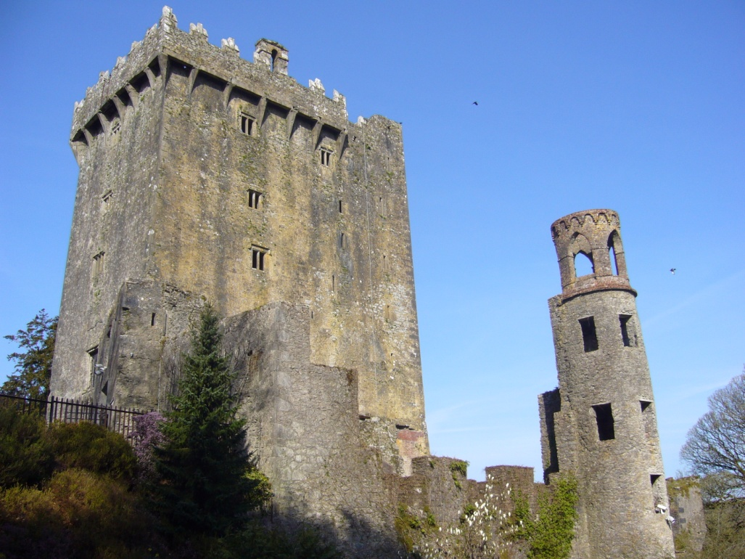

Slide 9
III. The Noblewoman
Women had prominent roles during the middle ages, as they were well respected by the code of chivalry.
Run the manor if the lord was away at war
Could become queens if their husbands died
Could inherit or receive land as a gift.
Very few women held onto their possessions as they were married off by their families and were expected to bear many children

Slide 10
Essential Question
What was the role of the knight and the castle in medieval Europe?
Homework

