Slide 1
Political Ideologies
Participation in Government
Johnstown High School
Mr. Cox

Slide 2
Bellringer
Define the terms:
Progressive
Traditional
Essential Question
How do Conservatives and Liberals represent contrasting American political ideologies?

Slide 3
What Influences our Political Views?
Family
Geography
Self Interest
Ethnicity and Religion
Self Image

Slide 4
What do you think is the Difference between Liberal and Conservative?
Conservative
Liberal

Slide 5
Definitions
CONSERVATIVES
“Traditionalists”
A political philosophy based on tradition and social stability.
Constitutionally limited government. Limiting the government protects the people
Preferring gradual development to abrupt change
Reject the notion that humans have a “right” to material goods.
Argue that rights come from God not from government.
“Skeptical of government intervention, optimistic of the free market”
LIBERALS
“Progressives”
The political philosophy that the government‘s role is to:
Promotes a constitutionally active government
Prefers quick action by the gov to solve issues
Government focus should be on economic/social justice as well as economic opportunity.
Strict separation of religion from governance
“Skeptical of the free market, optimistic of government intervention”

Slide 6
“Stereotypical” Conservative / Liberal Views
CONSERVATIVES
Abortion - Never
Taxation - Simplify the tax code, minimize crony capitalism
Global Warming -Skeptical of man’s involvement
Guns - Advocate for gun owners
Foreign Policy - Unilateral approach
Education - More accountability of teachers / school choice
Healthcare - Free Market solutions will result in greater efficiency and coverage of more people
LIBERALS
Abortion - On Demand
Taxation - Increase taxation of the wealthy will result in greater fairness
Global Warming -Rising Global temperature is a result of man’s involvement
Guns - Advocate for gun control
Foreign Policy - Multilateral approach
Education - More support for teachers, investment must be increased
Healthcare - Government solutions will result in greater efficiency and coverage of more people

Slide 7
Political Nuances
Libertarian
Individuals should have complete freedom of action, provided their actions do not infringe on the freedom of others.
Example – End the war on drugs, allow people to make their own choices.
Authoritarian
Personal freedoms are constrained by leaders, where moral judgments are created into law, so the good of “the whole” can be achieved.
Example – The war on drugs is necessary for public safety.

Slide 8
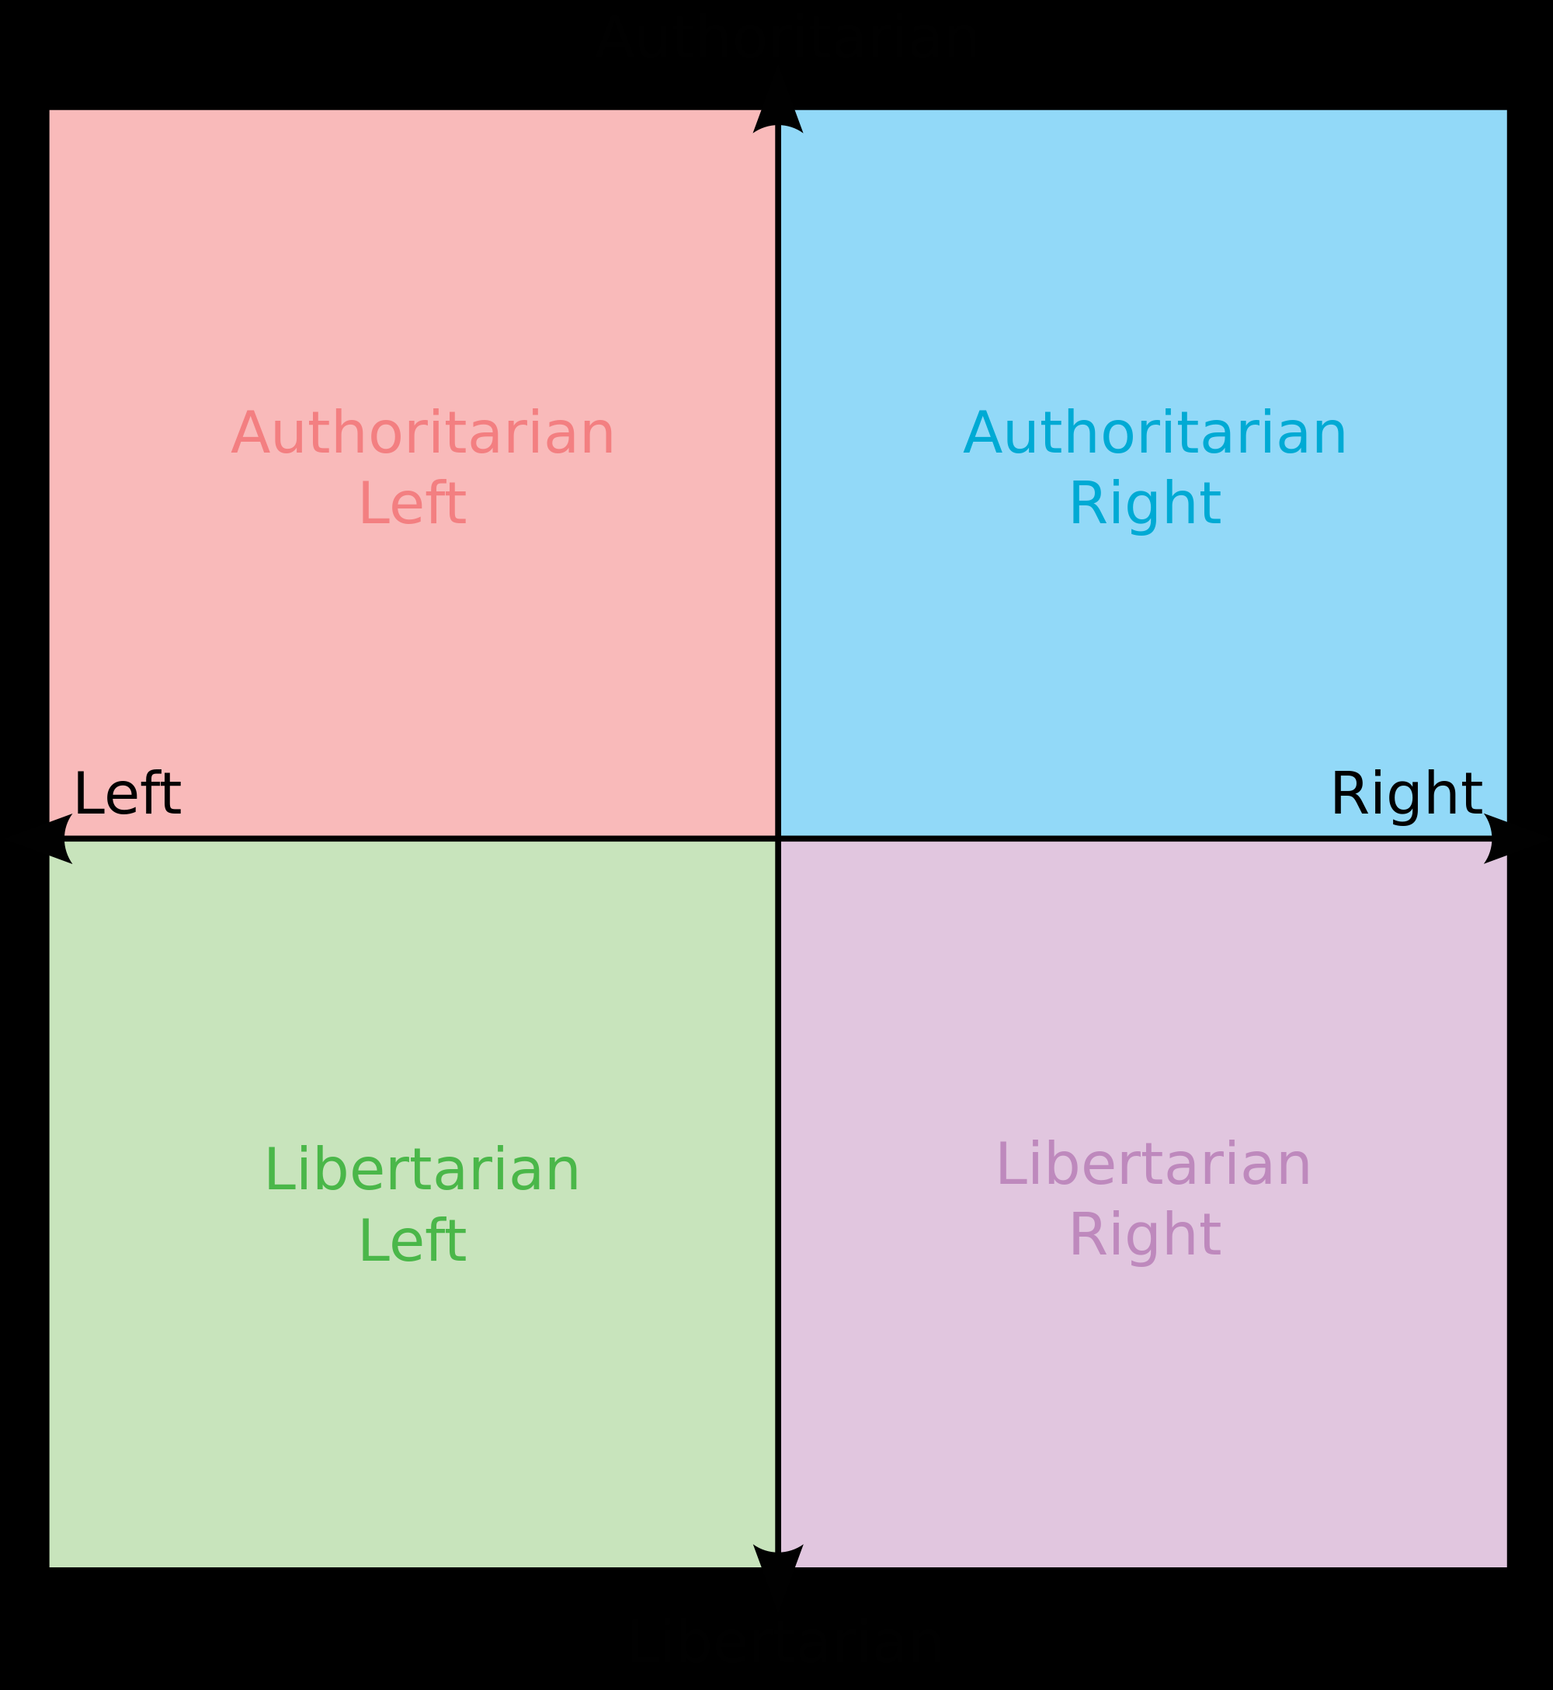

Slide 9
Stereotypes “Day in the Life”
A Day in the Life of a
Conservative
A Day in the Life of a
Liberal
7:00am – Wake-up, flip on Fox News, pick outfit to match terror alert level. Blow Dry mullet.
8:00am – Bible Study
8:30am – Listen to Rush Limbaugh while eating your 3rd Egg McMuffin at McDonald’s, smearing grease all over your newest NASCAR t-shirt.
9:00am – Arrive at work, force the community ‘s last mom-and-pop shop out of business, because you love Wal-Mart
10:00am – Buy 100 shares of Halliburton stock in anticipation of war with Iran.
7:00am – Wake-up, flip on MSNBC News, select outfit that will bring awareness to the current, oppressed people group of the day. Wax dread locks.
8:00am – Yoga Workout
8:30am – Read the New York Times while stirring granola into your Chobani, sipping your Latte at Starbucks, in your Grateful Dead t-shirt.
9:00am – Arrive at work at non-profit organization, sharpen hemp based pencil
10:00am – Buy 100 carbon offsets to assuage guilt for leaving the lights on in your basement over the weekend.

Slide 10
Stereotypes “Day in the Life”
A Day in the Life of a
Conservative
A Day in the Life of a
Liberal
12:00pm – Eat sandwich of left over venison from the weekend hunt, wash down with a Budweiser
1:00pm – forward e-mail to everyone in your address book warning that Hillary must be stopped
3:00pm – Gas up Hummer, reposition Confederate Flag on window, scrape homeless person off grill
5:00pm – Stop by convenience store for Lotto Tickets, report suspicious looking cashier to INS for deportation
6:00pm – Join guys at Hooters to watch ESPN and ogle the wait staff over a couple of pitchers
7:30pm – Sit down to family dinner , discuss whether or not Ted Cruz should be President..
12:00pm – Lunch on a fair trade, sustainably farmed, cruelty free, organic, vegan-fig-bar
1:00pm – forward e-mail to everyone in your address book warning that Rush Limbaugh must be stopped
3:00pm – Pump up air in eco-friendly bike tires, lecture passers by about the evils of the internal combustion engine
5:00pm – Stop by convenience store for Lottery Tickets, file punitive lawsuit for being told they have no more
6:00pm – Join fellow tree huggers to block commuter traffic until the city agrees to build a toad tunnel allowing frogs to safely cross the busy street
7:30pm – Sit down to family dinner , discuss whether or not Barack Obama is, in fact, actually the Messiah

Slide 11
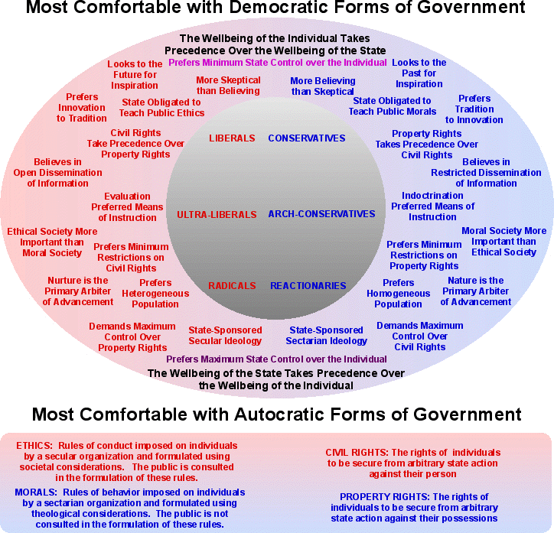

Slide 12
Essential Question
How do Conservatives and Liberals represent contrasting American political ideologies?
Homework
Write Summary of your own political ideology according to the quiz we previously took.

