Slide 1
Consuming Media
Participation in Government
Johnstown High School
Mr. Cox

Slide 2
Define: 1. Media 2. Press, then distinguish between the two.
“What is the job of the News Media/Press?”
Entertain or inform? Does it matter?
Define Bias? Is it always bad?
Comment on the following statement:
“you are what you read, see, and hear.”
Intelligently Consume Information
Challenge for you, “the Consumer”
Frame of Reference
When you have none, all information will appear to be regular news story, and not an apparent attempt to sway the public’s view.
Awareness of the Outlet’s Political Bias
this will give you a skeptical and more critical look at the information presented.

Slide 3
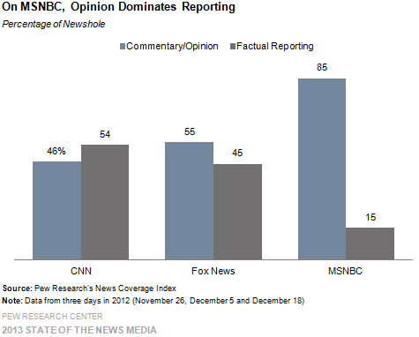
Big Three Opinion Based Reporting

Slide 4
We the Consumer Need to Identify:
Story Framing / Word Selection
How the story is presented
Every story can be told differently
Softball v. Hardball News Reporting
You aggressively interview and/or pursue those people and points you disagree with, and softball the views and people who share your views.
Photo Images
Do the images reinforce a stance/stereotype>?
Bias by Omission
Ignoring a story, or marginalizing a story that does not reinforce your opinion or world view

Slide 5
Tonight
Watch the news..
Pick a station, any station
NBC, CBS, ABC, FOX, CNN, TWC, Local News, Yahoo!, BBC, etc.
Watch as much as you want, but focus on a single segment/news story. For that segment or news story, identify the following:
The Issue(s) Addressed
Story Framing
Softball or Hardball
Photo Images
Bias by Omission (if applicable)

