Slide 1
Laws and Lawmaking
Participation in Government
Johnstown High School
Mr. Cox

Slide 2
Congressional Committees – How the Bills Really Become Laws
Committees – these play a vital and crucial role in the development of a bill.
Draft or consider bills based on certain topics to be taken before congress
Featured in both senate and the house
Committees rise and fall as time progresses based on current needs

Slide 3
Current United States Congressional Committees
Senate | Aging (Special) · Agriculture, Nutrition and Forestry · Appropriations · Armed Services · Banking, Housing, and Urban Affairs · Budget · Commerce, Science and Transportation · Energy and Natural Resources · Environment and Public Works · Ethics (Select) · Finance · Foreign Relations · Health, Education, Labor, and Pensions · Homeland Security and Governmental Affairs · Indian Affairs · Intelligence (Select) · Judiciary · Rules and Administration · Small Business and Entrepreneurship · Veterans' Affairs
House | Agriculture · Appropriations · Armed Services · Budget · Education and the Workforce · Energy and Commerce · Ethics · Financial Services · Foreign Affairs · Homeland Security · House Administration · Intelligence (Permanent Select) · Judiciary · Natural Resources · Oversight and Government Reform · Rules · Science, Space and Technology · Small Business · Transportation and Infrastructure · Veterans' Affairs · Ways and Means ·
Joint | Deficit Reduction (Select) · Economic · Inaugural Ceremonies (Special) · Library · Printing · Taxation

Slide 4
Steps to Making a Law
Proposal – by Senate, House, or Joint Committee
Vote – in one house, often bills are sent back to committee for revising
Vote in other House – if passed, the bill must be passed by the other house before
Signed by the President
2/3 vote in both houses overrides veto

Slide 5
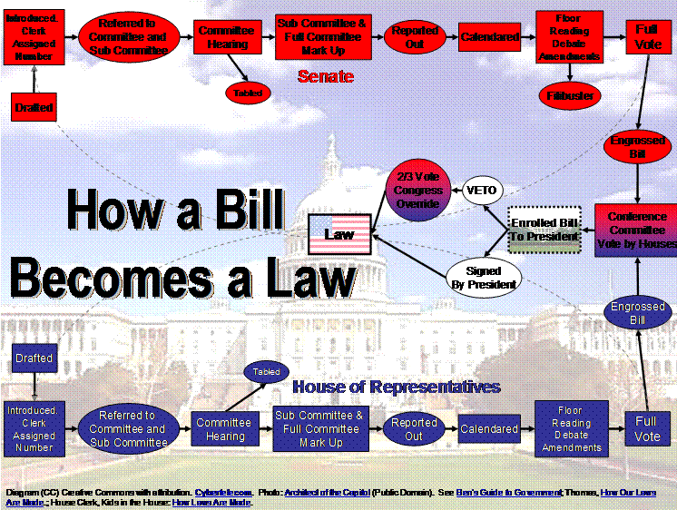

Slide 6
Which Committees would each of the following Bills begin in?
ObamaCare
Iran Nuke Deal
Clean Air Act
Students with Disabilities Act
Property Tax
Watch School House Rock video…
LINK TO…

Slide 7
How Can One Stop a Bill?
Filibuster – a Parliamentary Procedure (agreed upon rules of order used by both the Senate and the House)
House of Representatives – used until 1842, when a permanent rule limiting debate was created.
Senate – still uses this tactic today.
This grants the right of an individual to extend debate
Allows a lone member to delay or entirely prevent a vote on a given proposal.
https://www.youtube.com/watch?v=RkJJd7If0Aw

Slide 8
Essential Question
How do Conservatives and Liberals represent contrasting American political ideologies?
Homework
Write Summary of your own political ideology according to the quiz we previously took.

Slide 9
From a Bill to a Law Project
The class will be given two different bills,
which they will attempt to pass them into law.
The class will be subdivided into a “House” and a “Senate.”
The House and the Senate will each get a particular Bill to begin with.
You will be given 10 minutes to discuss and modify the given bill (shared with one group member via Google Docs)
Take an initial vote on positions of the bill
Modify the wording to get a majority vote within your group
If passed, the bill will head to the other branch of Congress.
The entire process will begin again, where another 10 minutes will be given, until we have two passed/killed bills by both houses.
If any changes have been made to either bill by the other house, the conference committee (the whole class), must rectify the bill. This is all done within 5 minutes.
After the time is up, the bill will be voted upon a final time for Presidential veto or signature.
If vetoed, the bill goes back to the two houses, where 2/3 passage is required for the bill to be passed into law.

