Slide 1
Interest Groups and Lobbying
Participation in Government
Johnstown High School
Mr. Cox

Slide 2
Interest Groups
Group of individuals who represent a particular cause or group and have an interest in influencing legislation
Many different Types
Businesses/Corporations
Labor Unions (AFL-CIO, NYSUT)
Single Issue Groups (NRA, NEA)
Demographic Groups (AARP, NAACP)

Slide 3
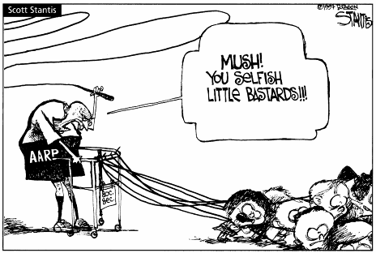
AARP:
The Nation’s Most Powerful Interest Group
The National Rifle Association
36 million members
Offers a wide array of material benefits like insurance and magazines
One of the most influential lobbying groups in D.C.

Slide 4
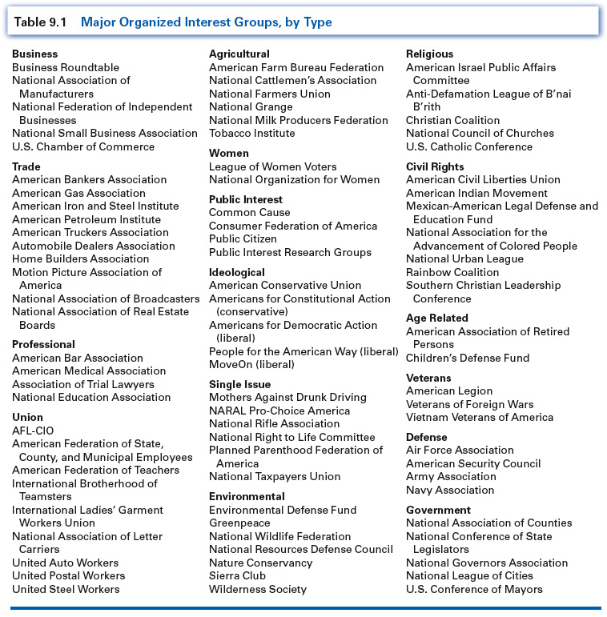
Major Organized Interest Groups

Slide 5
Lobbying
The process of influencing legislation
Lobbyists work for Interest Groups and are paid to achieve legislative goals
Strategies Used
Campaign Contributions
Organizing fundraisers
Persuasion
Incentives: Monetary and Material
Note*
Technically speaking, lobbying can be any influencing action, therefore the writing of a letter to an elected rep or attending a public meeting and speaking up is considered to be lobbying!

Slide 6
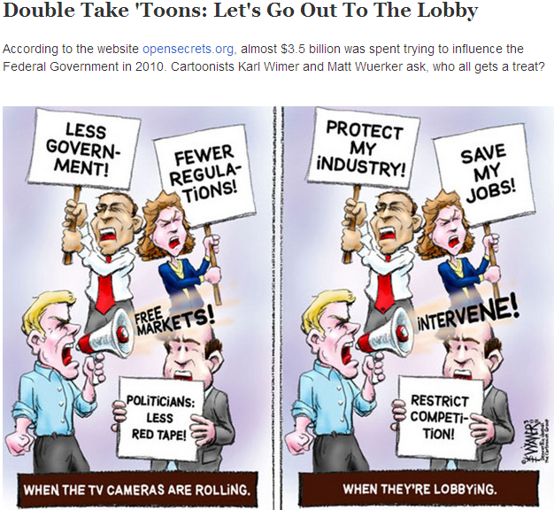

Slide 7
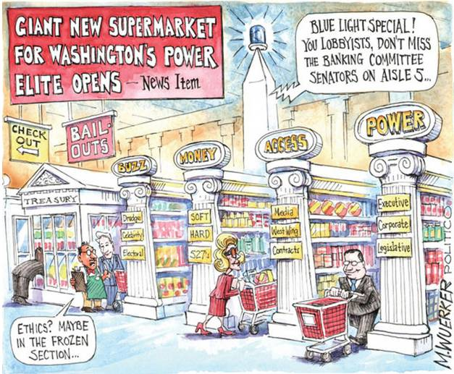

Slide 8
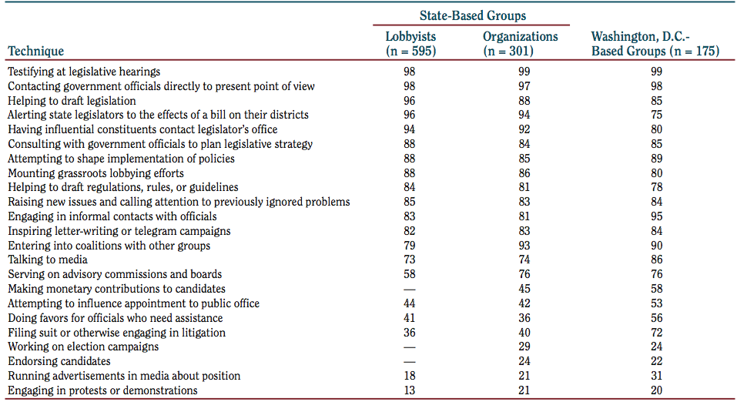
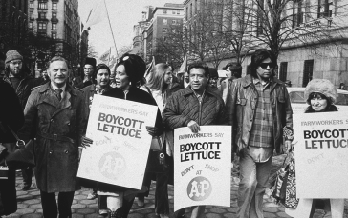
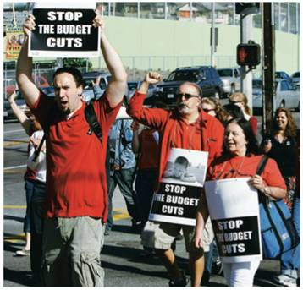
Other Techniques
Notes:
Pictures of Grape Boycott led by Cesar Chavez, teachers in downtown Los Angeles protesting state budget cuts for education, and PETA.
Groups often use protest to generate interest and to bring support to their cause.

Slide 10
“Amazing, the man makes a fortune as a crooked lobbyist then once he's caught he spins himself as this naive fool who innocently got caught up in a game he didn't completely understand. And from this he continues to make a fortune on books and lectures! Talk about a spin king. He should be shot for treason.”

Slide 11
Political Action Committees (PACs)
PACs – the political arm of an interest group that can fundraise legally
Allows lobbyists direct influence over officials
Funds can be withheld if agreeable terms aren’t met
Indirectly grants Interest Groups a large amount of influence in the democratic process.
Ethical Situation
Shouldn’t these groups have more influence than everyday Americans? After all, they represent not only large financial interests, but large groups of people as well…

Slide 12
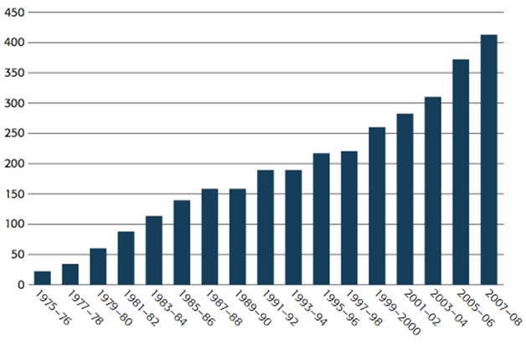
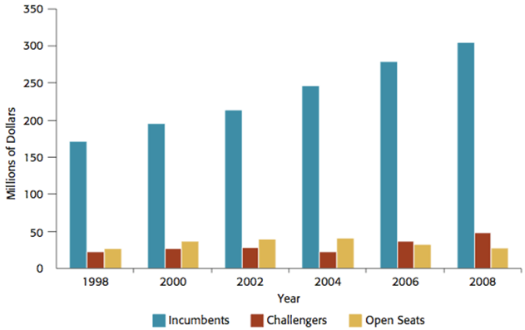
PAC Contributions to Congressional Candidates
1998–2008.
Contributions to Candidates for U.S. Congress, 1975–2008
(in Millions).
Notes:
12

Slide 13
Essential Question
Homework

