Slide 1
Political Parties
Participation in Government
Johnstown High School
Mr. Cox

Slide 2
Bellringer
Which demographics typically identify as conservative or liberal? Why is this?
Essential Question
How does America’s two party system impact its government?

Slide 3
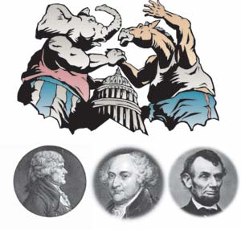
U.S. Political Parties
What is a political party?
Organization of people who share similar ideas about the way the country should be governed

Slide 4
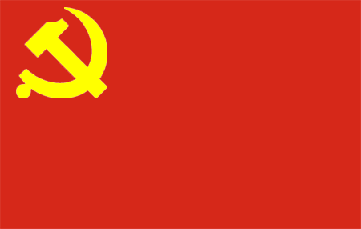
Political Party Systems
3 Political Party Systems in the World
1.) One Party System: Political party and the government are the SAME
Only 1 party, so no competing ideas
Party membership based on lineage, wealth, military power, religious power
Example: China (Communist Party)

Slide 5
Political Party Systems
2.) Multi-Party System: Three or more parties compete for control of the government
Common in Europe, Israel, Japan
Advantage: provides voters with many different choices and ideas
Disadvantage: difficult for one party to get majority of votes, action can be slow

Slide 6
Political Party Systems
3. Two-Party System: Two parties compete with each other to run the government.
Party system of U.S.: Democrats and Republicans
Advantages: Continuity
Disadvantages: Minority parties (third parties) receive little attention – focus is on two main parties

Slide 7
U.S. Political Parties: Beginnings
George Washington against political parties
“parties serve their own interests”
“parties not beneficial to American people”
Parties formed after his exit:
Democratic-Republicans
2. Federalists

Slide 8
The Big 2
Democrat Party – founded in 1828
Republican Party – founded in 1854

Slide 9
The Big 2
Democratic Party
Tends to Attract
Working people (blue collar)
Liberals
Catholics
Minorities
Union Members
People in favor of govt. involvement in social policies

Slide 10
The Big 2
Republican Party
Tends to attract
Businesspeople (white collar)
Protestants
Conservatives
Non-minorities
Non-union supporters
People against govt.involvement in social policies

Slide 11
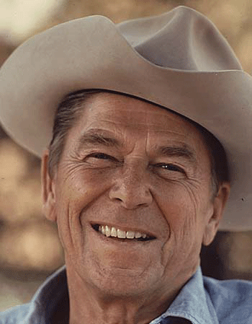
How To Tell Em Apart
Republicans usually wear hats.
Ronald Reagan

Slide 12
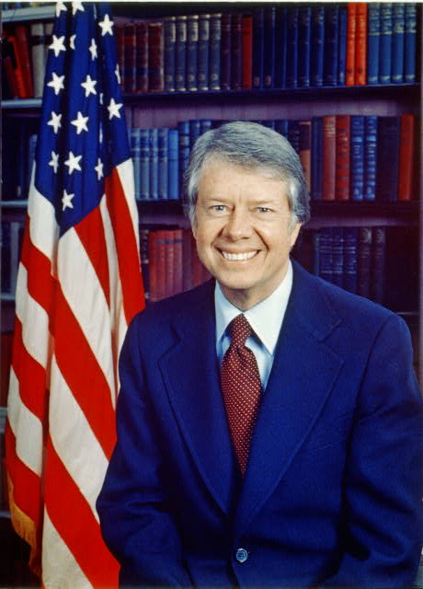
How To Tell Em Apart
Democrats usually don’t.
Jimmy Carter

Slide 13
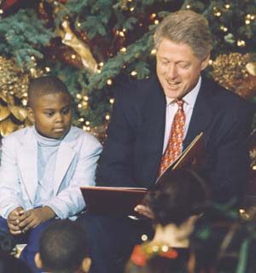
How To Tell Em Apart
Democrats buy banned books.
Bill Clinton

Slide 14
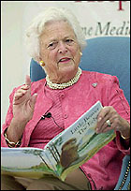
How To Tell Em Apart
Republicans form censorship committees, and then read them.
Barbara Bush

Slide 15
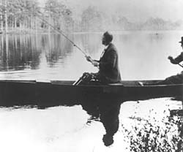
How To Tell Em Apart
Democrats eat the fish they catch.
FDR Fishing in Warms Springs, GA

Slide 16
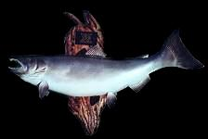
How To Tell Em Apart
Republicans hang them on their wall.

Slide 17
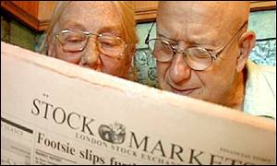
How To Tell Em Apart
Republicans study the financial pages of the newspaper.

Slide 18
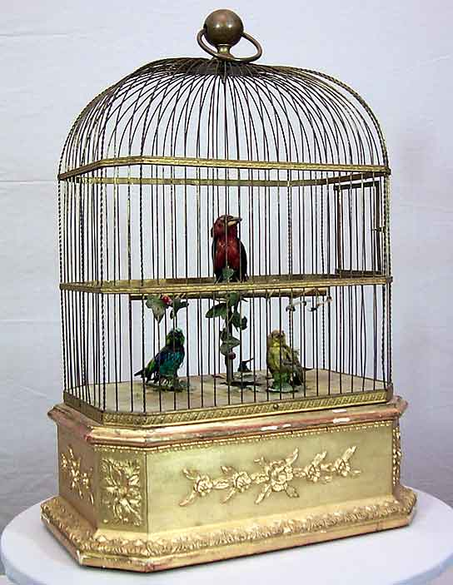
How To Tell Em Apart
Democrats put them on the bottom of their bird cage.

Slide 19
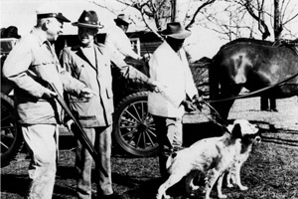
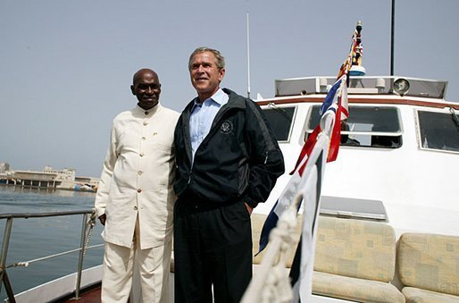
How To Tell Em Apart
On Saturday, Republicans head for the golf course, the yacht club, or the hunting lodge.
President George
W. Bush yachting
and golfing.
President Dwight D. Eisenhower hunting

Slide 20
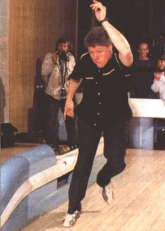
How To Tell Em Apart
Democrats get a haircut, wash the car, or go bowling.
A younger Bill Clinton bowling

Slide 21
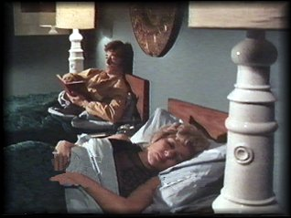
How To Tell Em Apart
Republicans sleep in twin beds – some even in separate rooms.

Slide 22
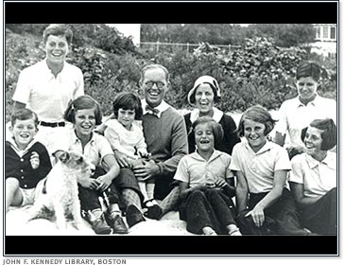
How To Tell Em Apart
That is why there are more Democrats.
The Kennedy Family

Slide 23
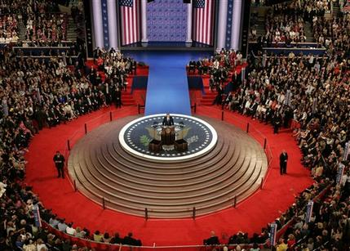
What Do Political Party Members Do??
Major function of each party is to get its candidate elected to office
Steps include
Party members nominate, or name the candidates they want to run for office

Slide 24
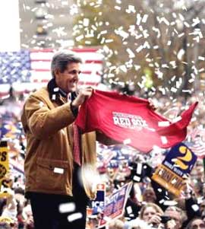
What Do Political Party Members Do??
2. Party starts an election campaign
An effort to gather support for its candidates and inform voters of the party’s stand on issues
Requires many party workers and volunteers to perform dozens of job that include:
Raising funds
Polling voters/making phone calls
Drive voters to the polls
Register voters

Slide 25
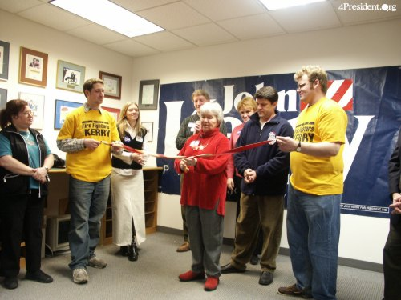
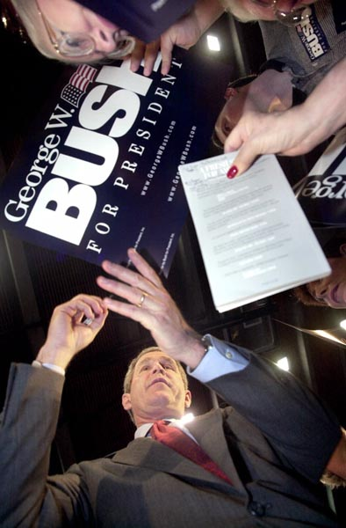
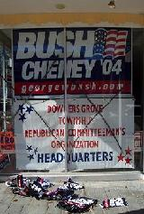
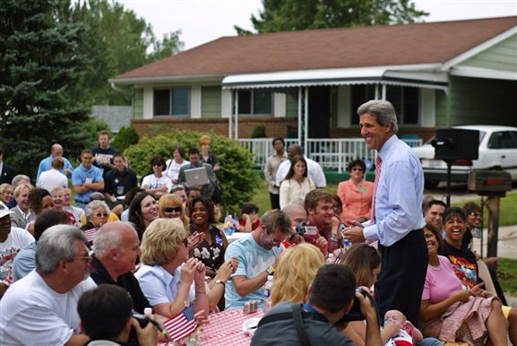
What Do Political Party Members Do?
Presidential Election Campaigns

Slide 26
What Do Political Party Members Do?
3. Once a party’s candidate is elected, the party helps the candidate organize and manage the govt.
Example: When a President is elected, 100’s of job vacancies in govt. must be filled. Jobs usually filled by party members who have contributed time, energy and money to the campaign.
Patronage: giving jobs or special favors to party workers

Slide 27
Third Parties
What are Third Parties?
Parties representing minority opinions that challenge the Democrats and Republicans
Some successful Third Parties:
Populist Party – 1890’s
Progressive Party – split off from Rep. Part in 1912
Libertarian Party – third most popular party in U.S. today

Slide 28
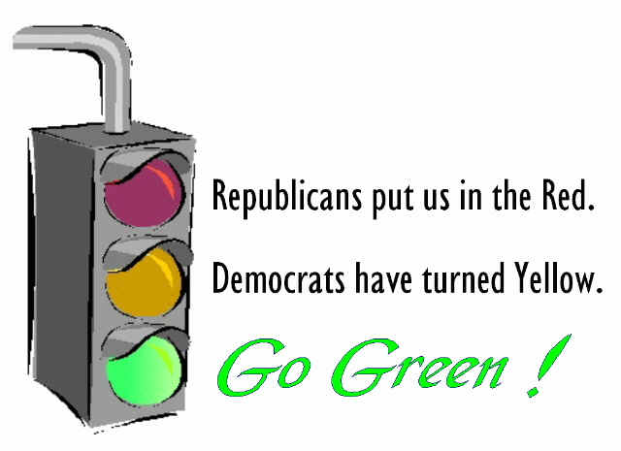
Third Parties
3 Kinds of Third Parties
1. Parties Tied to a Single Issue:
Examples:
Prohibition Party: formed in 1872 to support banning of alcohol in the U.S.
U.S. Marijuana Party: formed to support the legalization of marijuana in the U.S.
Green Party: formed to protect the environment
Link 1

Slide 29
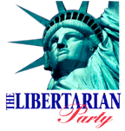
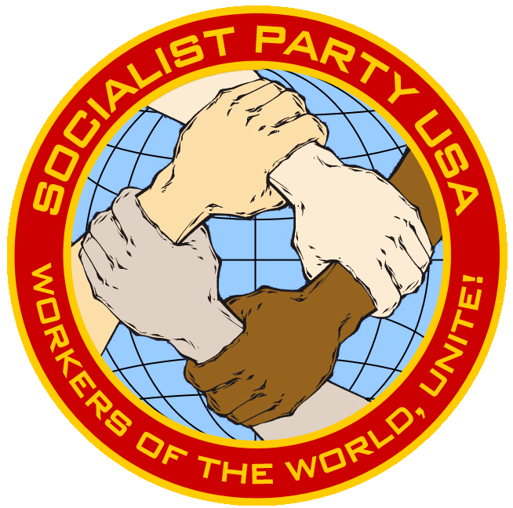
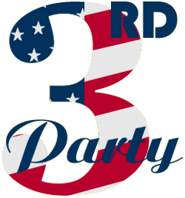
Third Parties
3 Kinds of Third Parties
2. Parties Tied to a Political Belief
Examples:
Libertarian Party
The Third Party
Socialist Parties

Slide 30
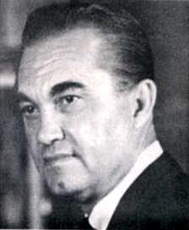
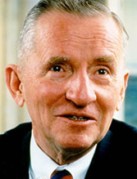
Third Parties
3 Kinds of Third Parties
3. Parties Tied to a Single Candidate
Examples:
Reform Party – formed around Presidential candidate Ross Perot in 1996
American Independent Party – formed around Presidential candidate George Wallace in 1968

Slide 31
Third Parties
America First Party
American Heritage Party
American Independent Party
American Nazi Party
Communist Party USA
Constitution Party
Family Values Party
Grassroots Party
Green Party
Independence Party
Labor Party
Libertarian Party
Light Party
Natural Law Party
The Third Party
Worker’s World Party
Peace and Freedom Party
Prohibition Party
Reform party
The Revolution
Socialist Party, USA
Southern Independence Party
U.S. Pacifist Party
Veterans Party of America
We the People Party
Knights Party
Libertarian National Socialist Green Party
Pansexual Peace Party
Pot Party
Constitutional Action Party
American Falangist Party
U.S. Marijuana Party

Slide 32
Essential Question
How does America’s two party system impact its government?
Homework

Slide 33
History of Political Parties in the U.S.
Why Created?
Organizational Practicality:
Helps categorize who we may want to vote for
Narrows the choice for voters
Party typically highlights common issues important to broadest swath of voters
Incumbent
Someone already in office
Can create stability and continuity
Often difficult to remove from office
Peaceful Transition
Well established Democracy promotes stability
Negatives:
Entrenched Politicians, controlled by the Political Machine
Difficult for them to be beat, corruption can continue
Alternatives:
Term Limits – some may argue, that removes the democratic process

Slide 34
Third Parties
Often Influence Election Platforms, but rarely if ever win….
They often act as spoilers….
Election of 2000…
Many parties have formed and dissolved over the years
http://en.wikipedia.org/wiki/List_of_political_parties_in_the_United_States
Rent is….
Link 1
Link 2

