Slide 1
Federal Policy
Participation in Government
Johnstown High School
Mr. Cox

Slide 2
Types of Policy
Policy – refers to any grouping of legislation passed by a government
Social – social issues: race, abortion, gay marriage, etc
Fiscal – economic issues: foreign aid, social security, subsidies, etc
Budgetary – federal budget: taxes, cuts in spending, financing programs, etc
Education – funding for schools tied to grants/mandates
Trends in policy illustrates partisan control in executive and legislature
Also appears heavily during election cycles

Slide 3
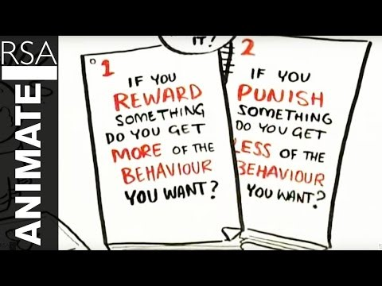

Slide 4
Education Policy
Education is a reserved right to the states, not delegated to the federal government
Therefore, federal government must influence educational policy through grants
Categorical Grants – money given to schools that has mandated usages (must be used for a certain purpose)
Policy Grants – money given to schools to aid in implementing federal policy mandates
Money goes to schools and State Ed Depts

Slide 5
No Child Left Behind Act
Goal: to improve the performance of U.S. schools
Components include
increased accountability
more choices for parents choosing schools
increased focus on reading
Receipt of federal funds are tied to school performance
Schools that succeed in meeting standards receive more money
Parents can move children to higher-achieving schools

Slide 6
No Child Left Behind Act
Concerns:
Schools already behind would become even more poorly funded
Teachers would spend most time preparing students for standardized tests
Some states established more charter schools
A public school that operates under a charter with freedom from many of the regulations that apply to traditional public schools.
© Darrin Henry/Shutterstock

Slide 7
Race to the Top
“$4.35B competitive fund grant to encourage and reward states making dramatic education reforms, especially in the four statutory ‘assurance areas’:
Standards and assessments that prepare students for success
Data systems to support instruction
Great teachers and leaders
Turning around struggling schools” - US DOE
Essentially, RTTP did the following things:
Implemented strict content standards (Common Core)
Harsh teacher evaluations (APPR)
Rewarded schools for high scores as they ‘compete’ with one another

Slide 9
Discussion Points
Reform Initiatives
Emphasis on Standardized Tests: should it be increased or decreased? Why?
Are tests important, or just a useless tool?
Privatization of Education
Should we seriously begin to consider private high schools?
What issues might they present?
Student input: what have you enjoyed doing in school?
Why was it beneficial?
How could those activities be incorporated into educational policy?

