Slide 1
Markets and Economic Systems
Introduction to Economics
Johnstown High School
Mr. Cox

Slide 2
Bellringer
Define: goods, services, resources, scarcity
How does the American Economy represent a mixed free-market economy?
Essential Question

Slide 3
Economic Systems
Def. The method used by a society to produce and distribute goods and services.
Def. the possible consumer base for a particular good or service
“Pieces of a Pie”
Market

Slide 4
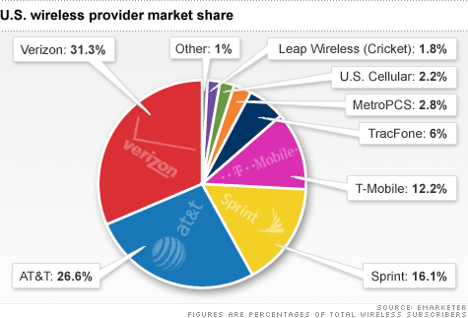
Pieces of the Pie – Cell Phone Providers

Slide 5
All Economic Systems Must Consider the Following Questions:
What goods and services to produce?
How will they produce them?
Who will get them?
How much will they produce now, and how much later?
Each economic system answers these questions in a DIFFERENT WAY.
Worksheet

Slide 6
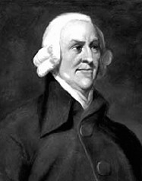
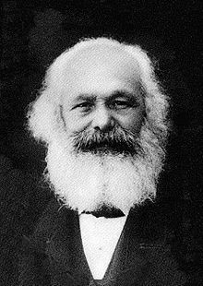
The Battle of Two Economic Models
Adam Smith
1723 – 1790
Scotsman
Karl Marx
1818 – 1883
Prussian-German

Slide 7
Karl Marx’s Plan
What is the problem? Wealthy control resources, therefore control working class
Who can fix it? – The intellectual class, central authority, the government (Decision makers)
What is done? – The central authority dictates how resources are allocated
Why this way? – Intended to provide equality
“From each according to his ability, to each according to his need…..”

Slide 8
Adam Smith’s Plan
What is the problem? Economic decisions should be made by the individual
What is done? – “The invisible hand” guides decision making, ensures efficient use of resources
Why do this? –When people handle resources that are not their own, they are not incentivized to be efficient. We never handle “other people’s money” like we handle our own.
How is this done? – The invisible hand or self interest ensures each individual makes decisions based on their own best interests..
“The real tragedy of the poor is the poverty of their aspirations.”

Slide 9
Types of Economic Systems
There are 3 basic types of economic systems.

Slide 10
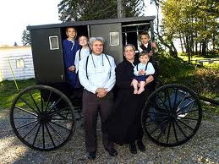
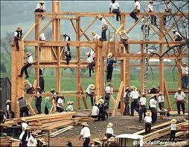
1. Traditional Economy
Economic questions are answered by habits and customs (the way it has always been done)
Children work the same jobs parents worked, often farming or hunter/gatherer
Fear Change!
Ex. Eskimos, the Amish, Pigmies

Slide 11
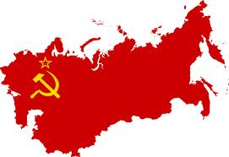
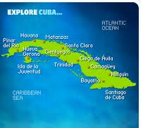
2. Command Economy
The government answers the basic economic questions
Advantages: able to act quickly in emergencies, provide for all people equally
Disadvantages: Inefficient, no incentive to work hard or be creative
Ex. Communist Countries (China, Vietnam, North Korea, former Soviet Union, Cuba)

Slide 12
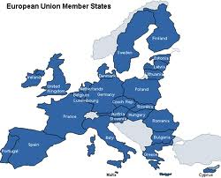
3. Free Market Economy
Economic questions are answered by individual buyers and sellers.
Supply and demand influence economy
People act out of self interest; motive for profit (money) drives the economy
Also known as FREE ENTERPRISE or CAPITALISM
Ex. The United States, Western Europe, Japan

Slide 13
I lied!
I said there were 3 types of economic systems, but there is a 4th!
Mixed Economy: No economy is pure market, pure command or pure traditional, elements of each appear in all economies, some have more elements of one economy than another.
America has a mixed economy
Market Mixed Command
USA Great Britain China

Slide 14
Features of American Free Market Economy
Economic Freedom: individuals have the right to choose
Competition: more than one producer of good/services insures choice
Private Property: individuals have the right to own their own property, including business
Self-Interest: individuals make
decisions based on what is best for them
Voluntary Exchange: individuals may freely buy and sell goods
Profit Motive: individuals are driven by a desire to profit (make money)

Slide 15
Features of American Command Economy
Government regulation of some business practices
Ex. Wages, labor hours, safety practice.
Government limits certain choices
Ex. Cannot buy or produce certain goods/services
Government provides aid to the needy
Ex. Medicare, Medicaid, welfare

Slide 16
My Pizzeria
How would my pizzeria function under different economic systems?

Slide 17
My Pizzeria in a Free Market
I answer the basic economic questions!
I determine how much cheese and pepperoni goes on the pizza
I determine the quality of the cheese and pepperoni
I set my employees wages
I set my business hours

Slide 18
My Pizzeria in a Command Economy
The government answers the basic economic questions
The government sets the amount of cheese and pepperoni on each pizza
The government determines quality of cheese and pepperoni
The government sets employees wages
The government sets business hours
Problem: What does the government know about pizza?

Slide 19
My Pizzeria in a Mixed Economy
The Government and I both answer the basic economic questions
I determine the amount of cheese and pepperoni on the pizzas; government determines the quality of cheese and pizza
I set employee wages; government sets minimum wage for employees
I determine business hours; government determines whether I am safe to be open or not

Slide 21
Economic “Systems”
Describe the challenges of the three Economic Questions.
What is the challenge of balancing freedom v Security?
Four systemic ways of answering those questions are demonstrated through the following…. (Define each….)
Traditional Economies
Market Economies
Command Economies
Mixed Economies
Interestingly enough you have just been placed in control of a nation.
Your assignment is to:
Name the fledgling country
Describe the region of planet earth in which it is located.
Establish an economic system you believe will enable it to function most efficiently.
Defend your reasoning for the choice you have made.

