Slide 1
The American Constitution – The “How”
Participation in Government
Johnstown High School
Mr. Cox

Slide 2
Bellringer
Define: constitution
How does the composition of the American Constitution reflect enlightenment thought as well as progressive (forward thinking) ideology?
Essential Question

Slide 3
The Constitution
Created by a special convention of delegates from the original 13 states
Over the course of 2 ½ years, the Constitution was drafted and ratified by the states
Contains seven separate articles and a series of amendments, with the first called the Bill of Rights

Slide 4
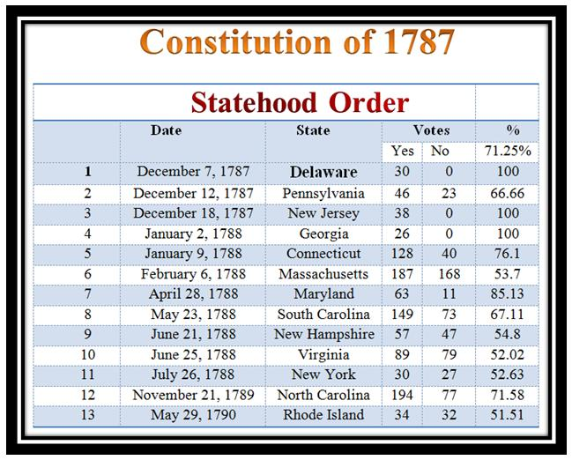

Slide 5
Influences
Role of Government – Locke
Consent of the Governed, Social Contract, etc
Separation of Powers/Checks and Balances – Montesquieu
Three Branches of Government
Ex. – Veto and Veto Override
Natural Rights - Rousseau
Bill of Rights – Cannot be impeded up by government

Slide 6
Six Key Constitutional Principles:
Popular Sovereignty – People decide for themselves
Limited Government – Laissez Faire
Separation of Powers – 3 Branches
Legislative, Executive, Judicial
Checks and Balances – Power is distributed and ‘supervised’
Judicial Review – Constitutionality of laws by Sup. Court
Federalism – Fed Gov is superior over state/local

Slide 7
https://www.youtube.com/watch?v=0bf3CwYCxXw&index=3&list=PL8dPuuaLjXtOfse2ncvffeelTrqvhrz8H

Slide 8
Articles of the Constitution
Legislature – Creates a bi-cameral legislature invested with the primary law making powers. Contains the House of Reps. and the Senate
Executive – creates the executive branch invested with the administration of the union. Contains the president and later the cabinet and executive offices
Judicial – Creates the federal court system to interpret laws. Contains the Supreme Court and lower courts

Slide 9
Articles Cont’d.
States Rights – defines the responsibilities and duties of states. Also explains the relationship between states and the Federal Government
Amendments – defines the amendment process to change the Constitution
Constitutional Authority – Constitution is the highest law of the union and must be upheld. Also carried over previous national debt
Ratification – 9/13 states must ratify the Constitution

Slide 10
How has the Constitution changed?
A proposed amendment passes through both houses with 2/3 vote
Now has 27 Amendments
The Amendment must be ratified by ¾ of the state legislatures.
Should it change thought…?

Slide 11
Interpretation of the Constitution (2 Views)
Originalism
Living Constitution
Generally a Conservative Position
The philosophy that the judiciary’s role is to uphold the rule and intent of the original constitution.
(all other duties should be relegated to Congress)
“Take the document as it is”
If it ain’t broke, don’t fix it
Generally a Liberal Position
The philosophy that we cannot know the intent of the framers, and thus we must interpret the text of the Constitution and its meaning into our time.
“Document as it should be”
Improvements are necessary as times change

Slide 12
Are there some values (laws) that don’t change/shouldn’t change?
Why should the constitution change (if you think it should)?
Who should have which powers?
Enumerated Powers – powers set forth to congress by the Constitution
Others go to states

Slide 13
United States Legislature
Bicameral Legislation – Two Co-Equal Houses
House of Representatives
# of Representatives depends on State’s population
Must be 25 years old
435 Legislators
Elected every 2 years
Has the Power to Impeach the President
Census
Taken every ten years
For reapportionment of House seats
Danger of Gerrymandering
Senate
2 members from each state
Must be 30 years old
100 Senators
Elected every 6 years
Has the authority to remove an impeached President, if 2/3 vote for removal.

Slide 14
Bills, Bills and More Bills….
Everything was designed to move slowly, in a very labored fashion.
Ours is a government that was designed for prudence
All Budget Bills begin in the House of Representatives
The most Democratic Legislature
Then Moves to the Senate, upon approval moves to the President.
President can sign or veto.
Upon veto, House of Representatives and the Senate must pass the bill by a 2/3 majority to override the veto.

Slide 15
Executive Branch
Four-Year Term
Eligibilities
Must be a Natural Born Citizen
Electoral College – determines presidency not popular election
Number of electors in a given state is:
States # of House of Representatives plus the 2 Senators
Each state popular vote determines a winner take all regarding the electoral college.
http://www.270towin.com/

Slide 16
Line of Succession
# | Office | Current Officer
1 | Vice President | Joe Biden
2 | Speaker of the House of Representatives | Paul Ryan
3 | President pro tempore of the Senate | Orrin Hatch
4 | Secretary of State | John Kerry
5 | Secretary of the Treasury | Jack Lew
6 | Secretary of Defense | Ash Carter
7 | Attorney General | Loretta Lynch
8 | Secretary of the Interior | Sally Jewell
9 | Secretary of Agriculture | Tom Vilsack

Slide 17
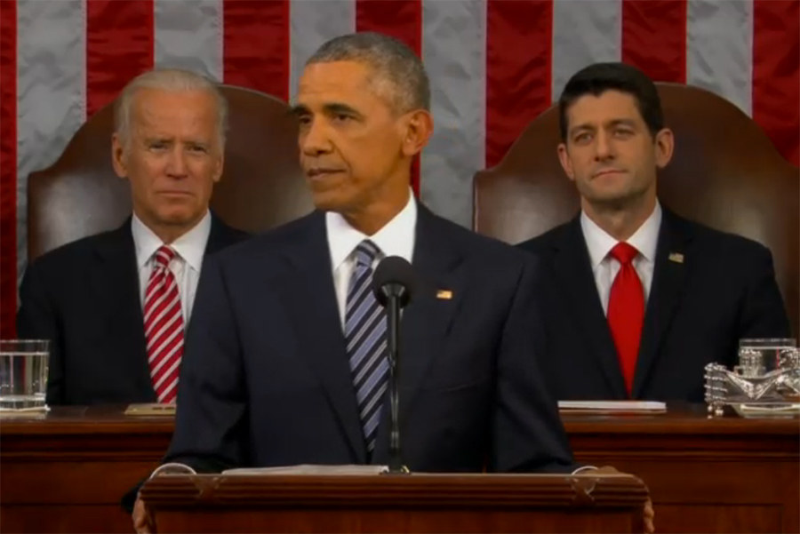
2 1 3

Slide 18
# in office | President | Year(s) elected | Length of term (days) | Date of death | Cause of death | Age | Successor
9 | Harrison, William H. | 1840 | 31 | April 4, 1841 | Pneumonia and pleurisy | 68 | Tyler, John
12 | Taylor, Zachary | 1848 | 491 | July 9, 1850 | Acute gastroenteritis | 65 | Fillmore, Millard
16 | Lincoln, Abraham | 1860, 1864 | 1,503 | April 15, 1865 | Assassinated by John Wilkes Booth | 56 | Johnson, Andrew
20 | Garfield, James A. | 1880 | 199 | September 19, 1881 | Assassinated by Charles Julius Guiteau | 49 | Arthur, Chester A.
25 | McKinley, William | 1896, 1900 | 1,654 | 14-Sep-01 | Assassinated by Leon Frank Czolgosz | 58 | Roosevelt, Theodore
29 | Harding, Warren G. | 1920 | 881 | 2-Aug-23 | Heart Attack | 57 | Coolidge, Calvin
32 | Roosevelt, Franklin | 1932, 1936, 1940, 1944 | 4,422 | 12-Apr-45 | Cerebral hemorrhage | 63 | Truman, Harry S.
35 | John F. Kennedy | 1960 | 1,036 | 22-Nov-63 | Assassinated by Lee Harvey Oswald | 46 | Johnson, Lyndon B.

Slide 19
Executive Branch
Responsibilities as well as Checks
Commander in Chief
Leading official regarding oversight of military operations
Broker Treaties w/ Foreign Nations
All must be ratified by 2/3 of Senate
Commission Federal Judges
Must be approved by Senate
State of the Union Address
Must be delivered yearly
Removal From Office
Only on the basis of:
Treason, Bribery, Other High Crimes or Misdemeanors.

Slide 20
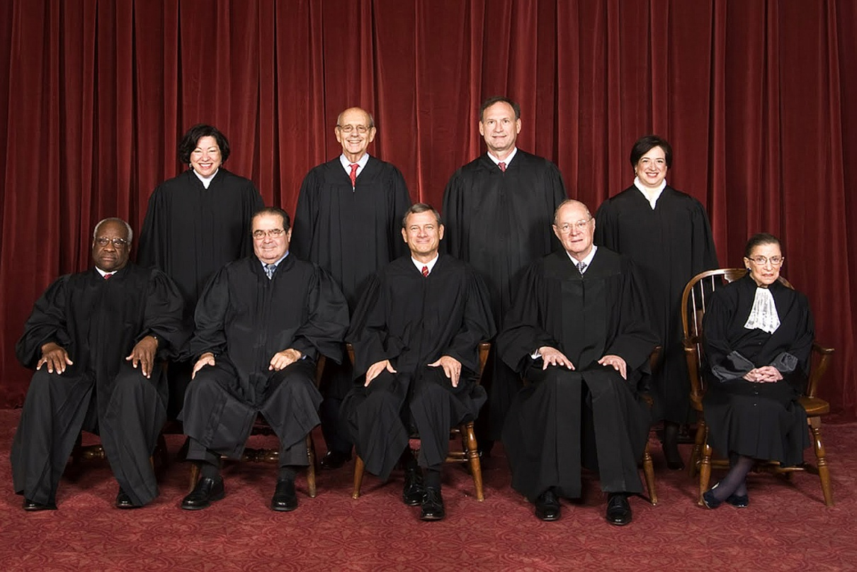
Judicial Branch
Lifetime Appointments for Justices
9 Justices, nonpartisan, appointed by Presidents
Approved by Congress
Supremacy Clause – decisions by Supreme Court trumps state/local courts

Slide 21
Article V – Amending Power
Amendment Process - very, very, very, very, very, difficult to do. Only have ever passed 27….
First, 2/3 of the House of Reps must pass the proposed amendment
Then, 2/3 of the States must ratify and pass an amendment to change to the Constitution.

Slide 22
Essential Question
How does the composition of the American Constitution reflect enlightenment thought as well as progressive (forward thinking) ideology?
Homework

