Slide 1
Native North Americans
Global History and Geography I
Mr. Cox

Slide 2
Bellringer
What are three words/phrases that you would use to describe a Native American?
Essential Question
Why did different North American tribes develop in different regions?

Slide 3
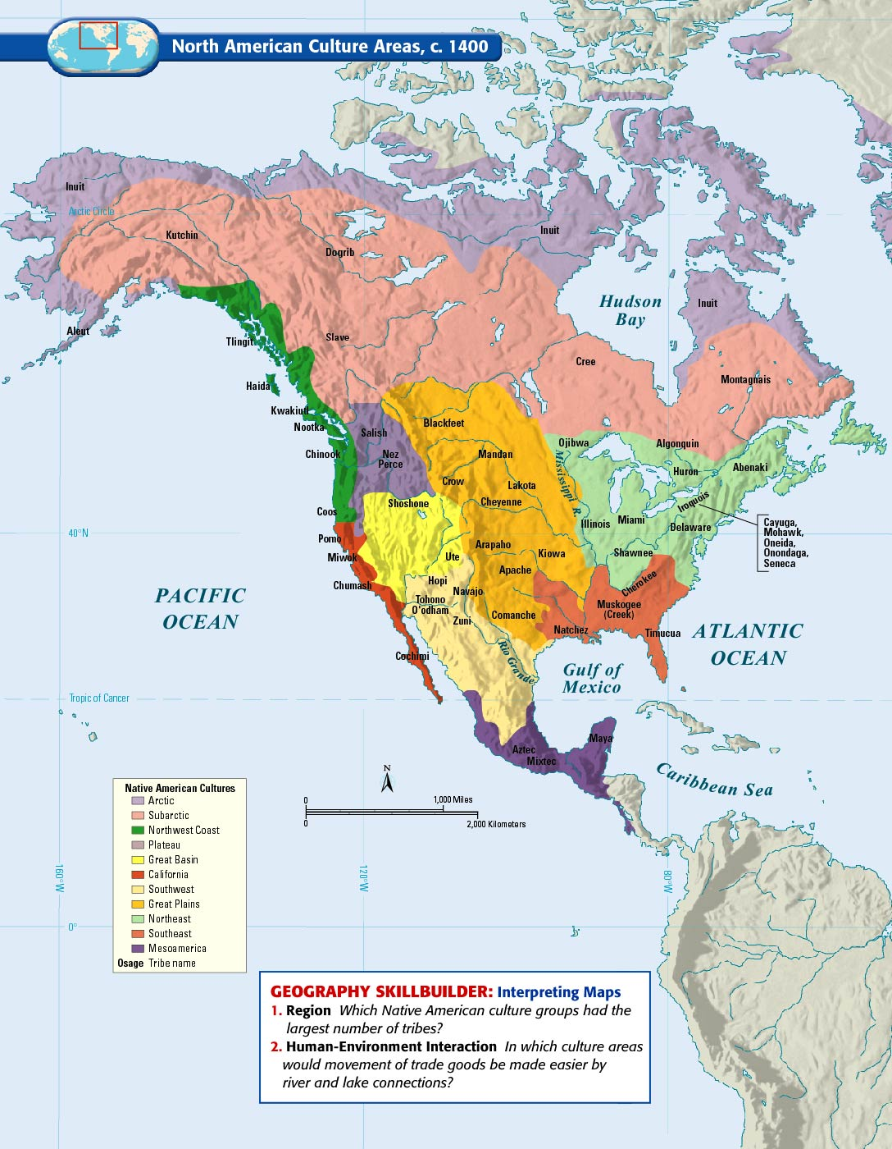

Slide 4
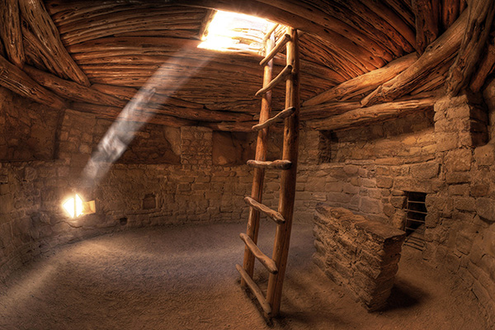
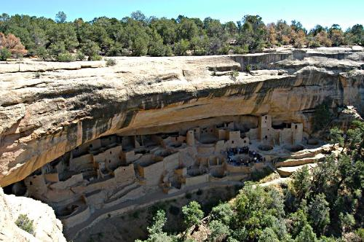
I. Southwest/Desert
Where: Southwest United States, ‘four corners’ area
Dwellings: Pueblos – large villages, and cliff dwellings (protection)
Culture: farming using irrigation, kiva: underground religious temple
Other: Cliff dwellings featured communal living: apartment rooms that were all shared

Slide 5
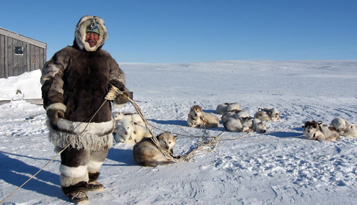
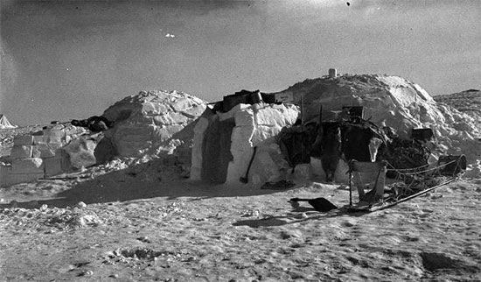
II. Inuit's (Eskimos)
Where: Northern Canada and Alaska
Dwellings: sod homes underground or igloos
Culture: lived by hunting and fishing, adapted to environment
Other: transported goods using sleds and kayaks

Slide 6
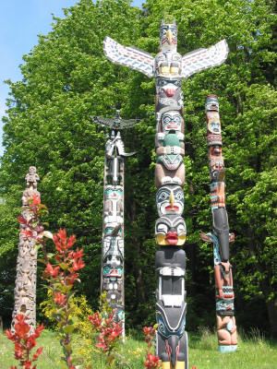
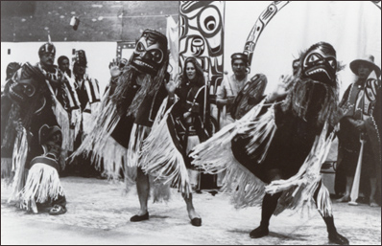
III. Northwest Coast Indians
Where: Northwest United States, Southwest Canada
Dwellings: Wood-made homes, permanent settlements
Culture: Rich farmland, surplus of food
Potlatch: gift-giving ceremony
Other: much of this culture is continued today

Slide 7
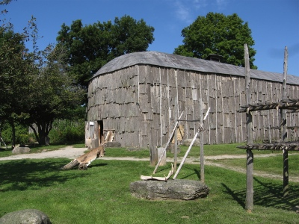
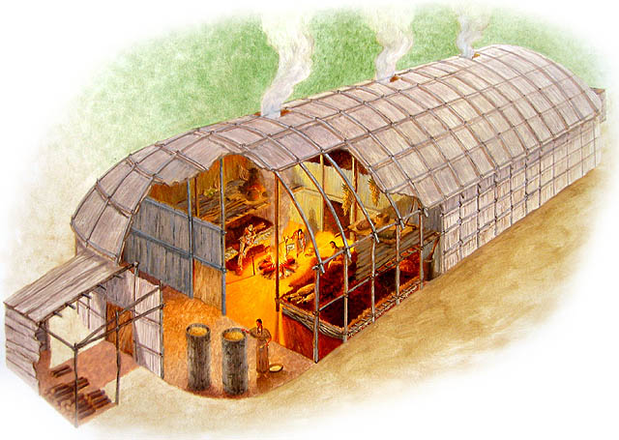
IV. Iroquois League
Where: Northeast United States, Southeast Canada
Dwellings: Longhouses, permanent villages
Culture: Relied on the farming of the ‘three sisters’
Other: Confederation of five tribes

Slide 8
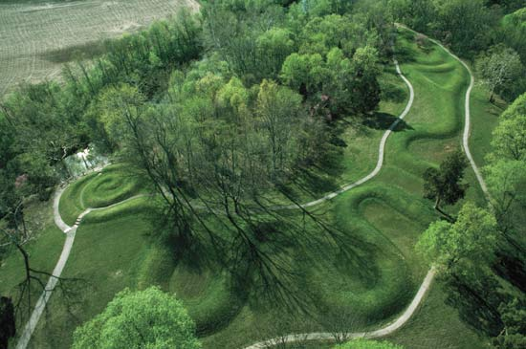
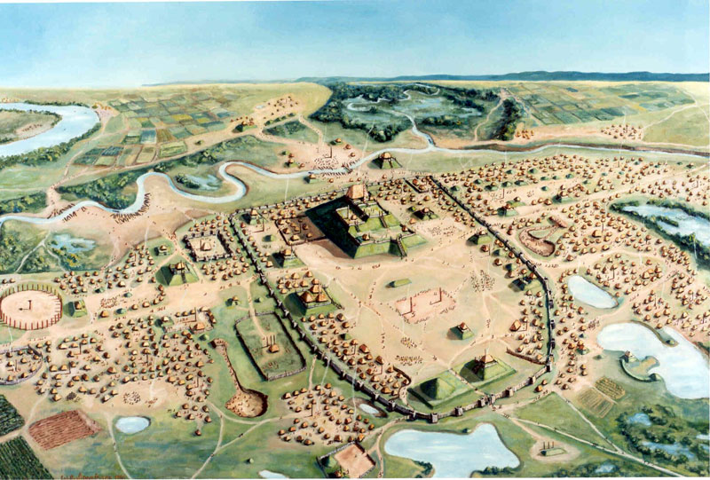
V. Mound Builders
Where: Mississippi and Ohio River valleys
Dwellings: villages of wood made homes, featured many mounds
Culture: built rounded mounds, religious influences
Other: featured larger villages, rulers/priests had homes/temples on mounds
http://www.youtube.com/watch?v=Yg9ZXvulMQE

Slide 9
Essential Question
Why did different North American tribes develop in different regions?
Pg. 170: 1-2
Honors: 1-3
Homework

