Slide 1
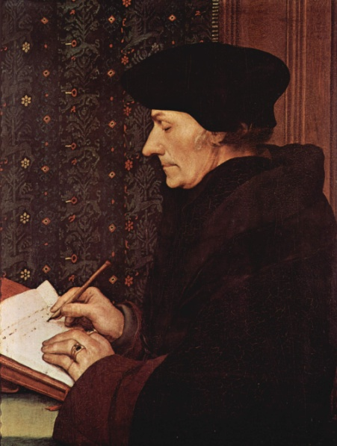
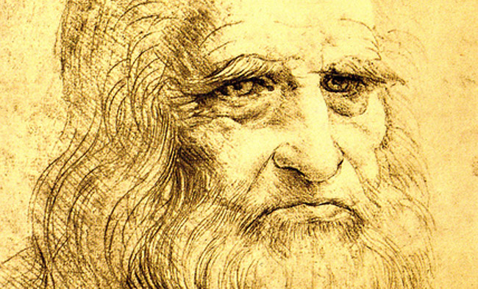
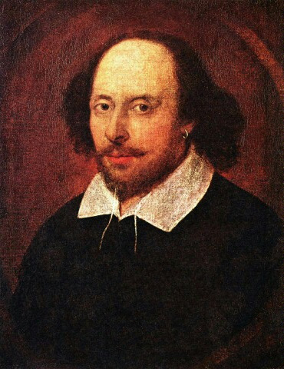
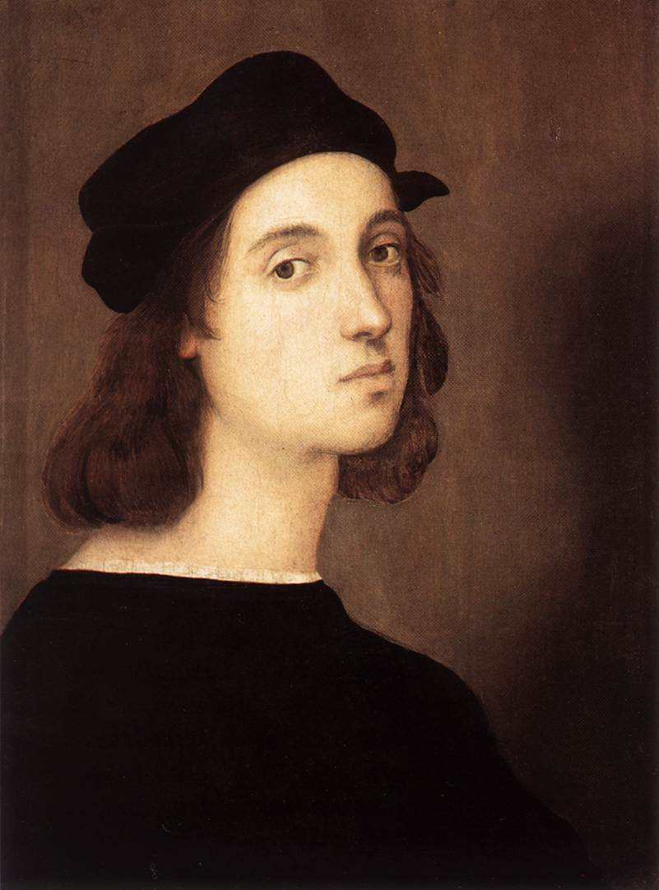
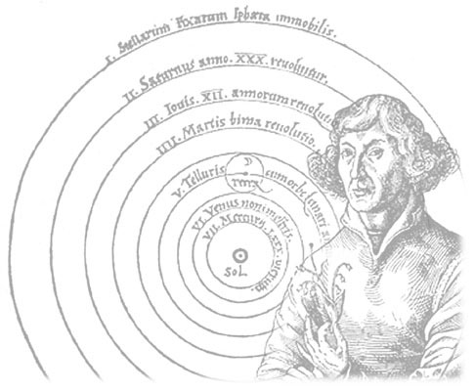
Notables of the Renaissance
Global History and Geography I
Mr. Cox

Slide 2
Bellringer
Choose a notable historical figure and explain why this person is notable.
Essential Question
How did the Renaissance spread from Italy to the rest of Europe?

Slide 3
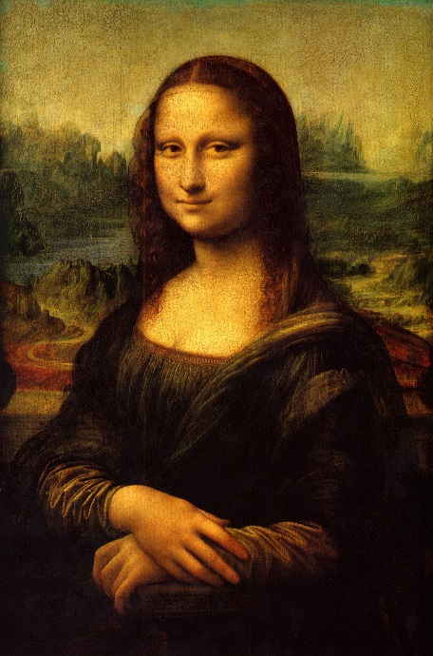
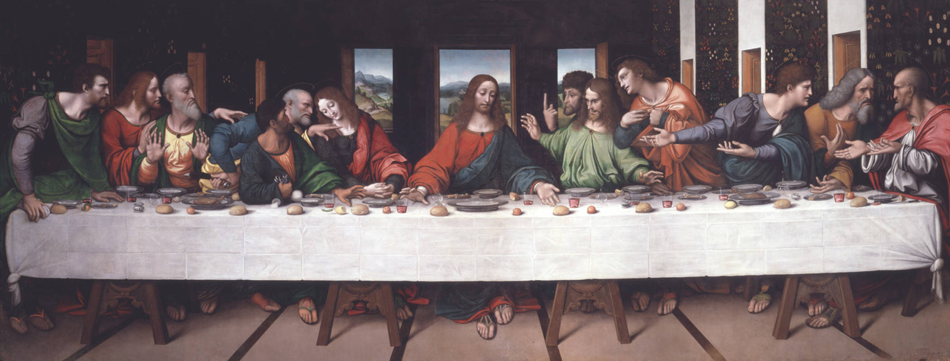
Leonardo Da Vinci
Artist, inventor, philosopher, engineer, biologist, etc who lived in Florence
Mona Lisa, The Last Supper

Slide 4
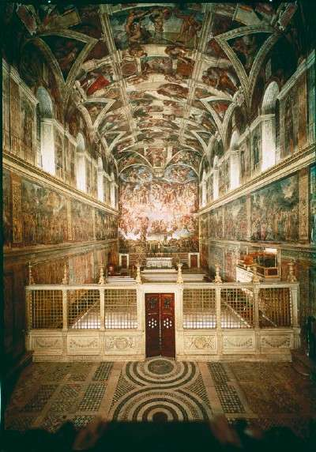
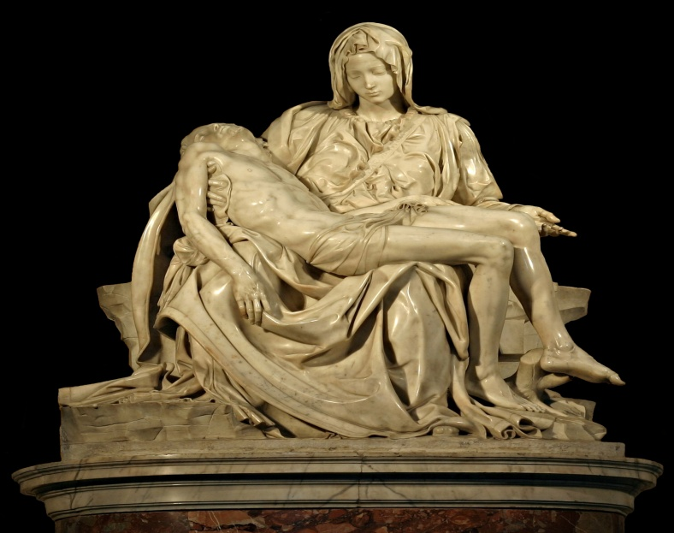
Michelangelo
Like da Vinci, Michelangelo was multi-talented and lived in Florence
Pieta, Sistine Chapel

Slide 5
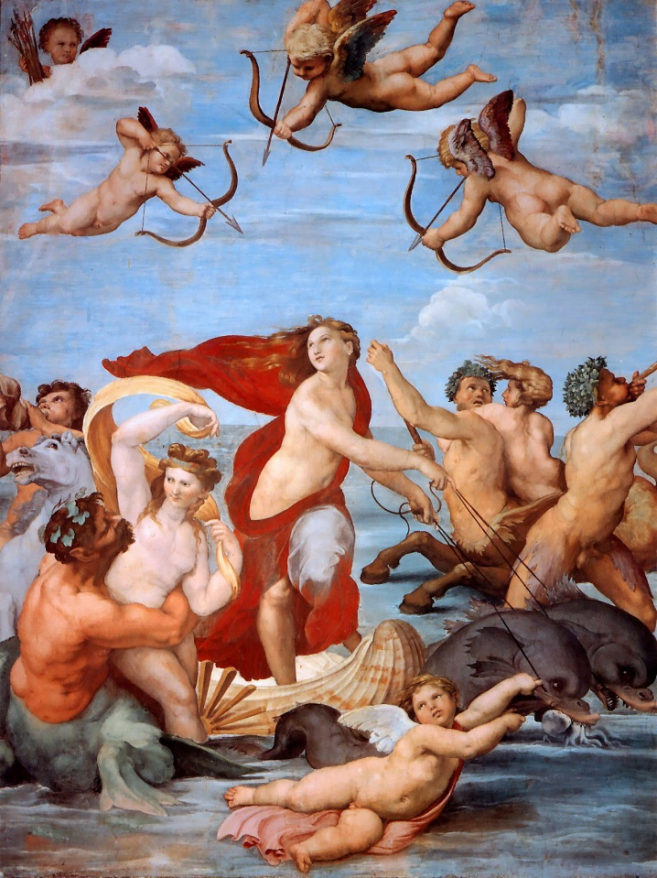
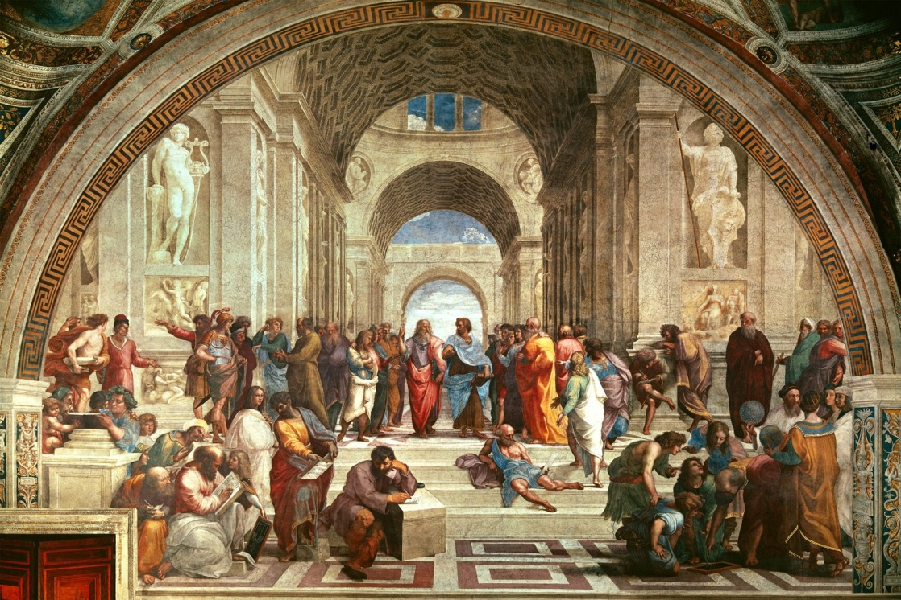
Raphael
Florentine artist influenced by Leonardo and Michalengo
Famous for his portrayal of the Madonna, or mother of Jesus, and The School of Athens

Slide 6
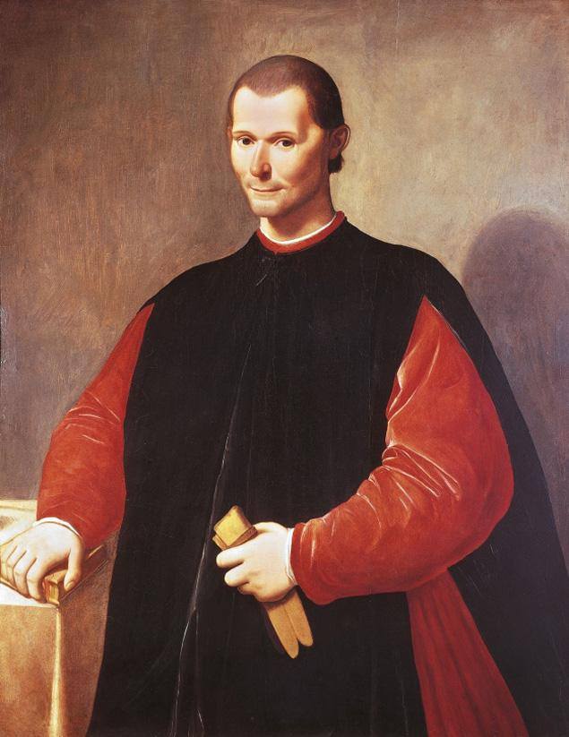
Niccolo Machiavelli
Wrote The Prince, a handbook for modern rulers that modeled the Medici rule in Florence
Ends justify the means
Use any methods to achieve goals
Getting results was more important than keeping promises

Slide 7
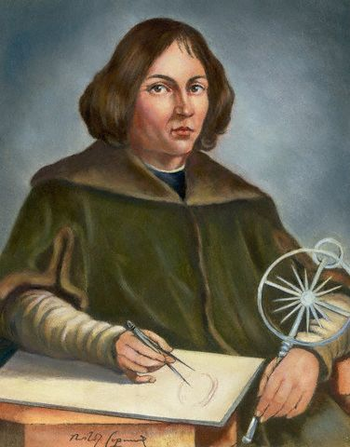
Copernicus
Revolutionized the viewing of the universe with the heliocentric model, placing the sun at the middle of the solar system, not the Earth

Slide 8
Renaissance Spreads
Through trade massive trade routes brought about by the Crusades, the Renaissance spread
From Italy north into France, Belgium, England, east into Germany, and west into Spain.
1450 CE

Slide 9
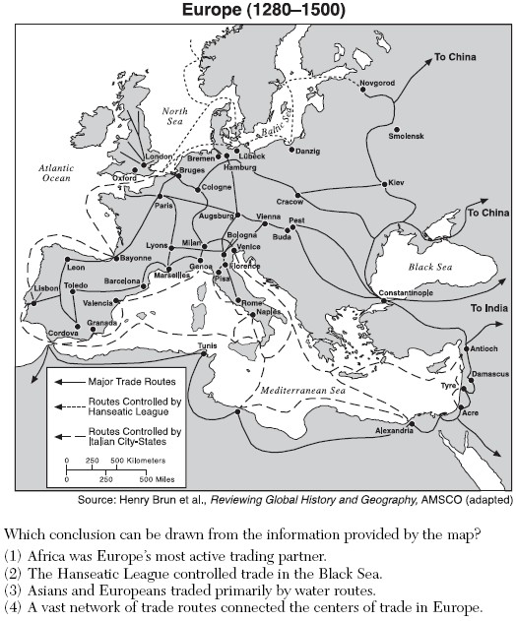

Slide 10
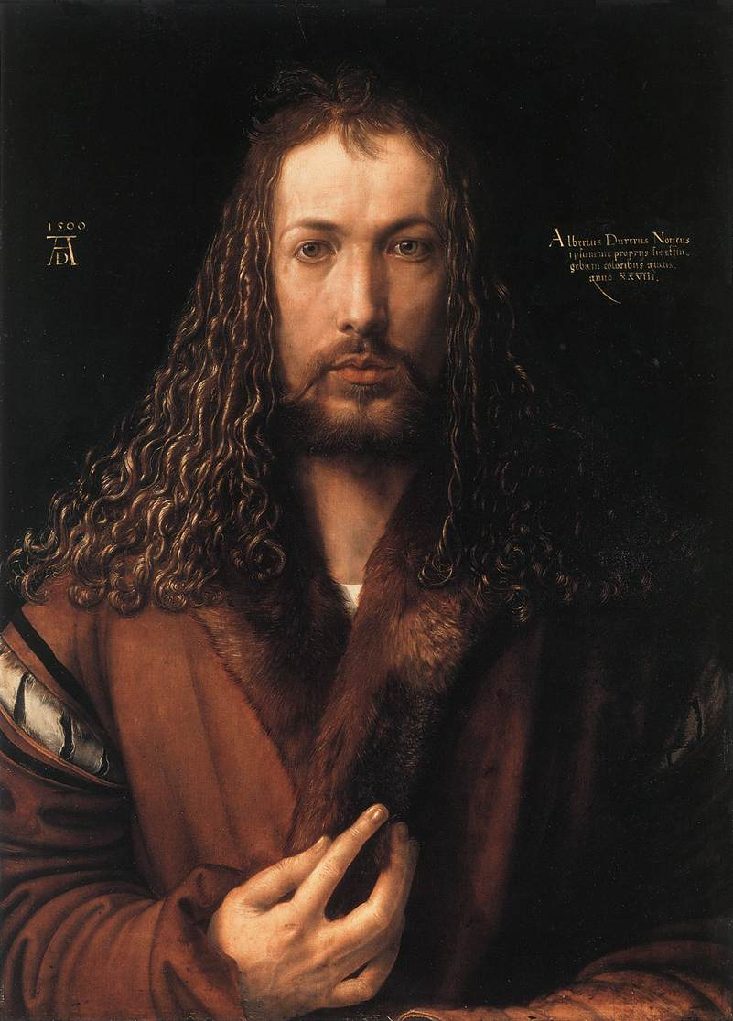
Albrecht Durer
Famous for his engravings, or acid etches, in Germany
Influenced by Italian artists, spread Renaissance to Germany

Slide 11
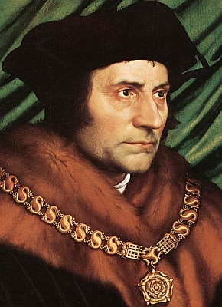
Erasmus
Dutch humanist who translated the Bible and produced many important works, including The Praise of Folly and On Free Will
English humanist who pressed for social reform and wrote Utopia.
Described a utopian, or ideal, society
Thomas More

Slide 12
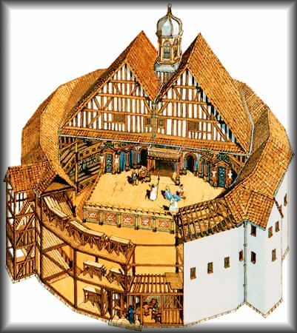
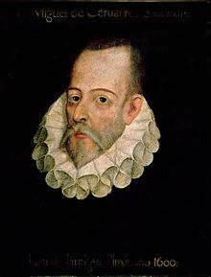
William Shakespeare
English playwright and poet
Famous for his sonnets, comedies, tragedies, and poems
Also famous for introducing more than 1700 new words into the English language
Miguel de Cervantes
Spanish author who wrote satirical comedies about the ways of Medieval life, notably Don Quixote

Slide 13
http://www.youtube.com/watch?v=Vufba_ZcoR0

Slide 14
Essential Question
How did the Renaissance spread from Italy to the rest of Europe?

Slide 15
Notables of the Renaissance Fake Facebook Project
To begin the project, you will select a Renaissance Man/Woman and create a fake Facebook account for the person and their accomplishments, contributions, works, etc.
Select a person from the list provided
Download the Templates from Mr. Cox’s webpage
Share the Google Doc with me
Complete all four pages for your notable. The pages are:
Their Facebook wall
Their basic information
Their photos
Events they would or have attended
When gathering information for your handout, be sure to use approved sources, including Library Databases (Gale, Grolier, Worldbook), your textbook, or other texts from the library or that are approved by me in advance. Be sure to submit these sources as a properly formatted bibliography
(50 points)

Slide 16
Leonardo da Vinci
Donatello
Michelangelo
Raphael
Luca Pacioli.
Galileo Galilei
Sir Isaac Newton
Johannes Kepler
Miguel de Cervantes
William Shakespeare
Dante Alighieri
Francis Bacon
Nicolaus Copernicus
Desiderius Erasmus
Niccolò Machiavelli
Robert Boyle
William Byrd
Claudio Monteverdi
Samuel de Champlain
John Cabot
Jacques Cartier
Christopher Columbus
Hernán Cortés
Bartolomeu Dias
Francis Drake
Juan Sebastián Elcano
Vasco da Gama
Ferdinand Magellan
Francisco Pizarro
Walter Raleigh
Willem Janszoon
Gerardus Mercator
Amerigo Vespucci
Giovanni da Verrazzano
Sofonisba Anguissola

