Slide 1
Ottoman and Safavid Empires
Global History and Geography I
Mr. Cox

Slide 2
Bellringer
What events gave rise to the Byzantine Empire?
Essential Question
How were the Islamic Ottoman and Safavid Empires similar yet different?

Slide 3
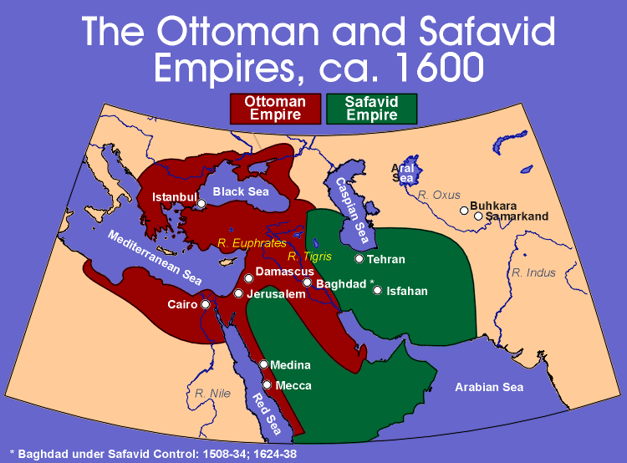

Slide 4
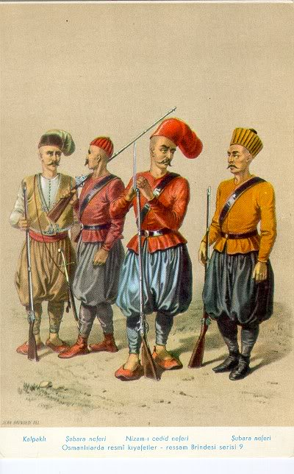
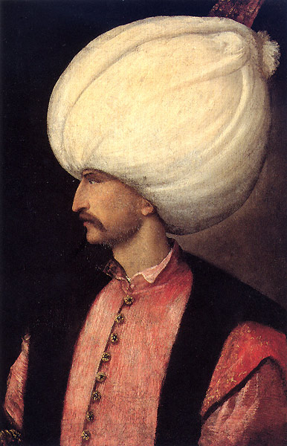
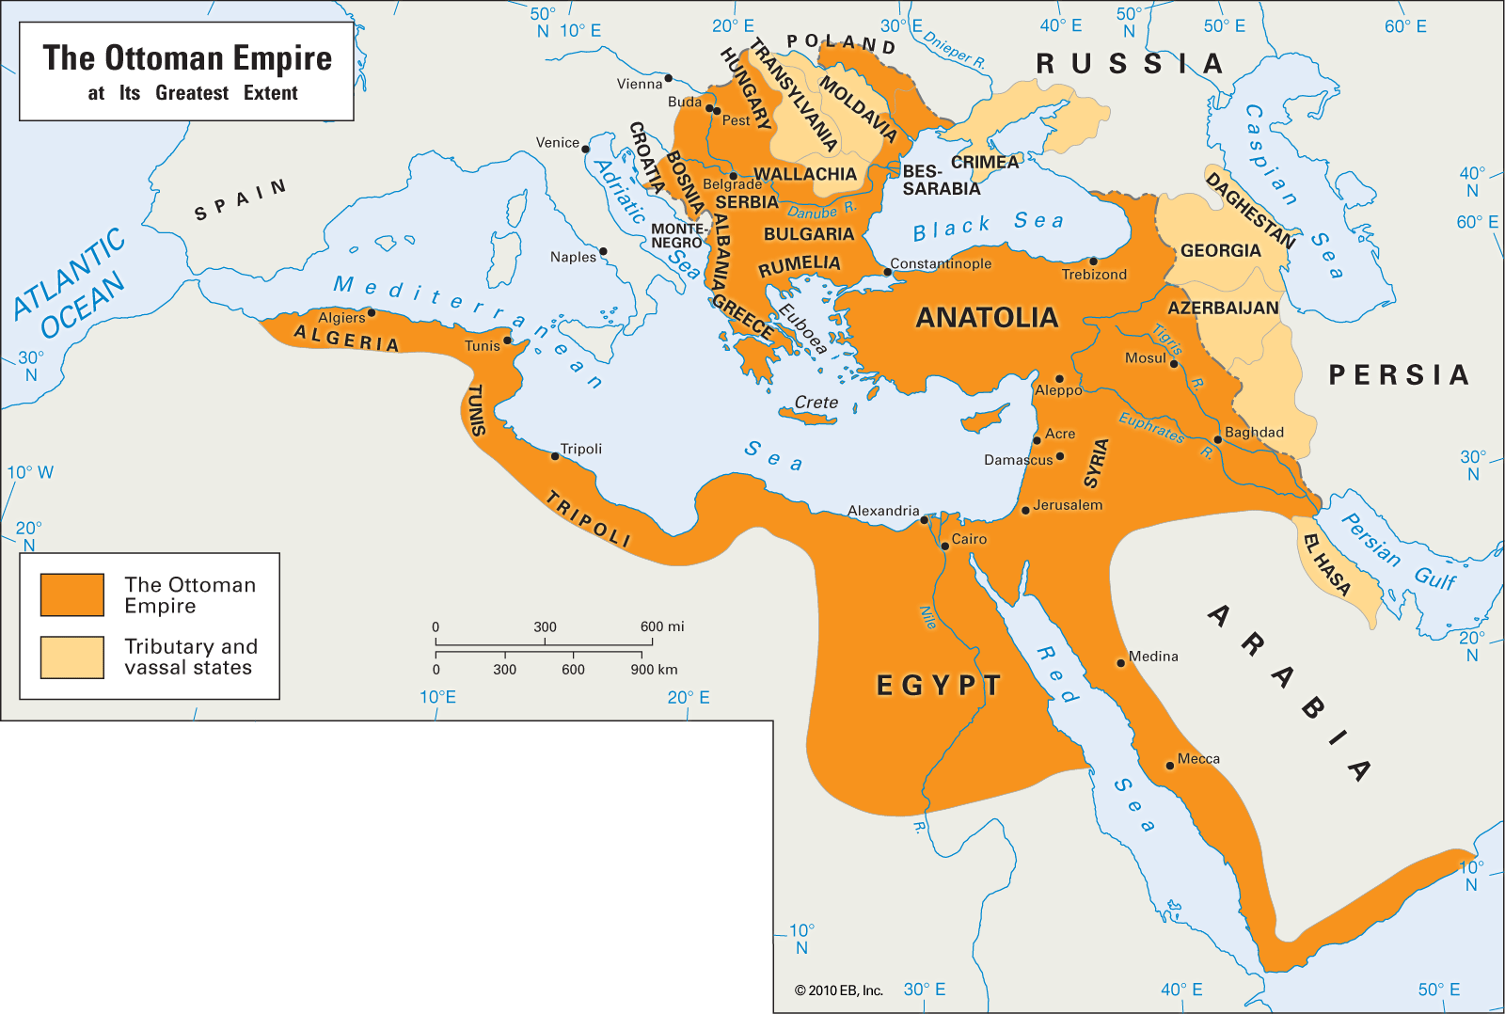
I. Ottoman Empire
Turks, settled in Asia Minor
Captured Constantinople, ending Byzantine rule in 1453 CE
Suleiman the Magnificent expanded Ottoman land into the Middle East and Eastern Europe

Slide 5
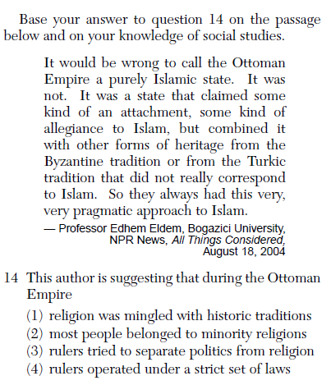

Slide 6
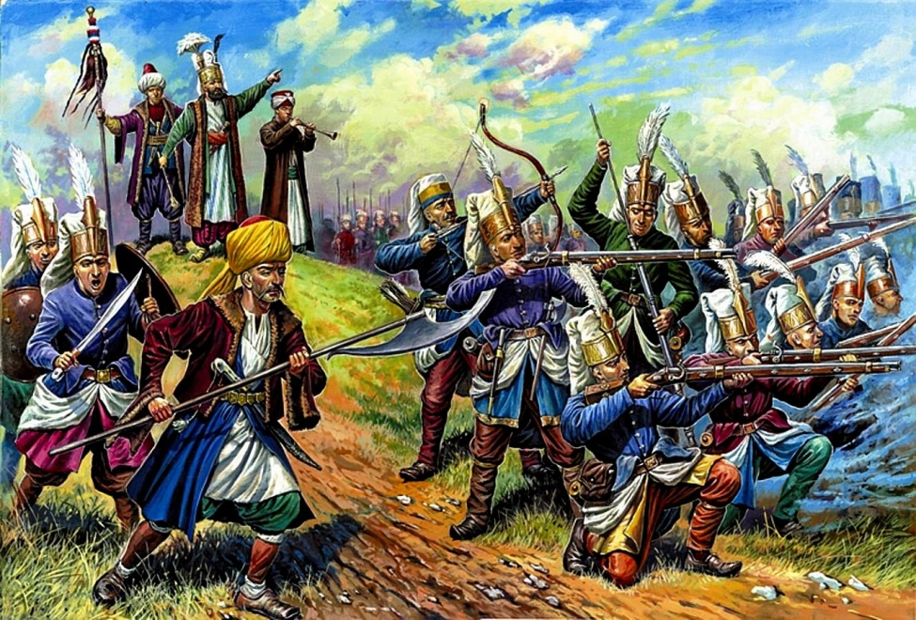
Ottomans had a very strict social structure
Men of the pen: scientists, lawyers, poets
Men of the sword: soldiers
Men of negotiation: merchants, artisans, tax collectors
Men of husbandry: farmers and herders
Other classes were millets, or classes of non-Muslims
Janizaries were the elite Ottoman army force

Slide 7
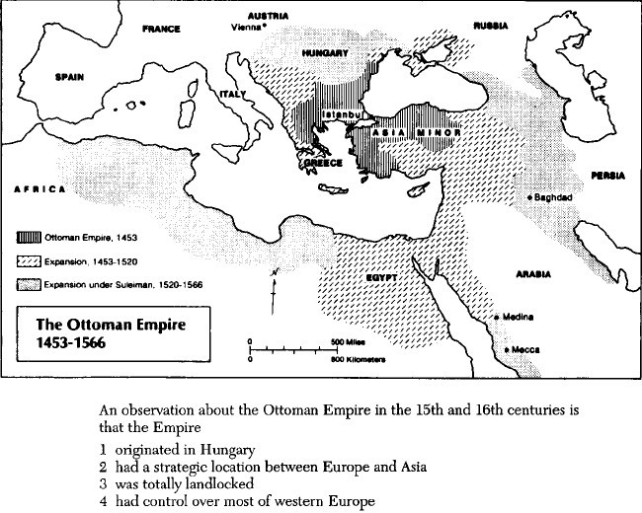

Slide 8
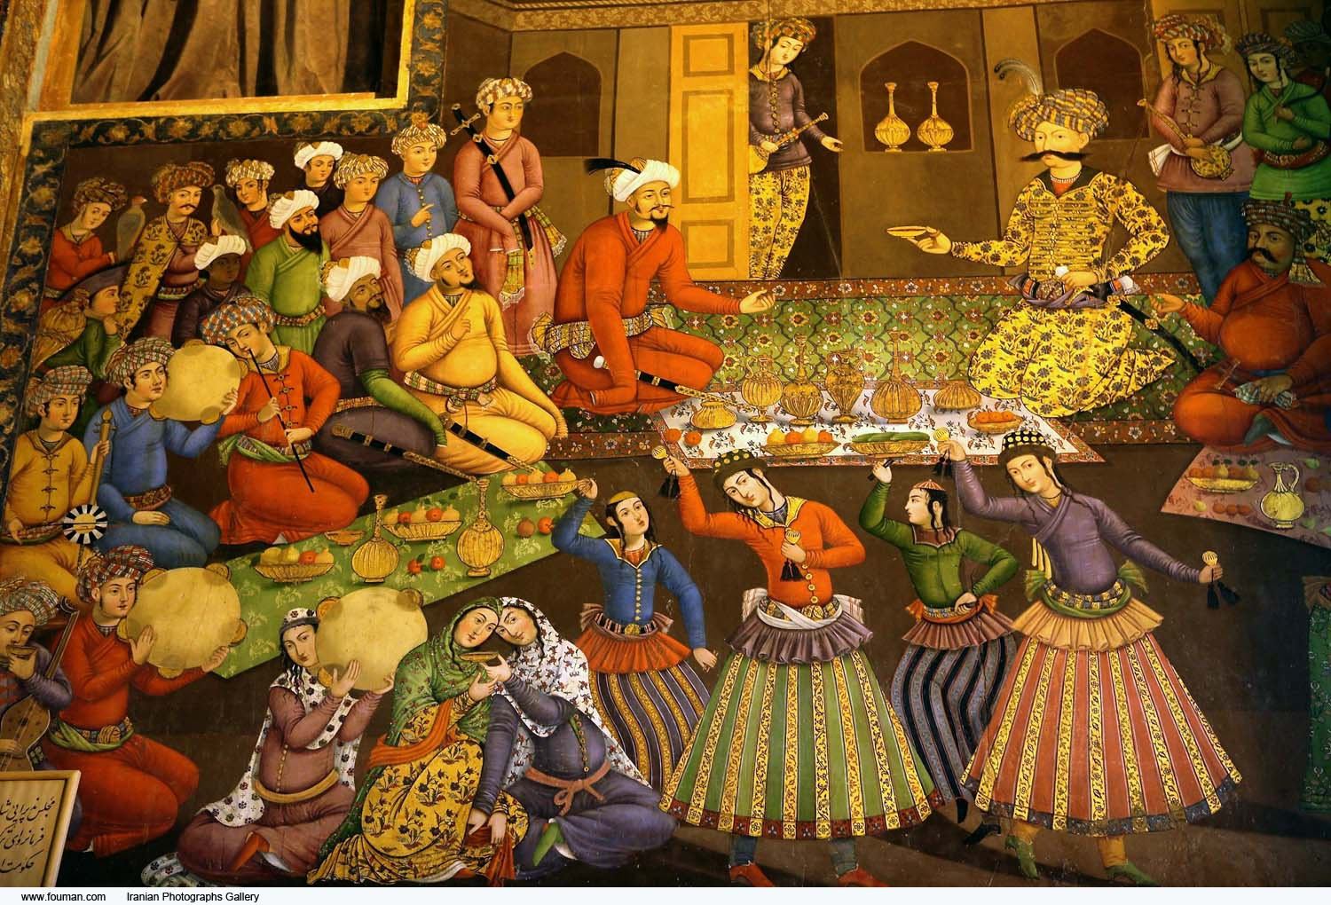
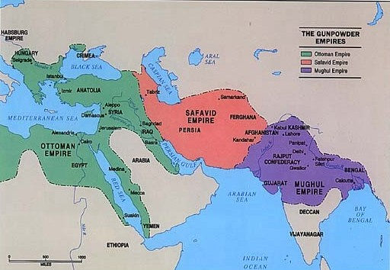
II. Safavid Empire
Emerged in Persia (Iran) in-between Mughal and Ottoman Empires
Shiite Muslim, frequently clashed with bordering Sunni empires
Abbas the Great: Safavid shah, or king, who wanted to revive the glory of Persia
Constantly conspired against Ottomans
Reduced taxes on farmers, promoted industry, tolerated minorities
Promoted trade from his capital at Ishfan

Slide 9
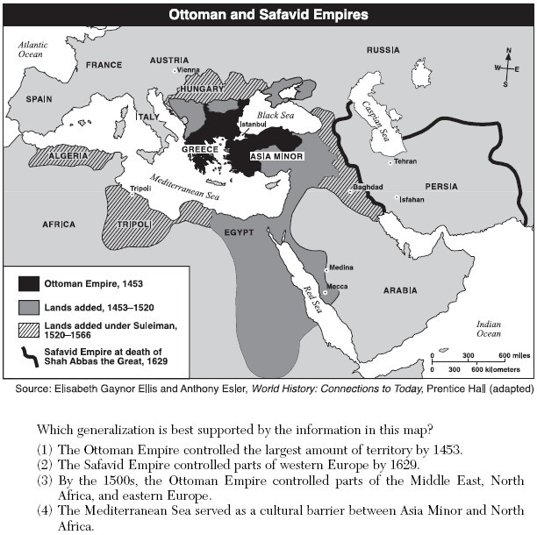

Slide 10
Ottoman Empire Safavid Empire

Slide 11
Essential Question
How were the Islamic Ottoman and Safavid Empires similar yet different?
Homework

